Slide 1
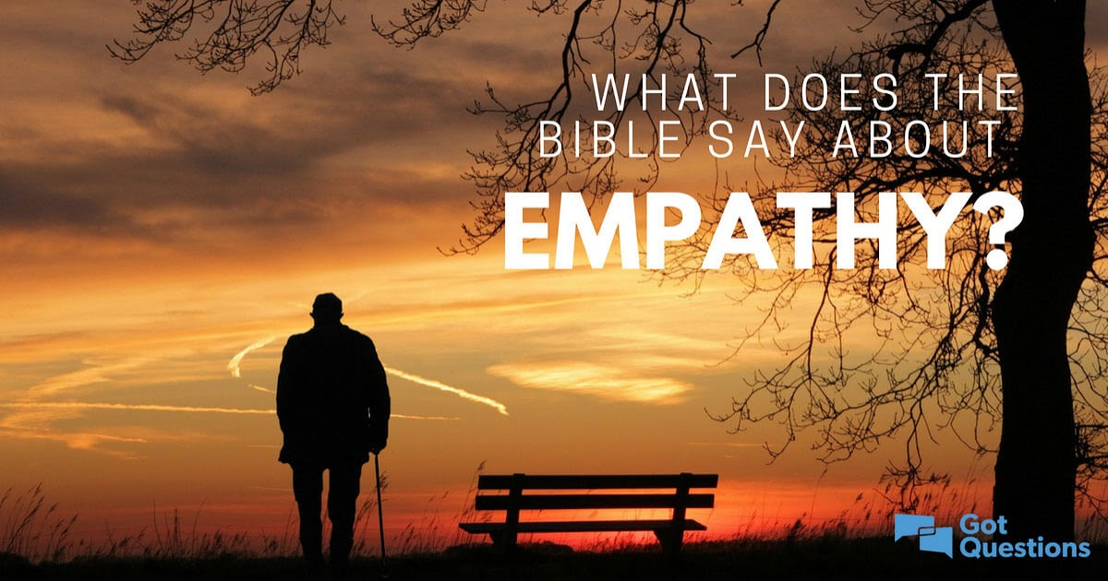
George Hayman talking about Empathy day
This Photo by Unknown author is licensed under CC BY-NC-ND.

Slide 2
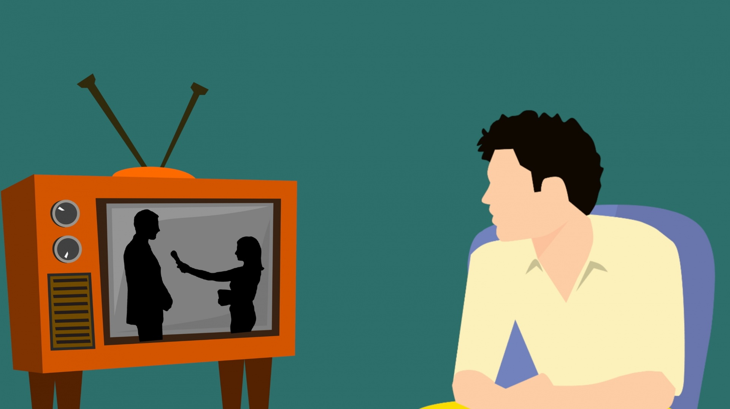
Hello my name is George Hayman and I am going to tell you all about Empathy.

Slide 3
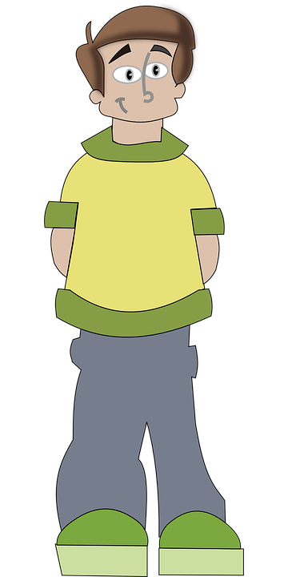
Empathy is when we step in someone's shoes and try to imagine how they are feeling.

Slide 4

This Photo by Unknown author is licensed under CC BY.
Today is Empathy day 2021

Slide 5


Empathy is when we try to think of others and how they are feeling.

Slide 6

Empathy day is when we be kind.
This Photo by Unknown author is licensed under CC BY-SA-NC.

Slide 7


