Slide 1
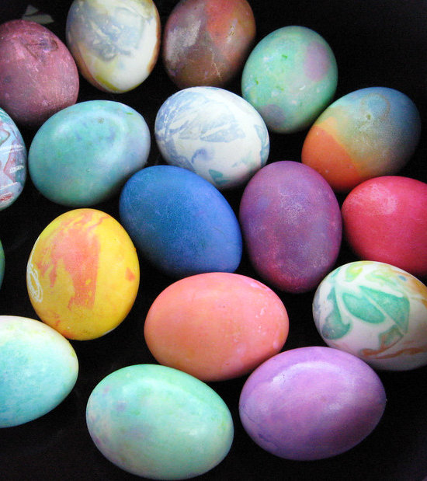
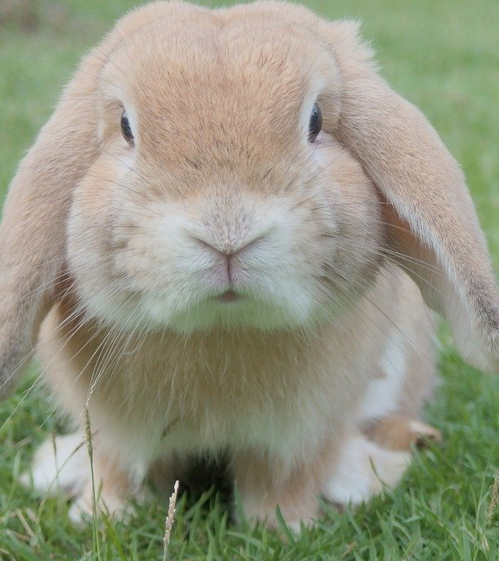
ISOBELLA A Gethin
This Photo by Unknown author is licensed under CC BY.

Slide 2
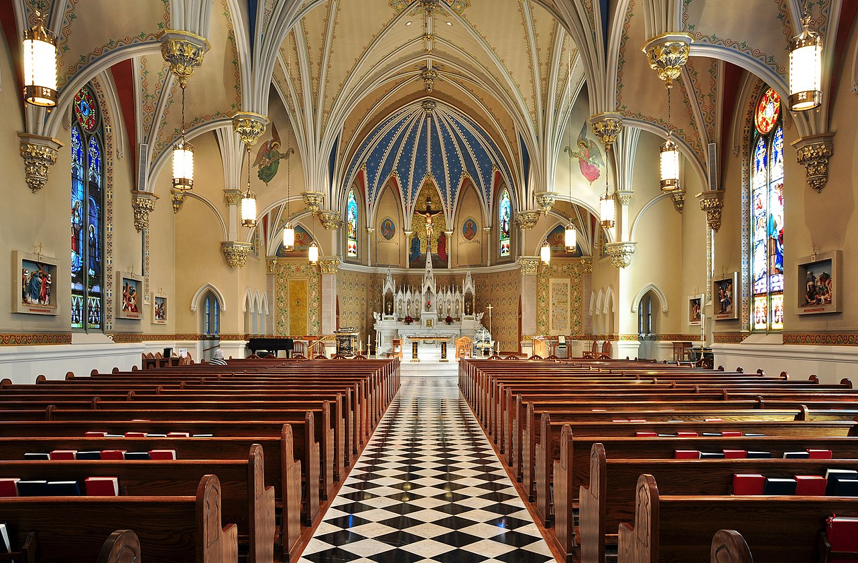
Ble mae pobl yn dathlu'r Pasg?
Yn yr eglwys - Cristnogion
This Photo by Unknown author is licensed under CC BY-SA.

Slide 3
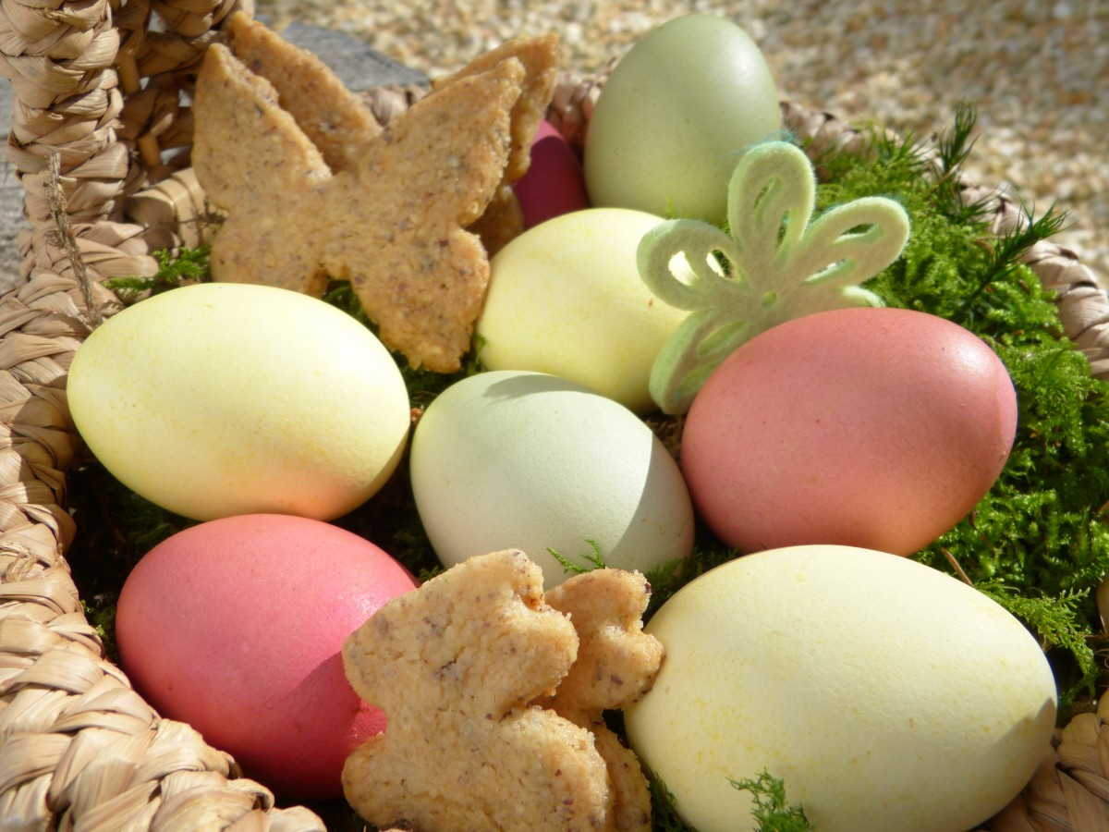
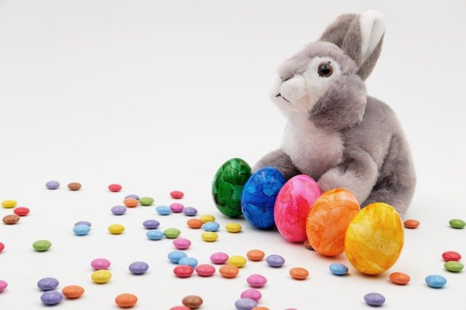
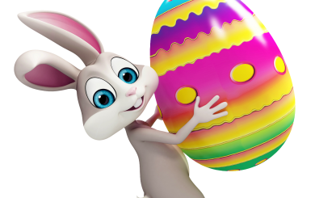
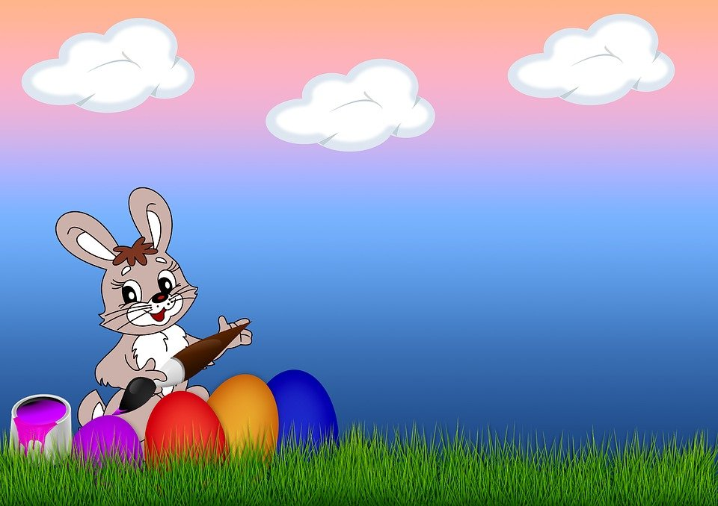

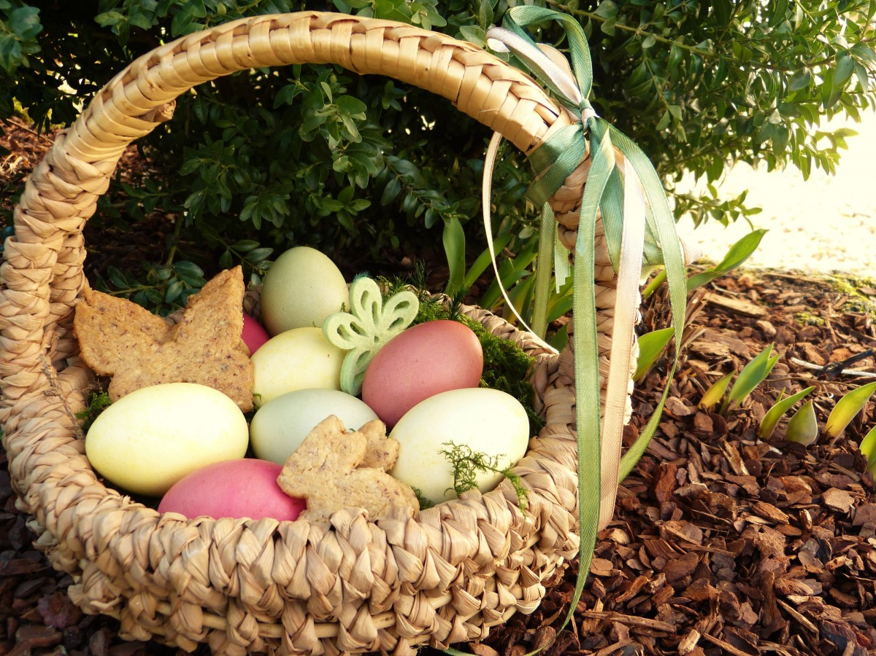
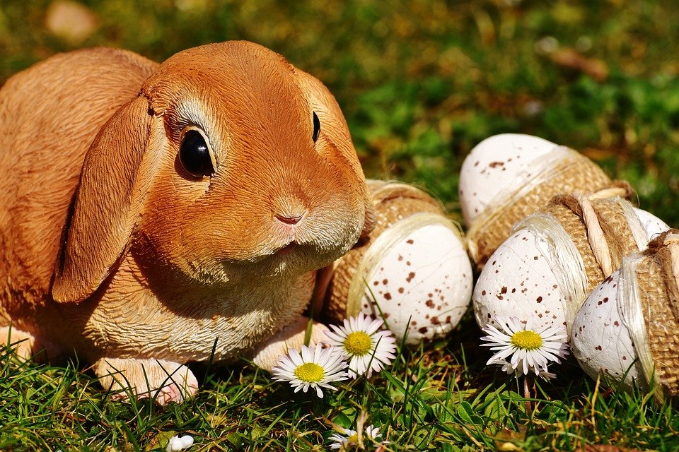


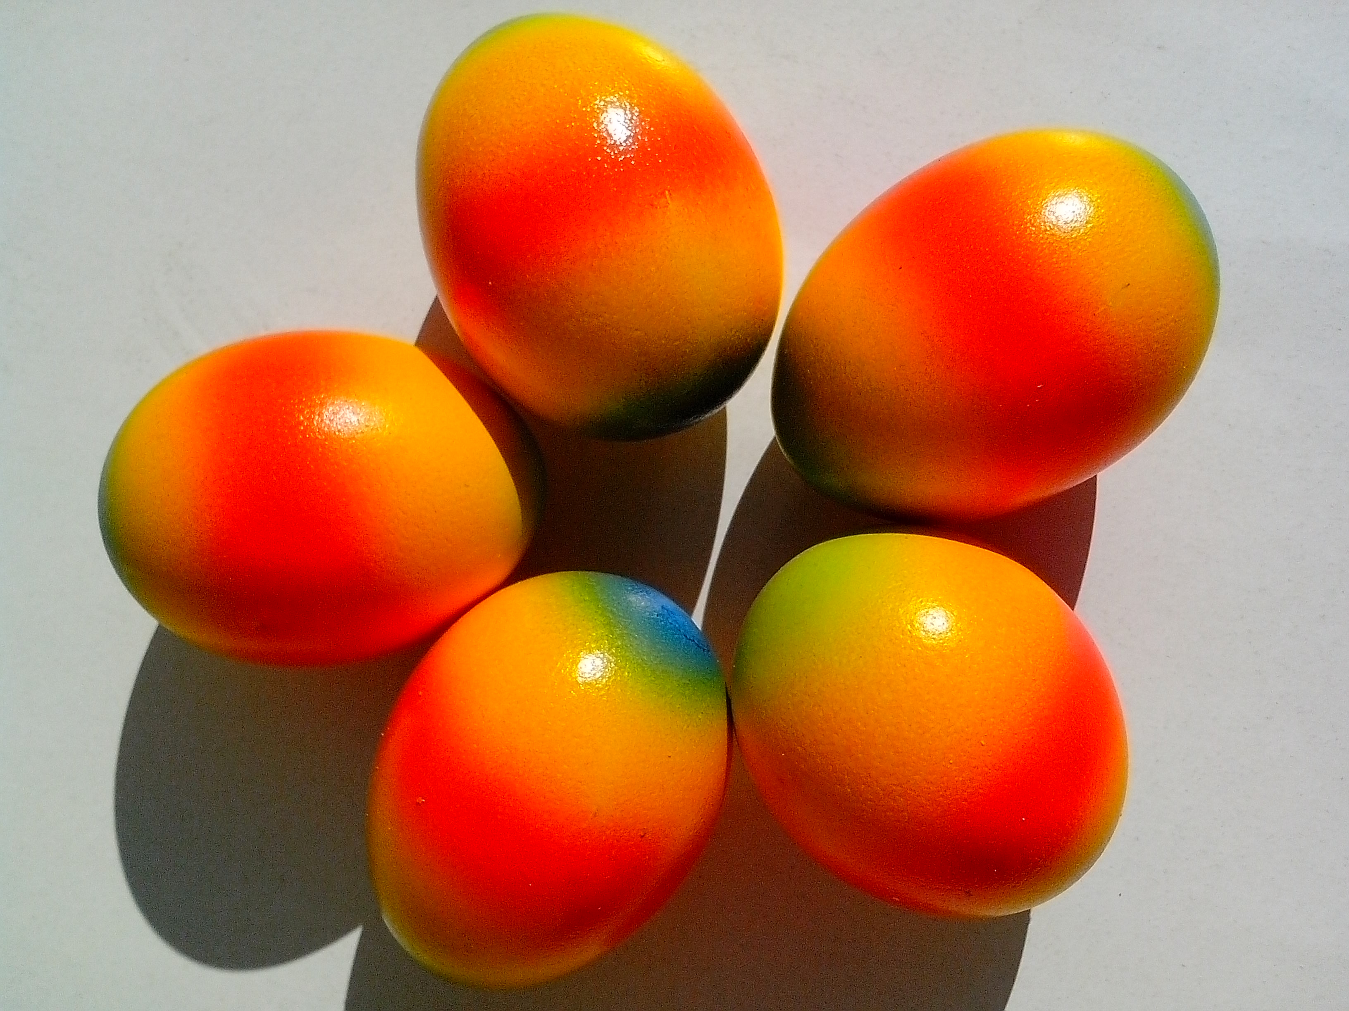
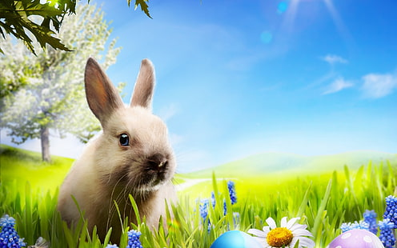
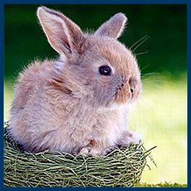
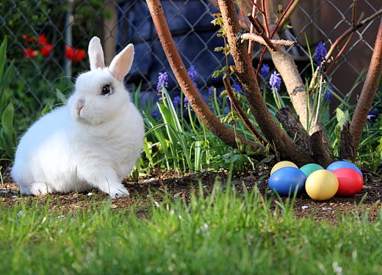
Y gwningen Pasg
This Photo by Unknown author is licensed under CC BY.
This Photo by Unknown author is licensed under CC BY-NC.
This Photo by Unknown author is licensed under CC BY-SA.
This Photo by Unknown author is licensed under CC BY-SA-NC.
This Photo by Unknown author is licensed under CC BY.

Slide 4
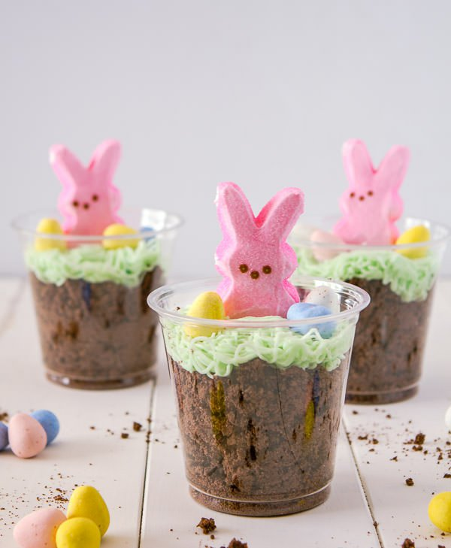

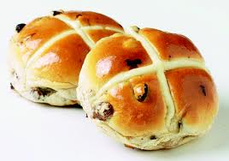
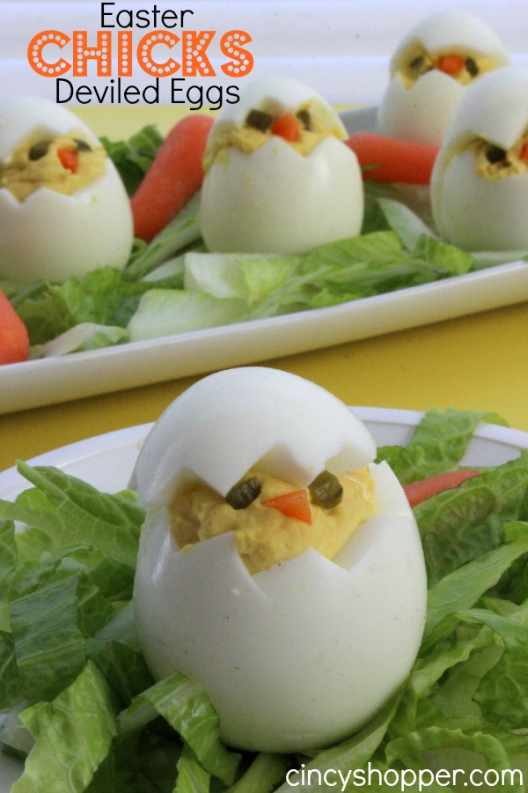
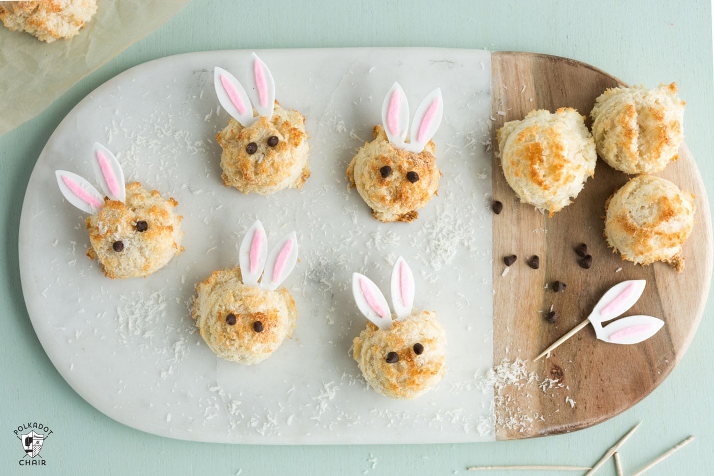
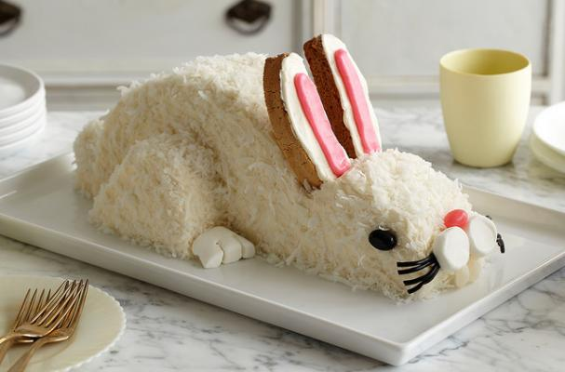
Bwyd Pasg
This Photo by Unknown author is licensed under CC BY-NC-ND.
This Photo by Unknown author is licensed under CC BY.
This Photo by Unknown author is licensed under CC BY-NC-ND.
This Photo by Unknown author is licensed under CC BY-NC-ND.
This Photo by Unknown author is licensed under CC BY-SA-NC.
This Photo by Unknown author is licensed under CC BY-NC-ND.

Slide 5
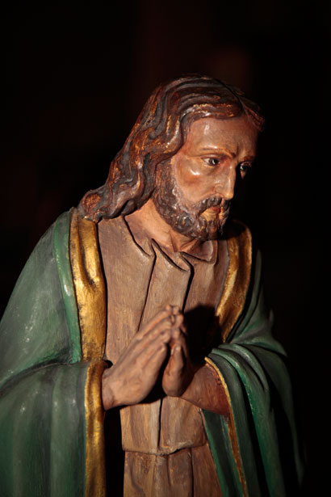
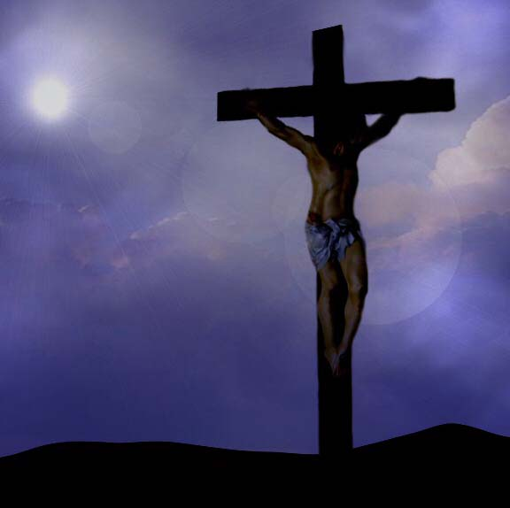
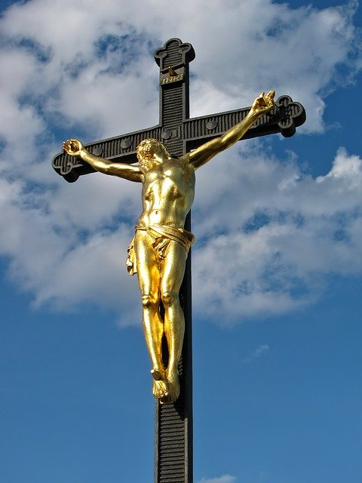
IESU ar y groes.
Dydd Gwener y Groglith
Ar ddydd Sul atgyfododd Iesu!
This Photo by Unknown author is licensed under CC BY-NC-ND.

Slide 6
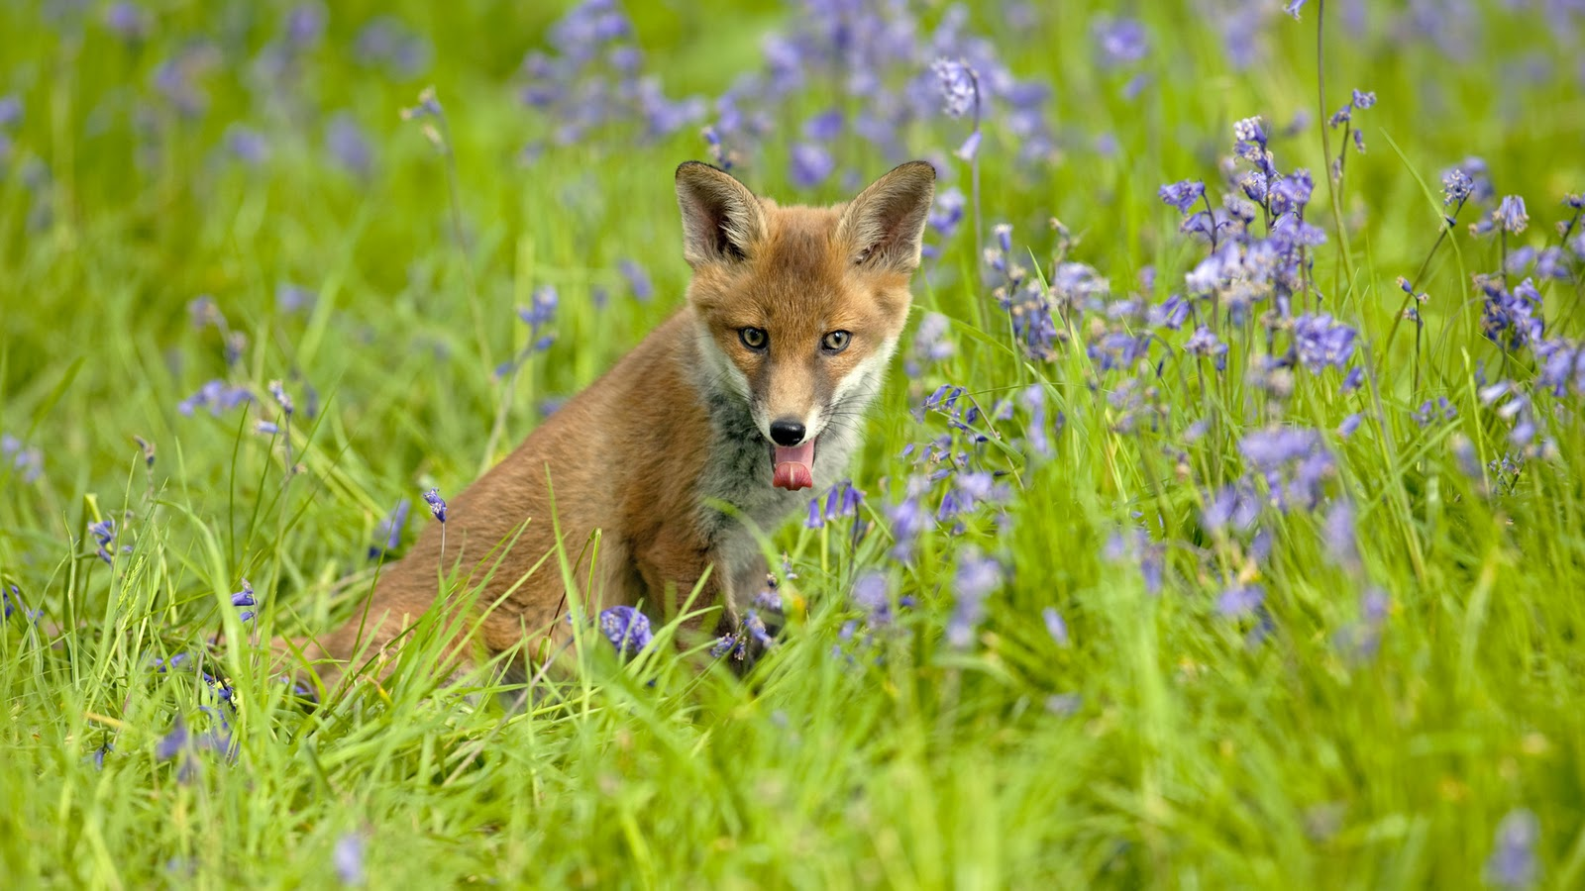
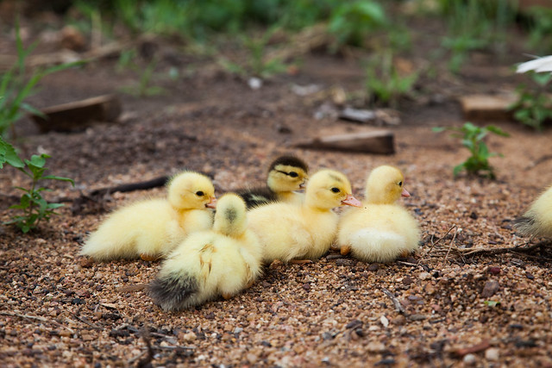
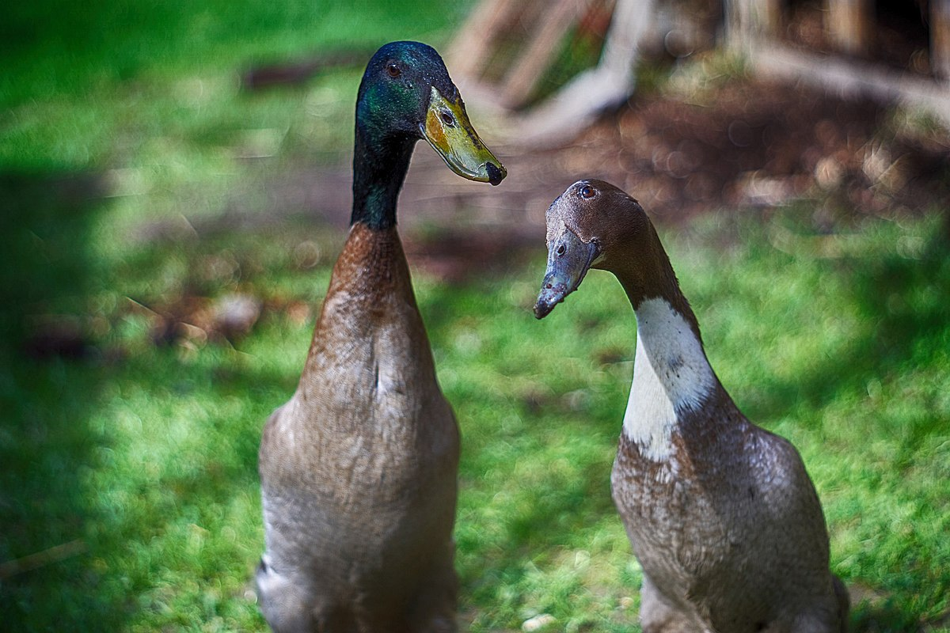
Mae cywion yn cael eu geni adeg y Pasg.
This Photo by Unknown author is licensed under CC BY.
This Photo by Unknown author is licensed under CC BY-SA.
This Photo by Unknown author is licensed under CC BY.

Slide 7
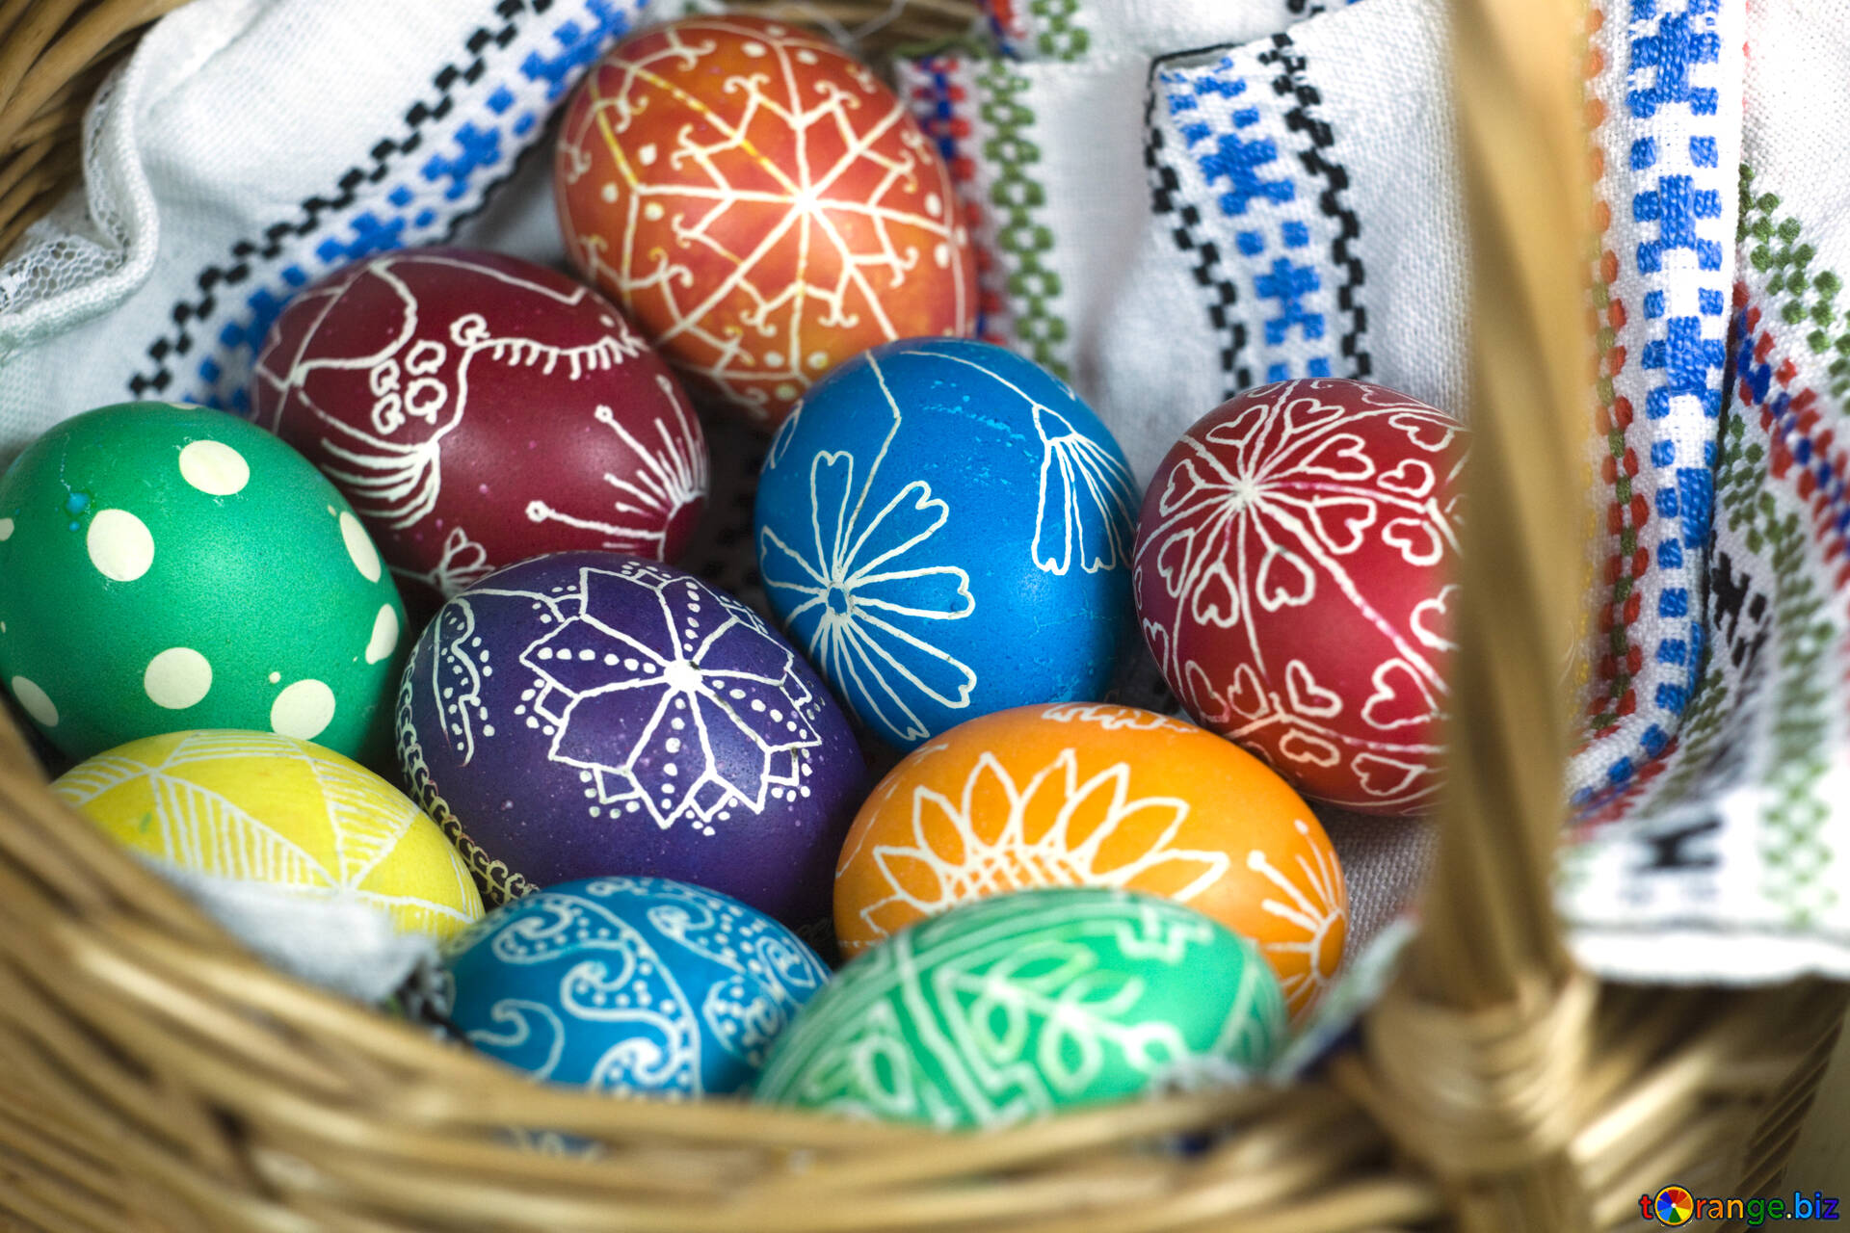
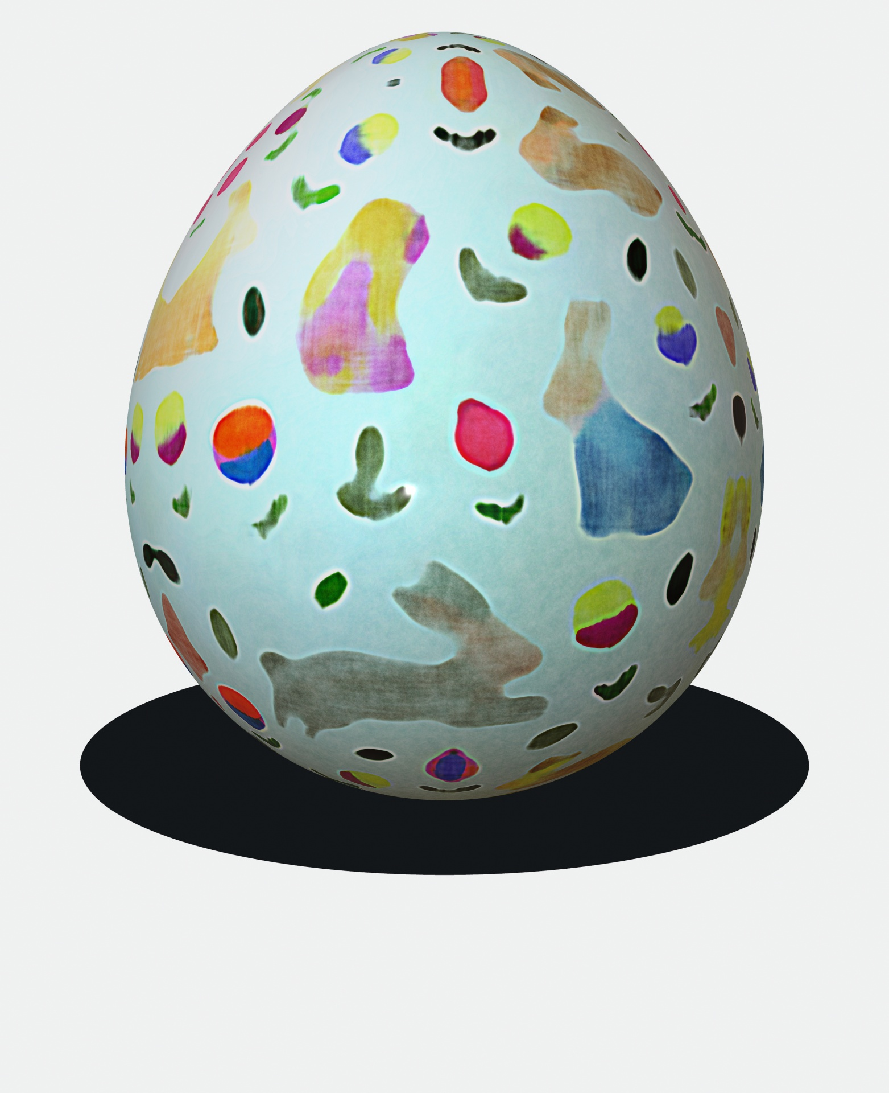
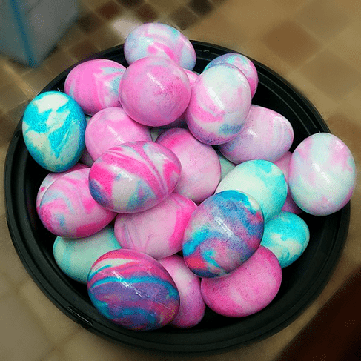
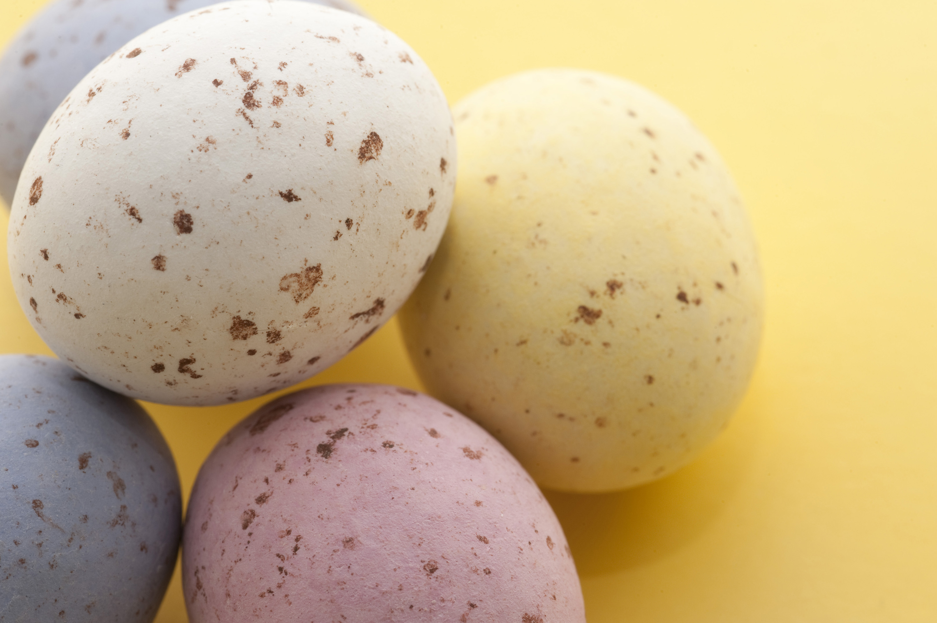
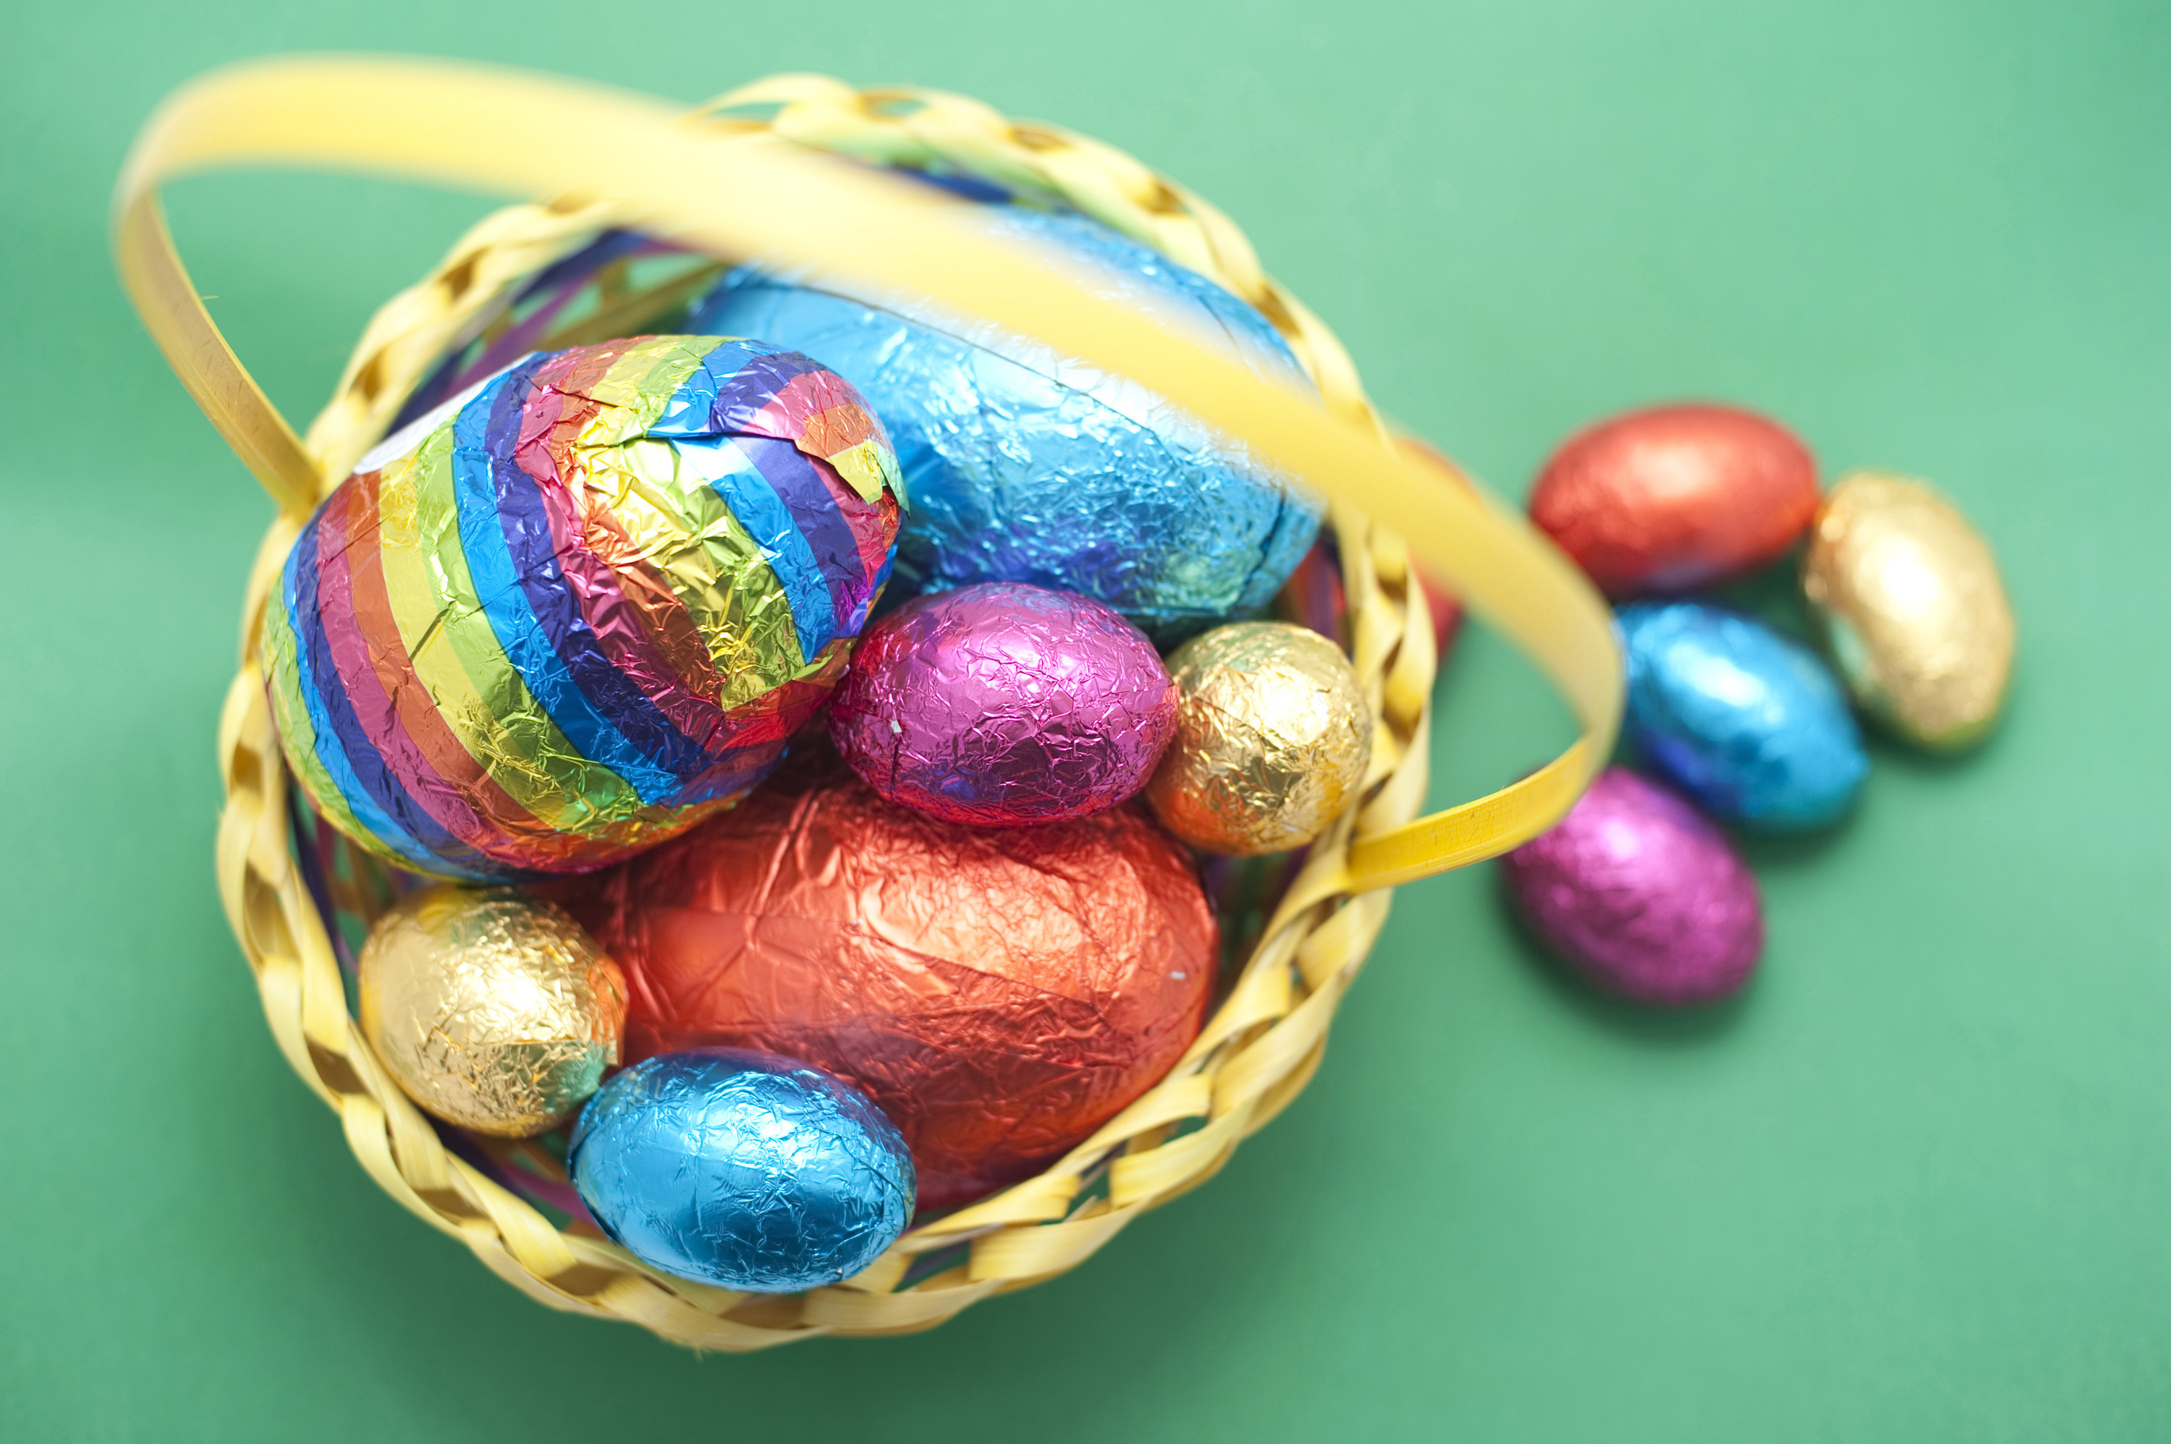
Wyau siocled
This Photo by Unknown author is licensed under CC BY.
This Photo by Unknown author is licensed under CC BY.
This Photo by Unknown author is licensed under CC BY-SA-NC.
This Photo by Unknown author is licensed under CC BY.

Slide 8
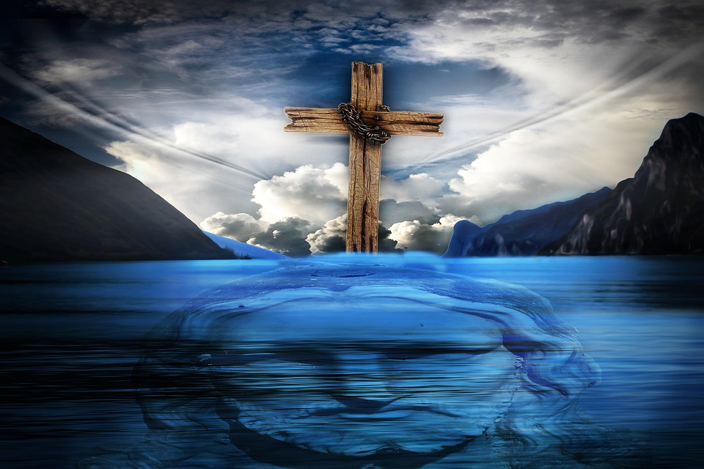
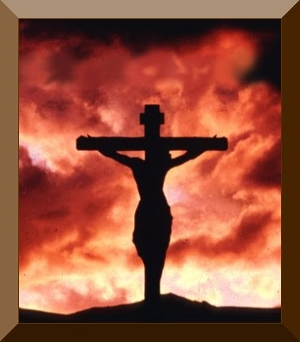
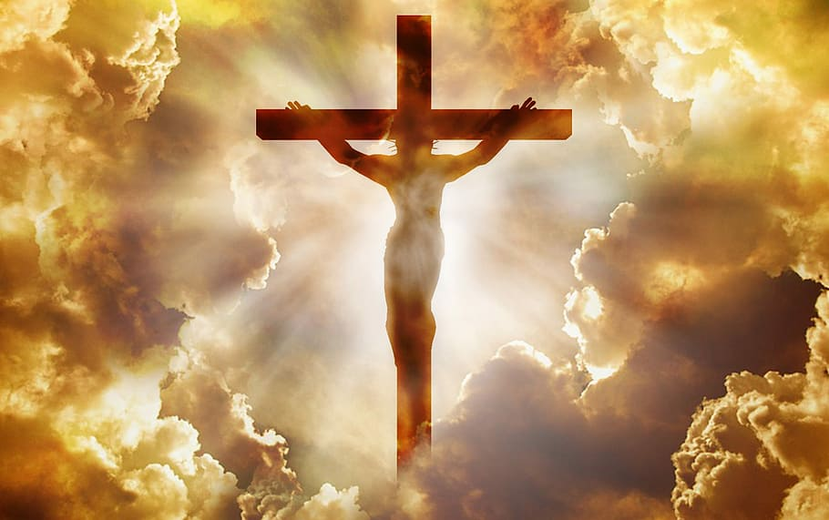
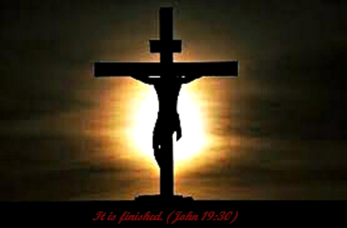
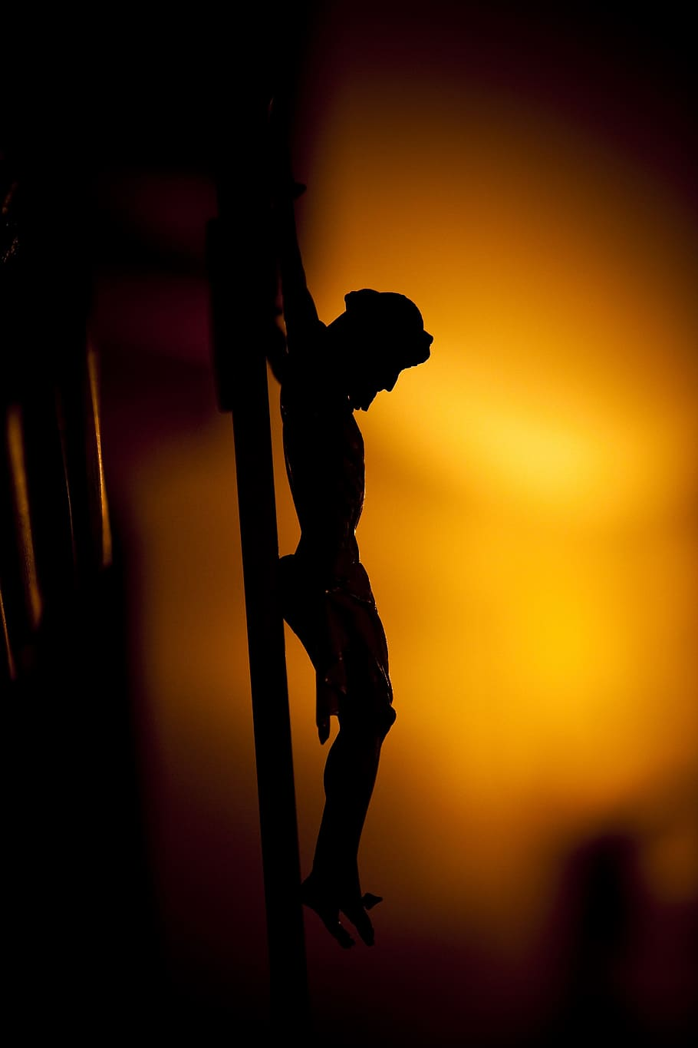
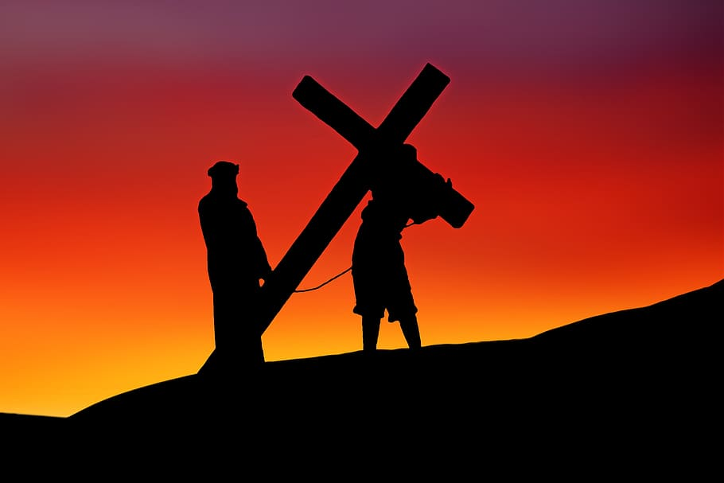
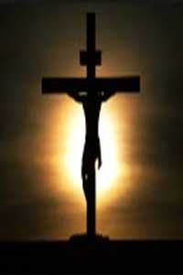
Y groes
Iesu ar y groes
This Photo by Unknown author is licensed under CC BY-NC-ND.
This Photo by Unknown author is licensed under CC BY.
This Photo by Unknown author is licensed under CC BY-NC-ND.

