Slide 1

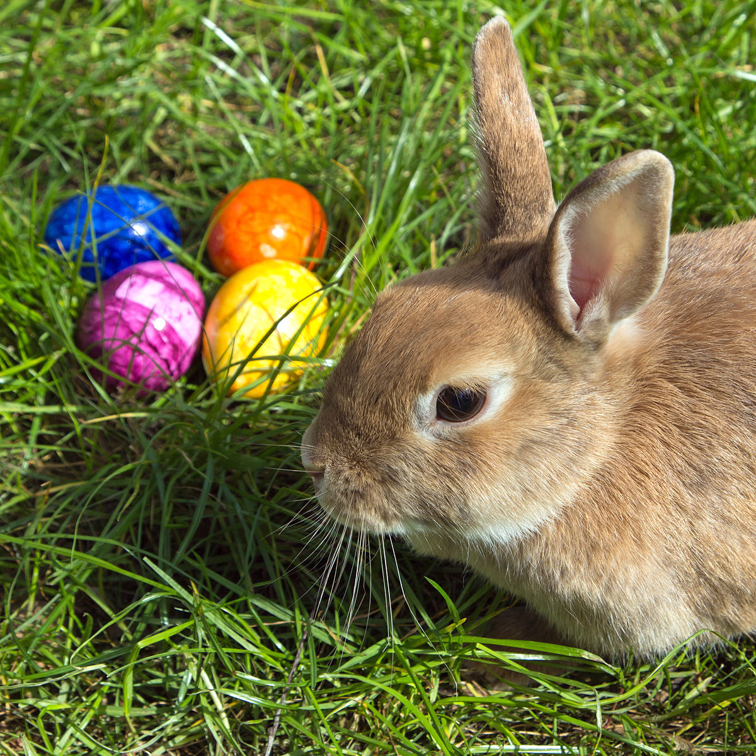
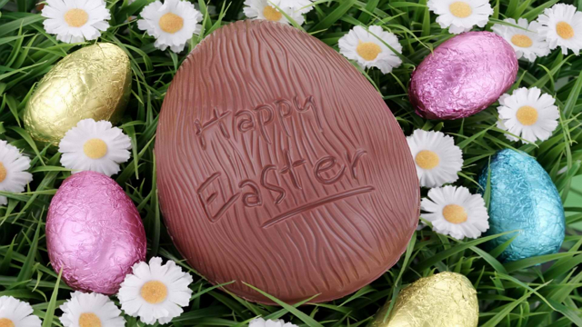
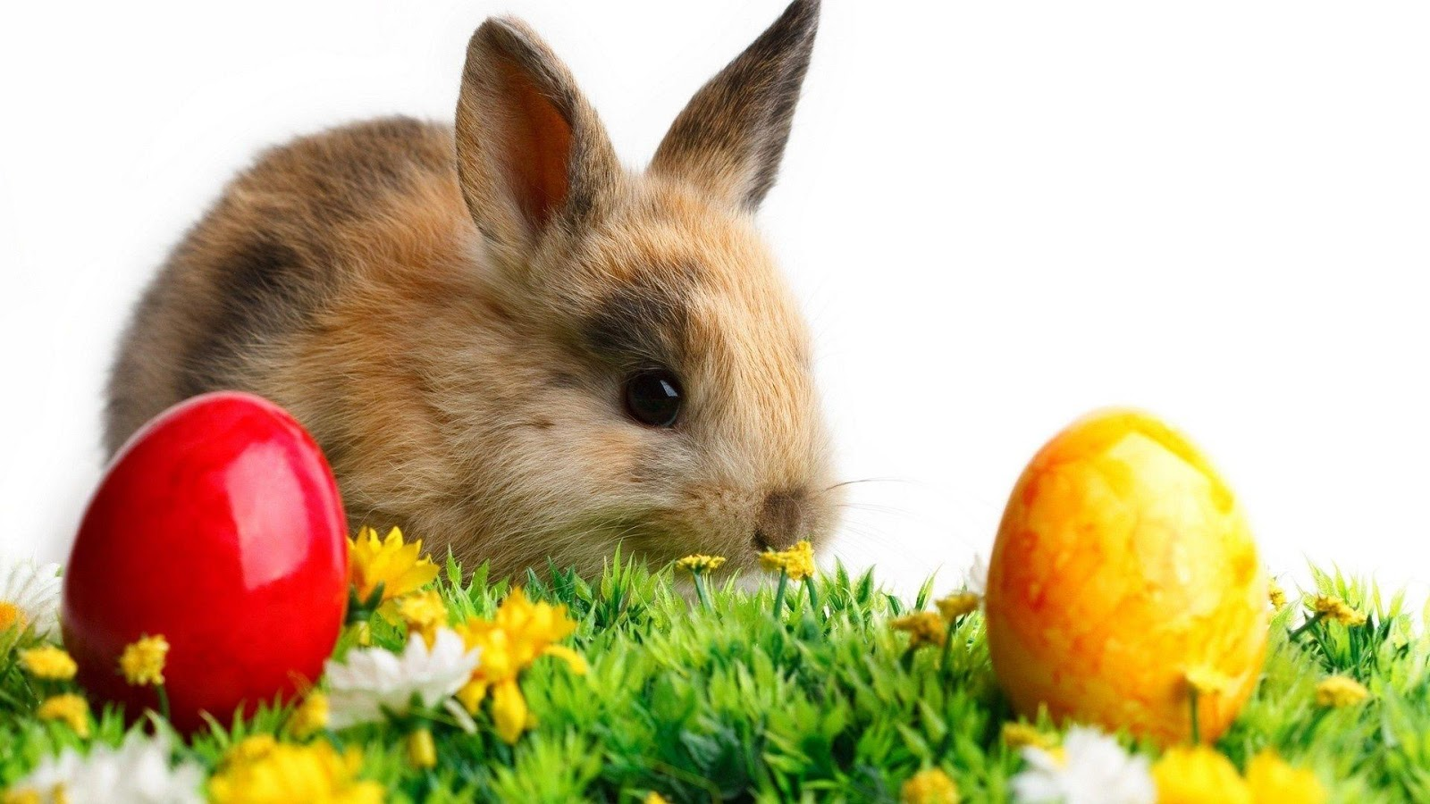
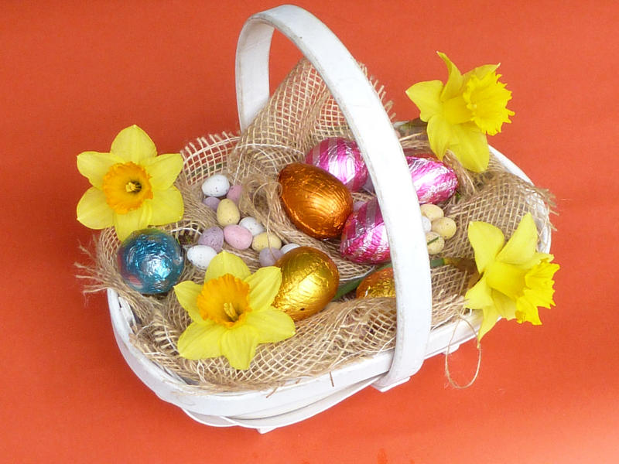
Popeth am y Pasg
This Photo by Unknown author is licensed under CC BY-NC-ND
This Photo by Unknown author is licensed under CC BY-NC

Slide 2
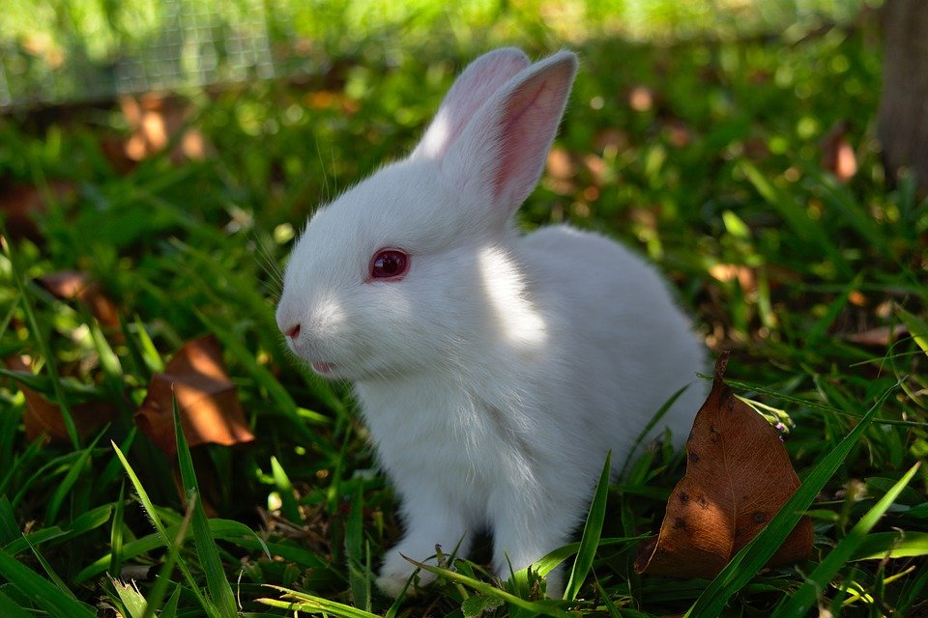
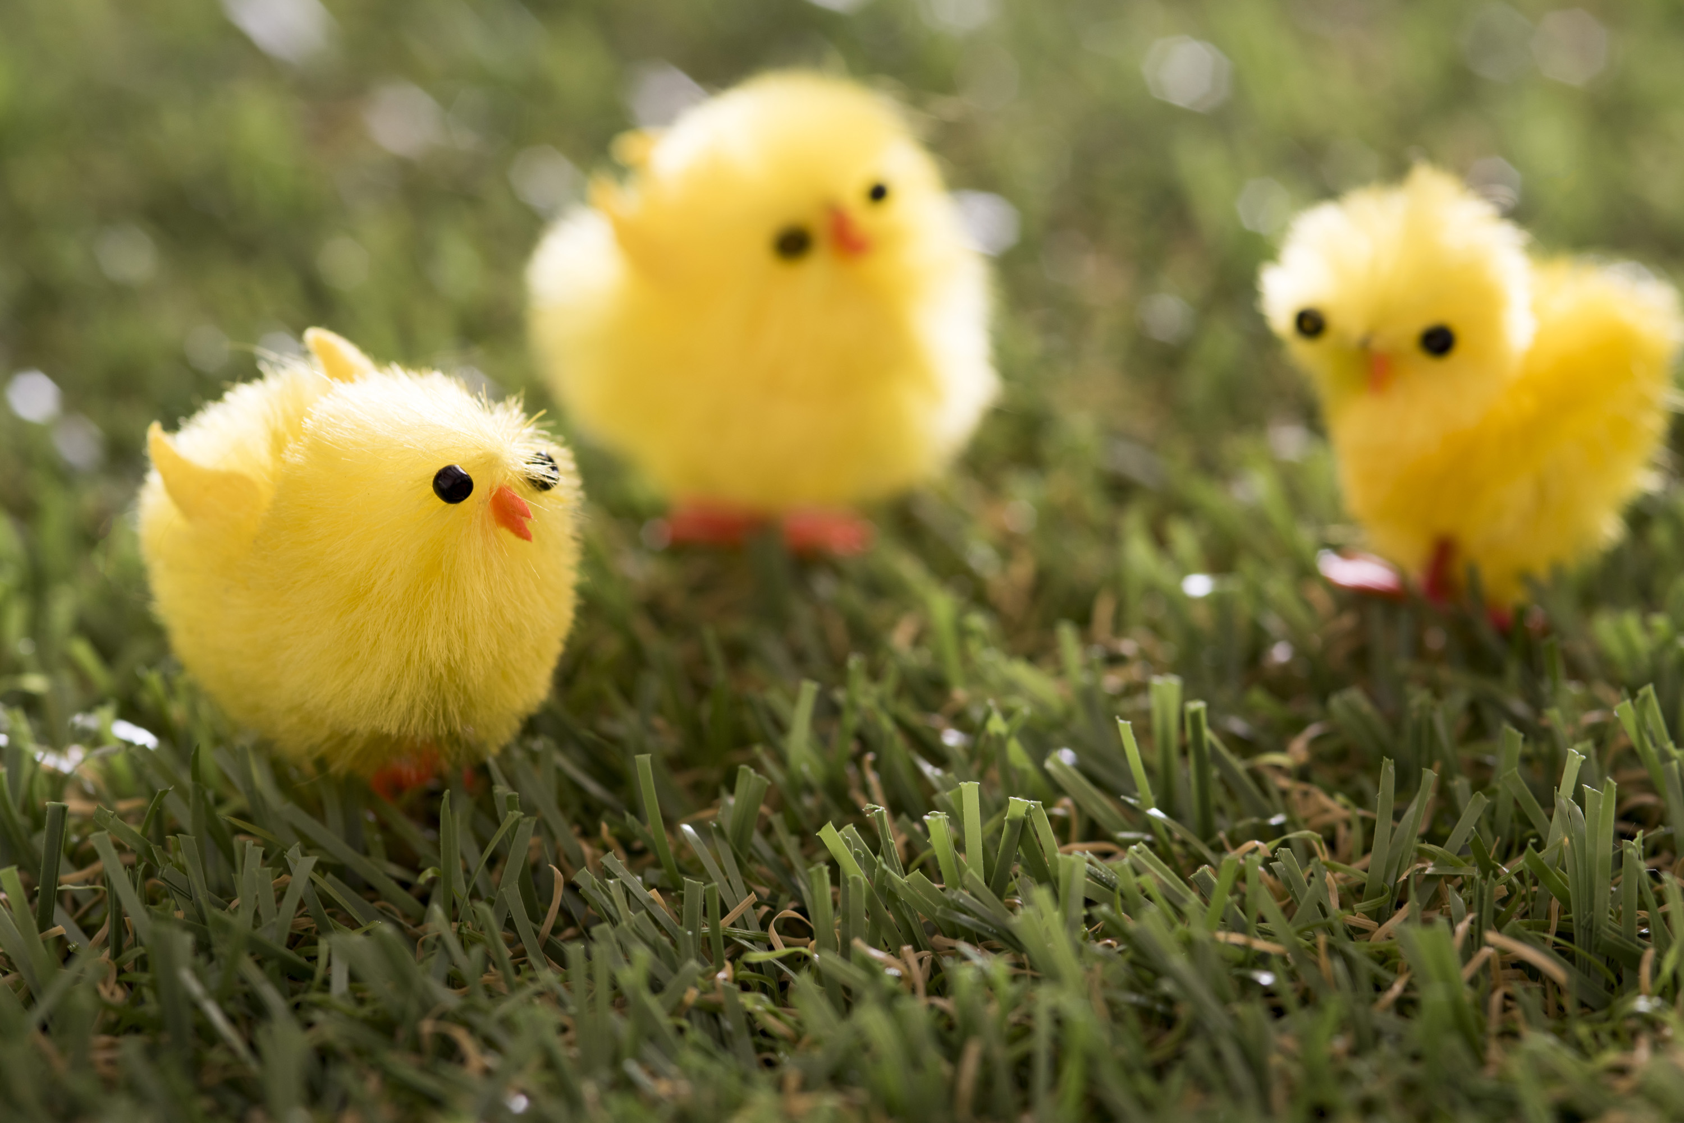
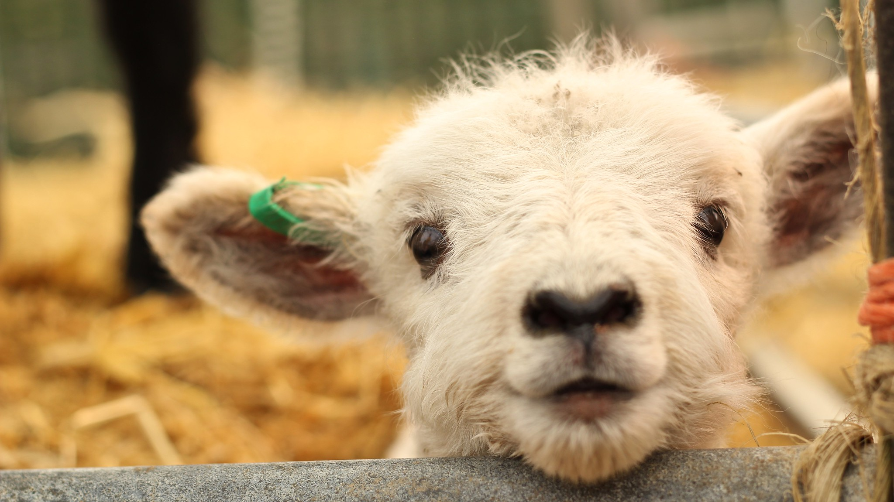
This Photo by Unknown author is licensed under CC BY.
Anifeiliaid y pasg
This Photo by Unknown author is licensed under CC BY.

Slide 3
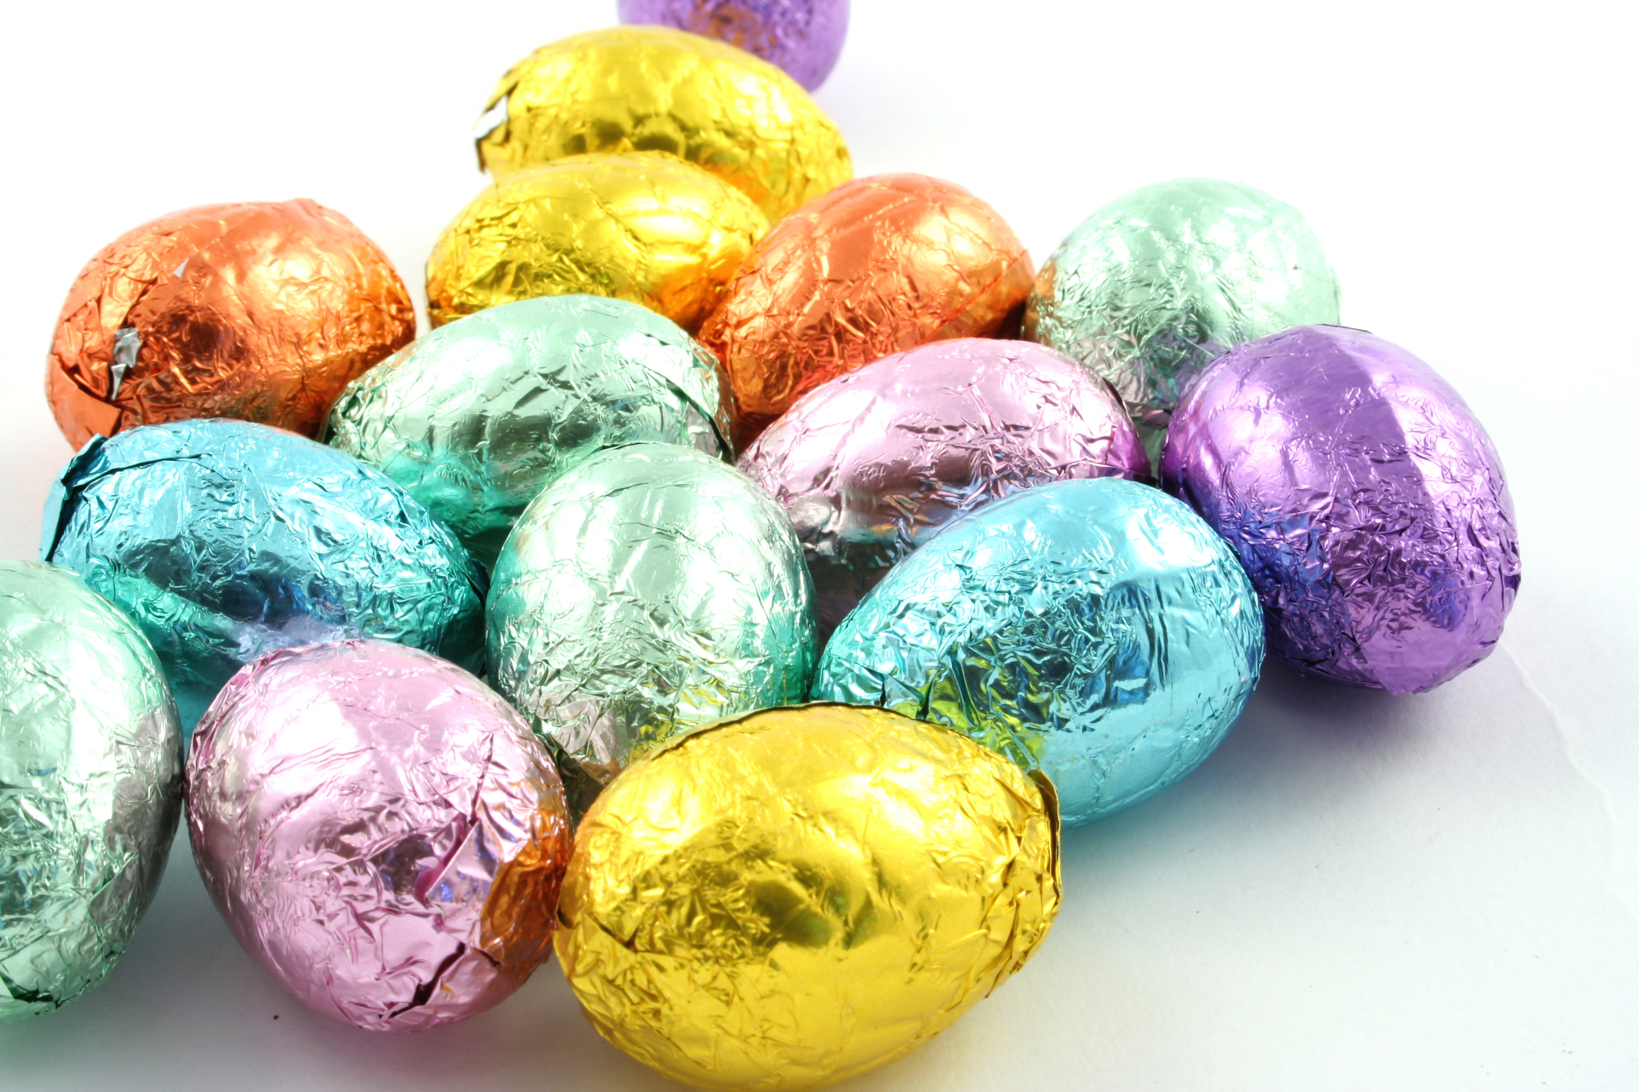
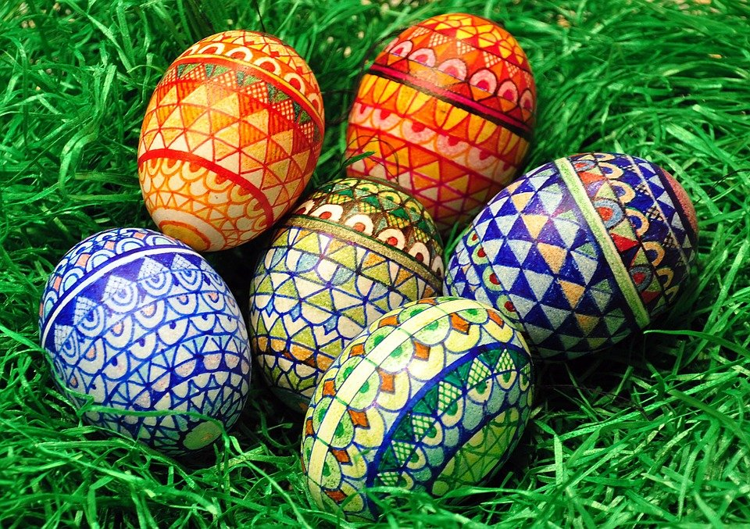
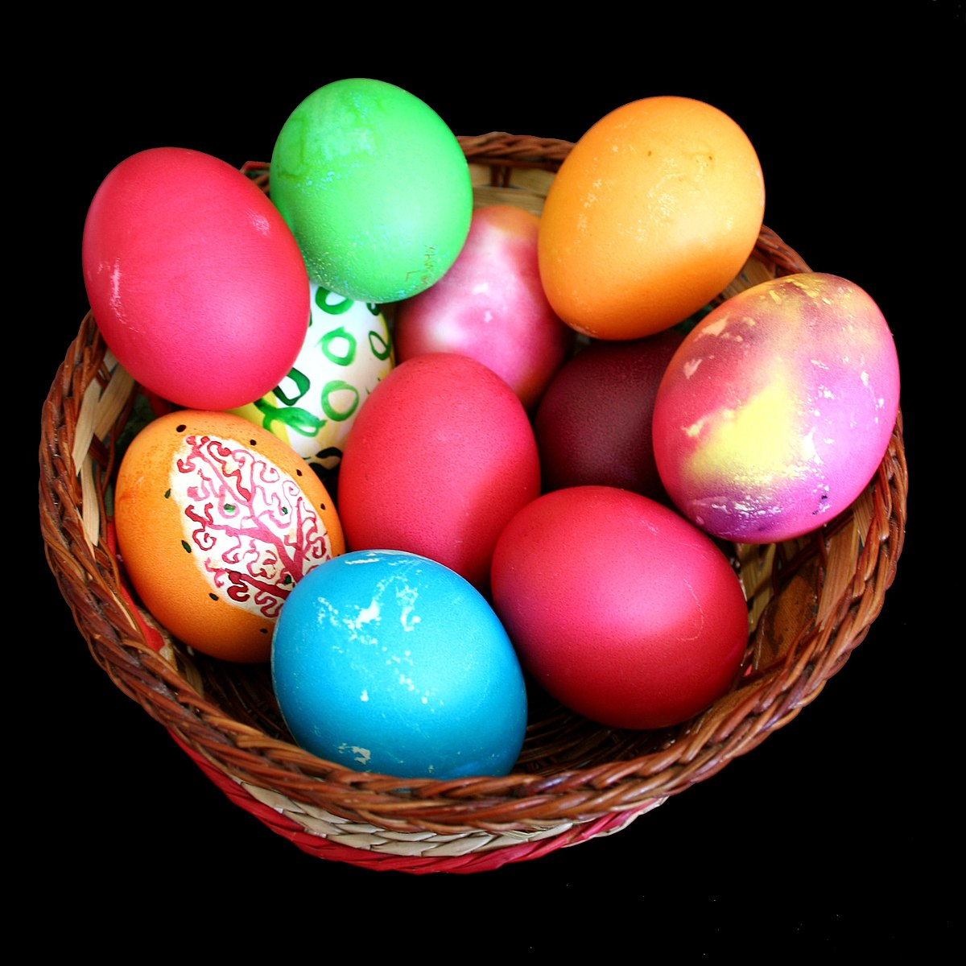
Wyau pasg
This Photo by Unknown author is licensed under CC BY-SA.

Slide 4
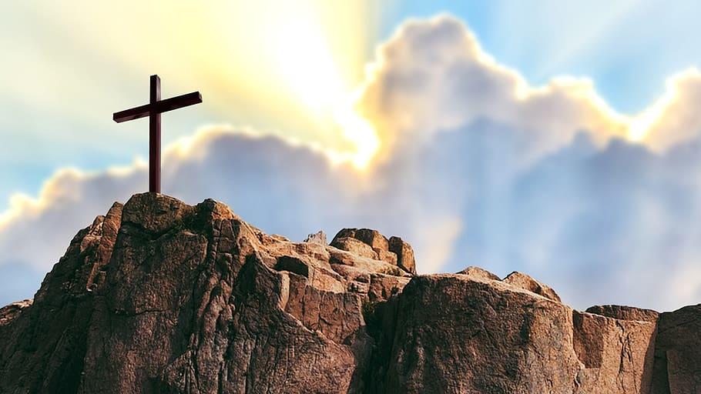
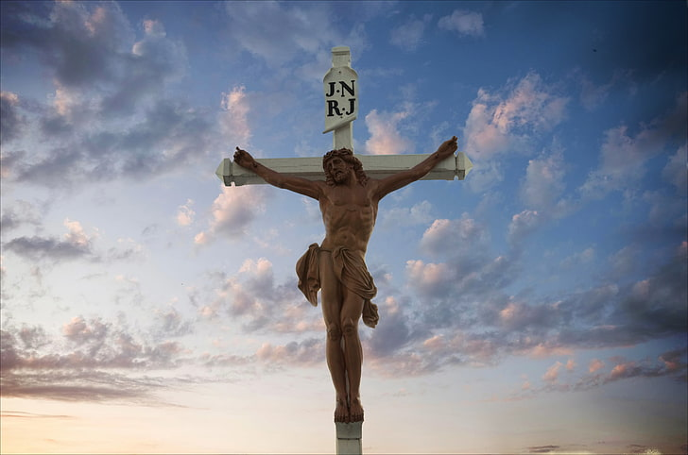
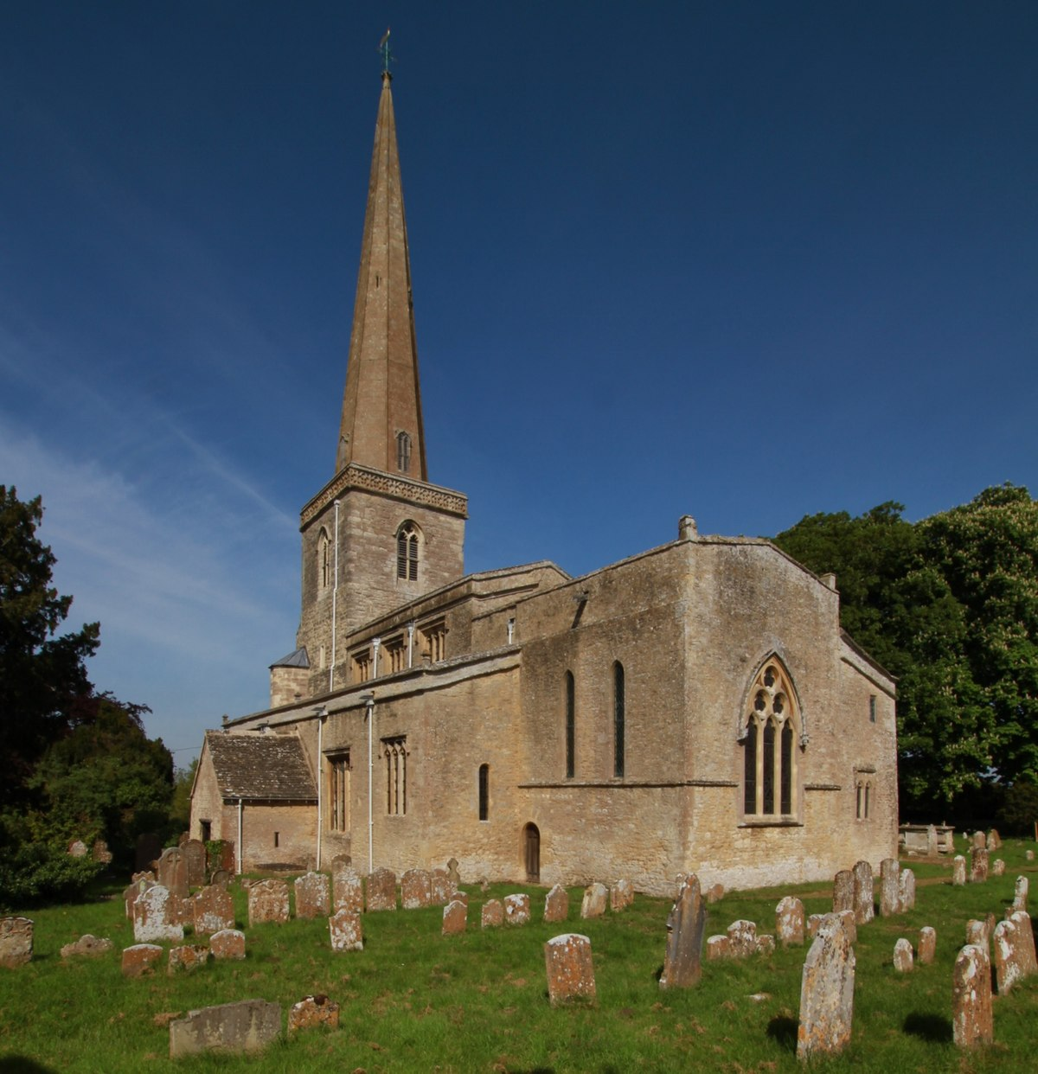
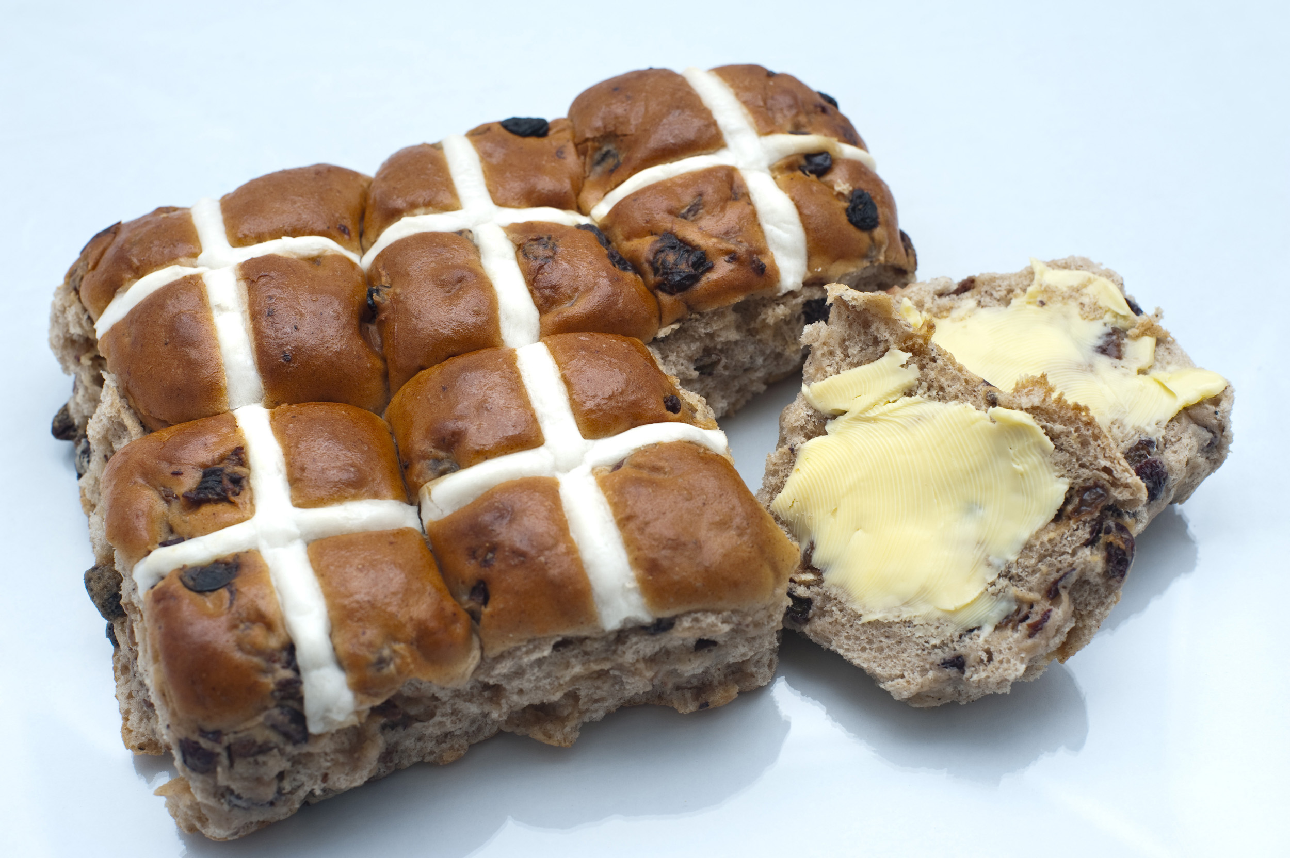
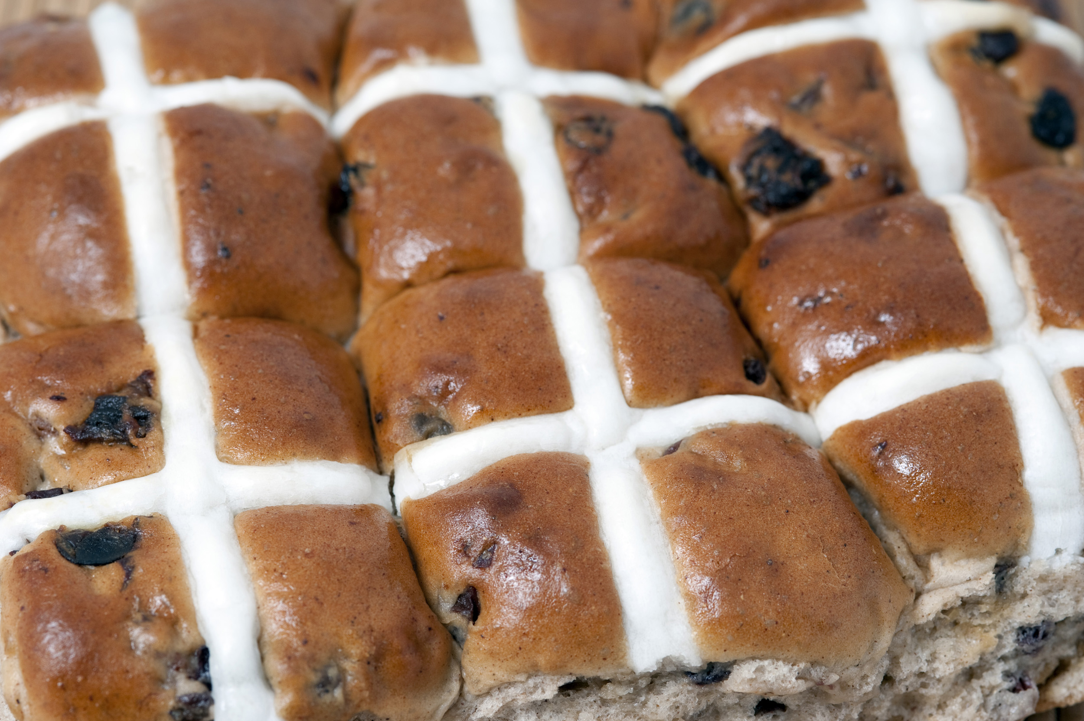
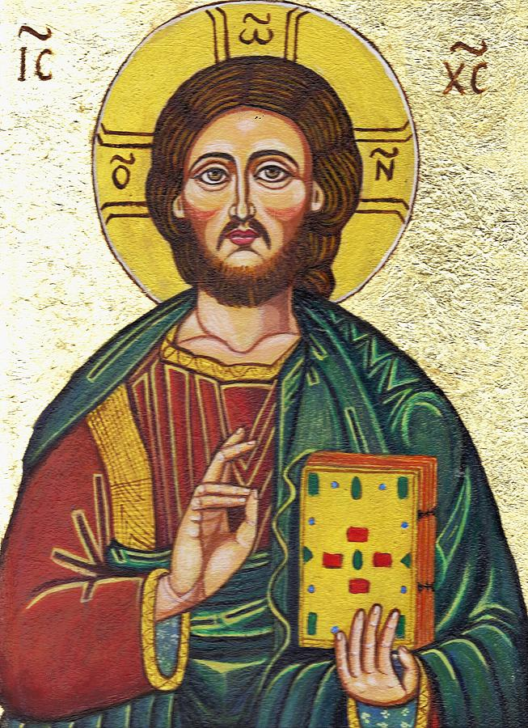
Symbolau o'r Pasg
This Photo by Unknown author is licensed under CC BY-SA.
This Photo by Unknown author is licensed under CC BY.
This Photo by Unknown author is licensed under CC BY.

