Slide 1
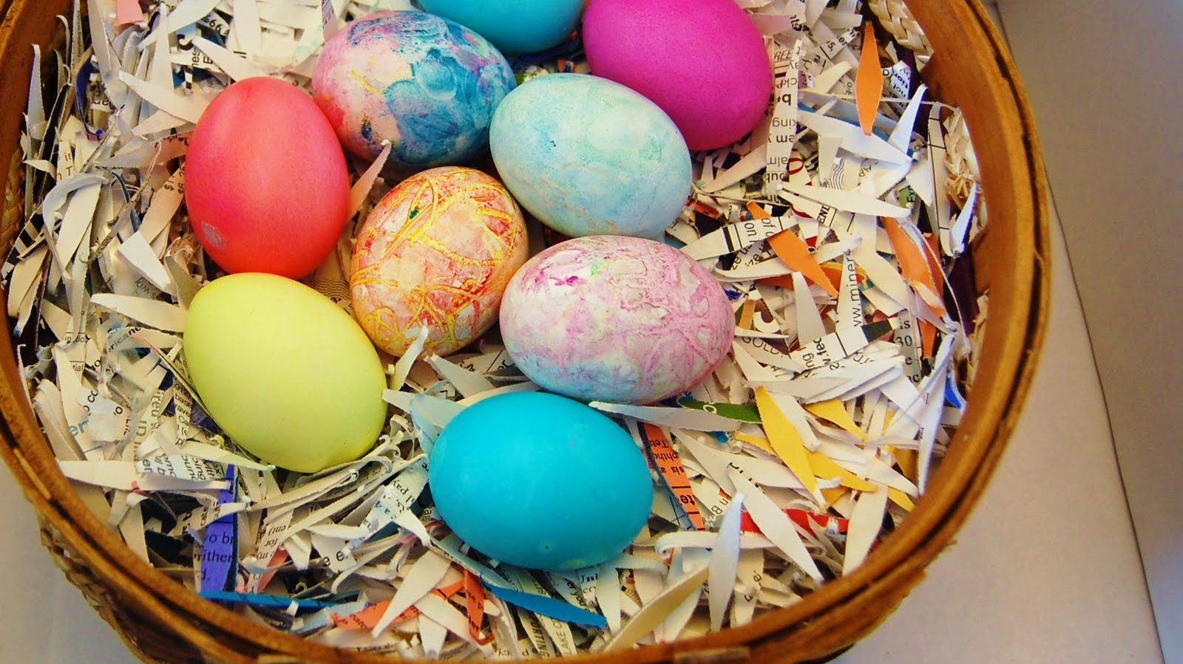
Y Pasg
Gan John a Ruth
This Photo by Unknown author is licensed under CC BY-SA-NC.

Slide 2
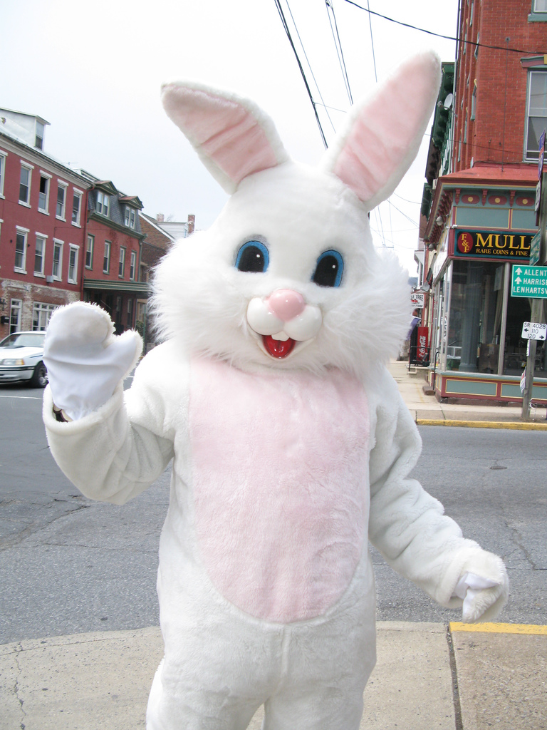
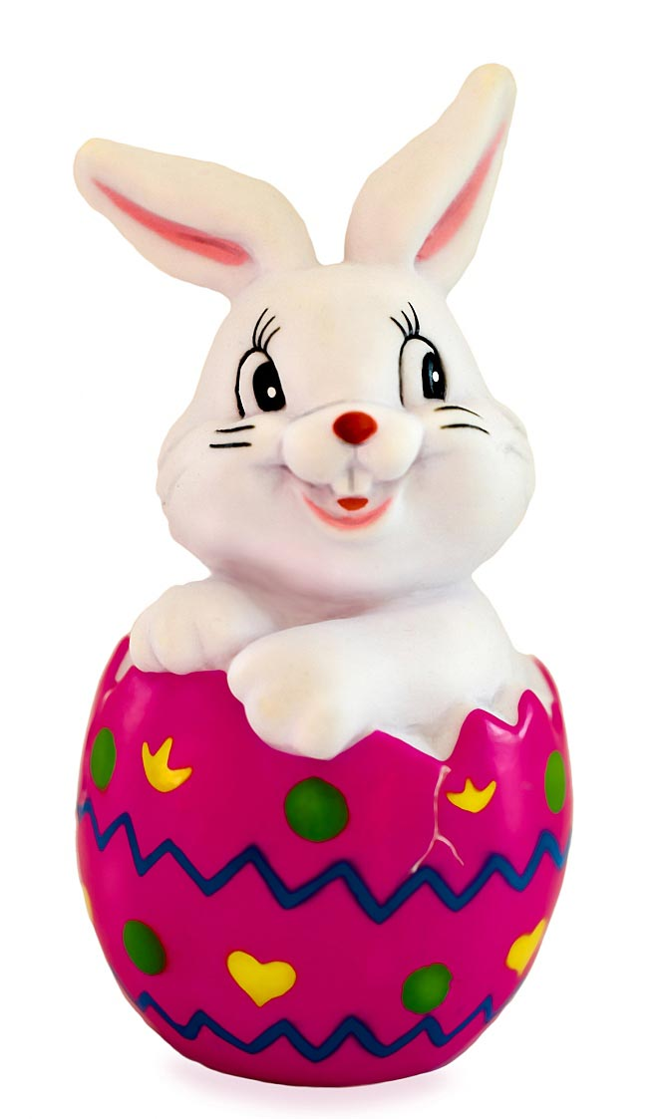
Mae pawb yn hoffi y cwningen pasg!
This Photo by Unknown author is licensed under CC BY-SA.
This Photo by Unknown author is licensed under CC BY-NC-ND.

Slide 3
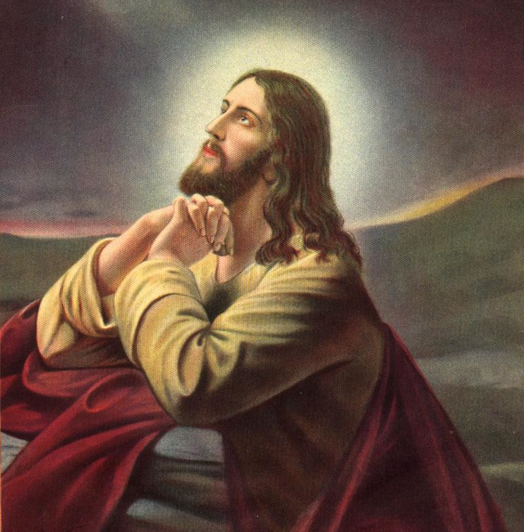
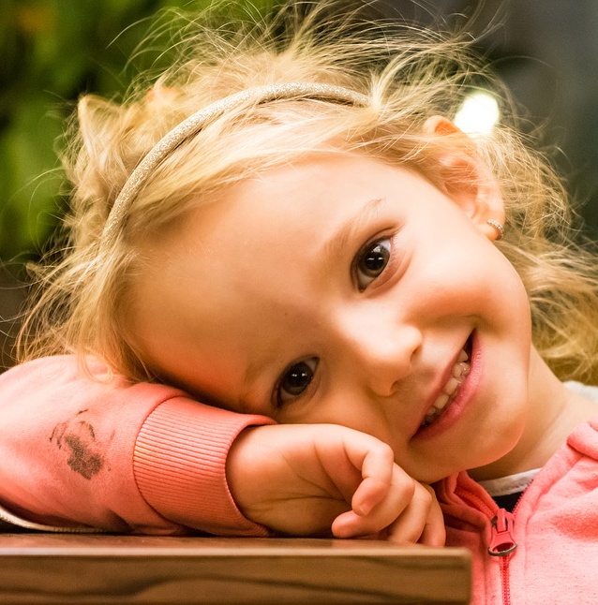
This Photo by Unknown author is licensed under CC BY-SA-NC.

Slide 4
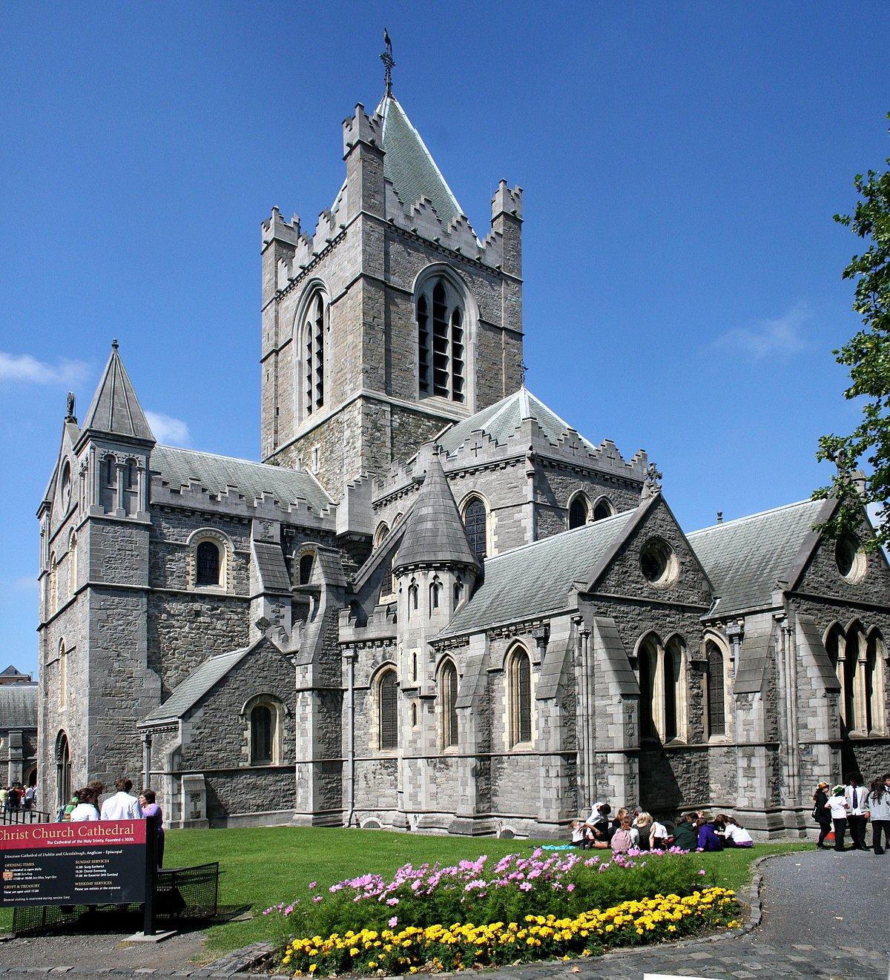

Mae rhai o bobl yn mynd I eglwys I ddathlu Pasg
This Photo by Unknown author is licensed under CC BY-SA.

Slide 5
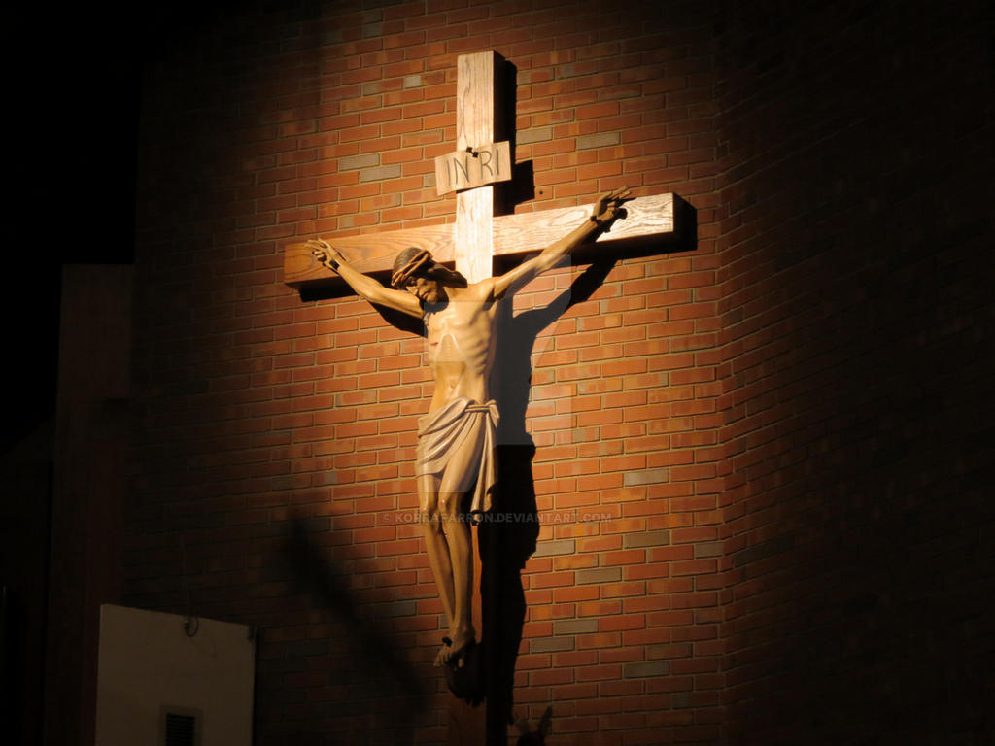
Rhoddodd rai pobl Iesu ar y groes ar ddydd Gwener y Groglith
This Photo by Unknown author is licensed under CC BY-NC-ND.

Slide 6

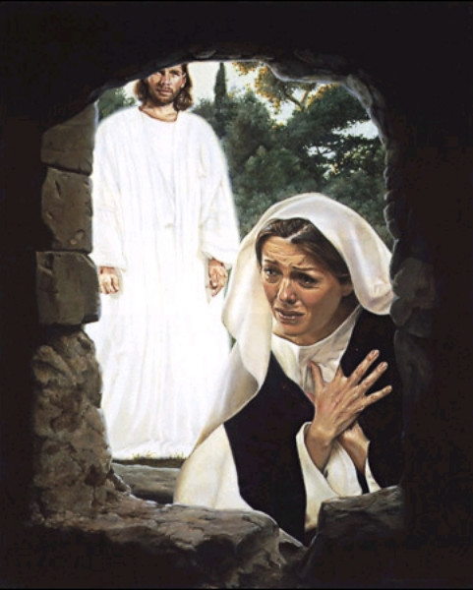
Ar y ddydd syl fy atgyfododd
This Photo by Unknown author is licensed under CC BY-SA-NC.

Slide 7
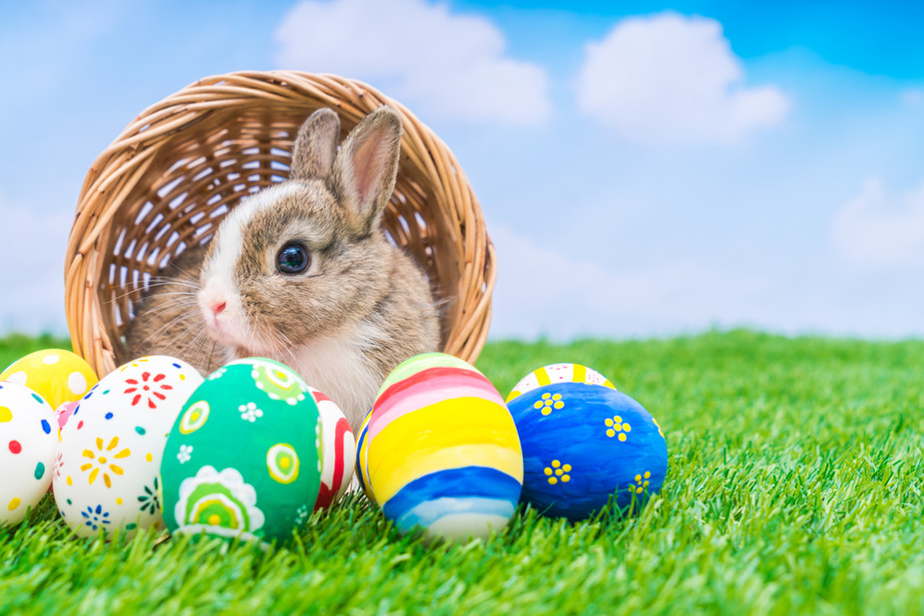
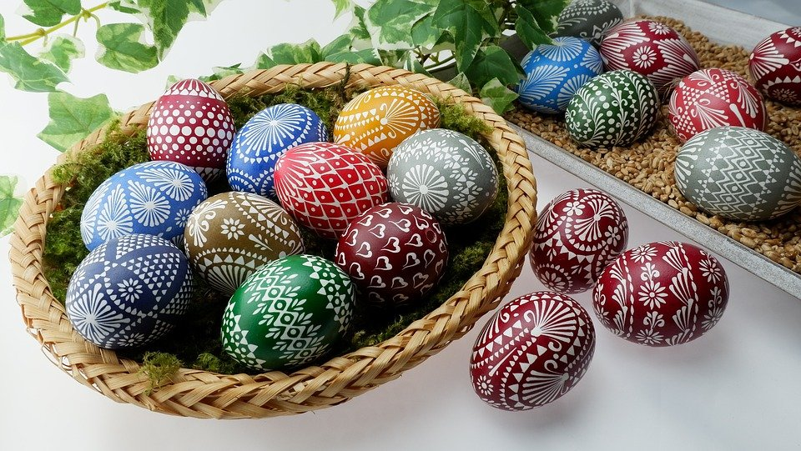
Rydym yn dathlu yr Pasg I ddathlu bod Iesu wedi dod nol yn fyw!A dyma rhai or pethau ni yn defnyddio I dathlu yr Pasg
Wyau pasg
Cwningen pasg
This Photo by Unknown author is licensed under CC BY-SA-NC.

Slide 8
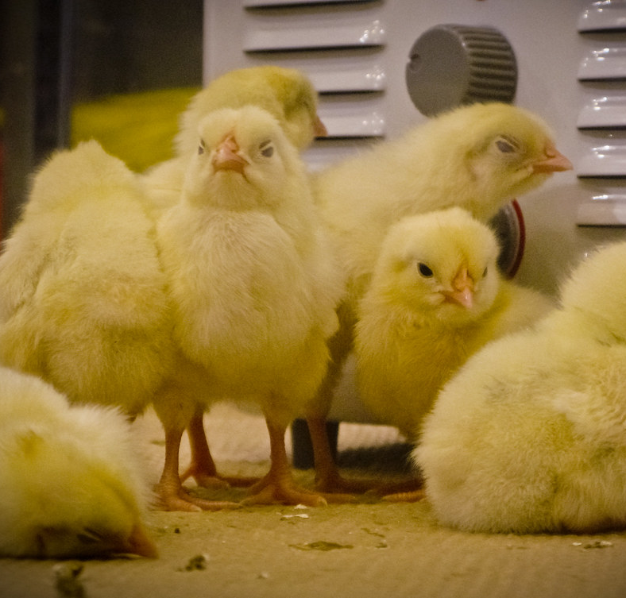
Mae cyw yn I gwneud gyda y Pasg hefyd.
Dyma rhai o gywion.
This Photo by Unknown author is licensed under CC BY-SA-NC.

Slide 9
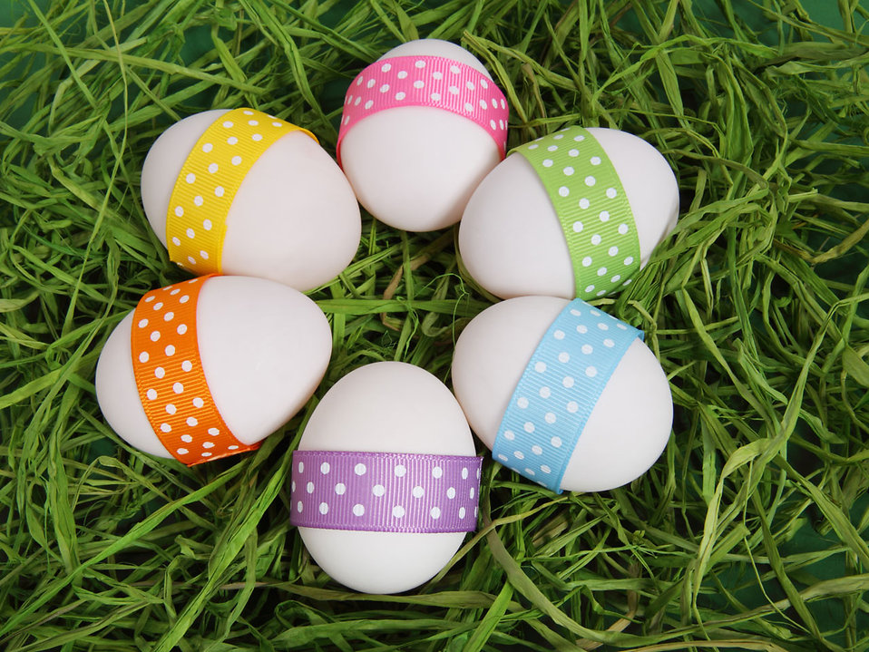
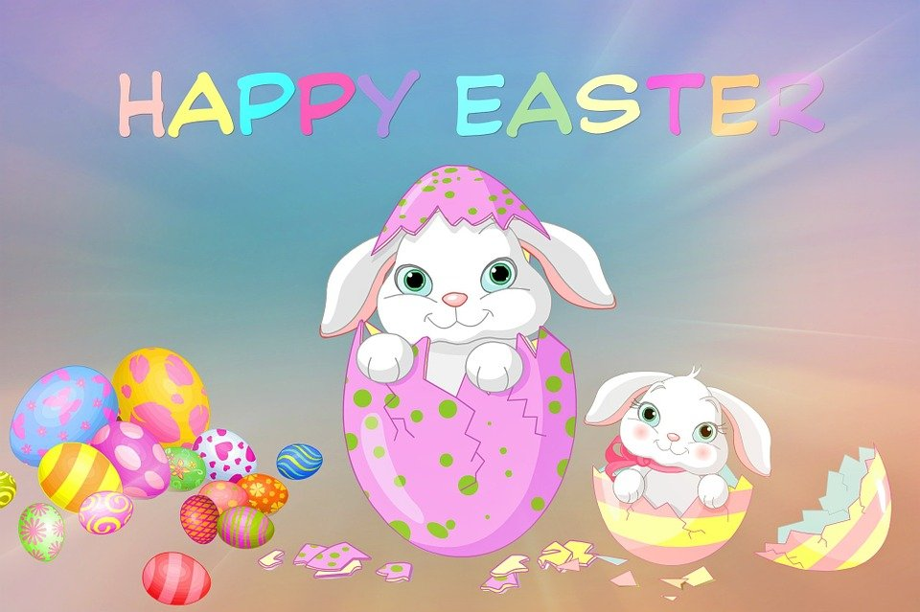
Beth wyt ti yn gallu meddwl am sydd amdano y Pasg?

Slide 10
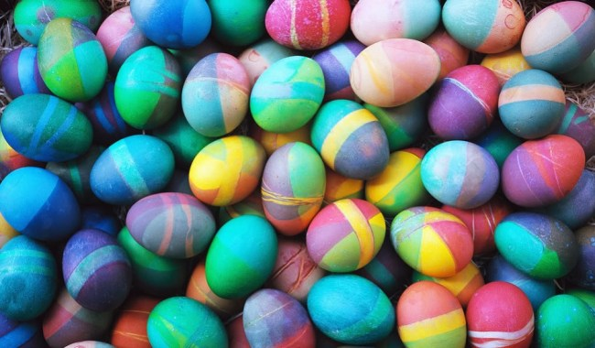
Y diwedd
This Photo by Unknown author is licensed under CC BY-NC-ND.

