Slide 1
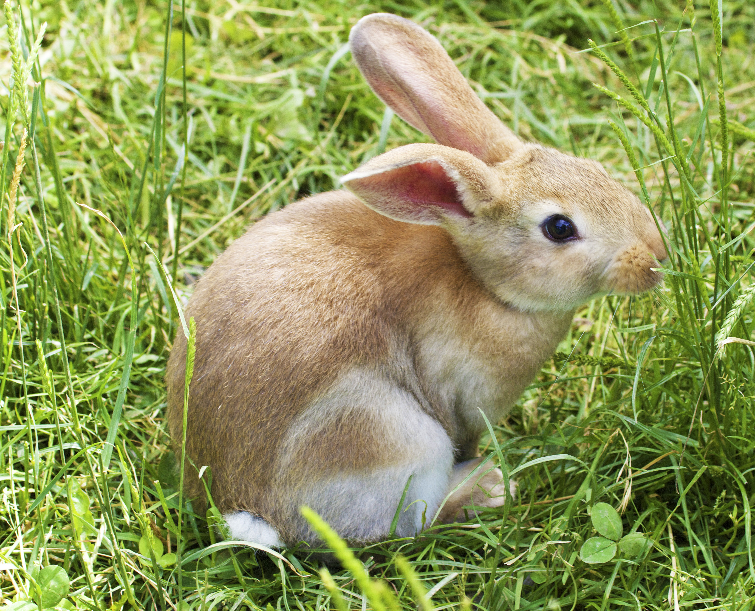
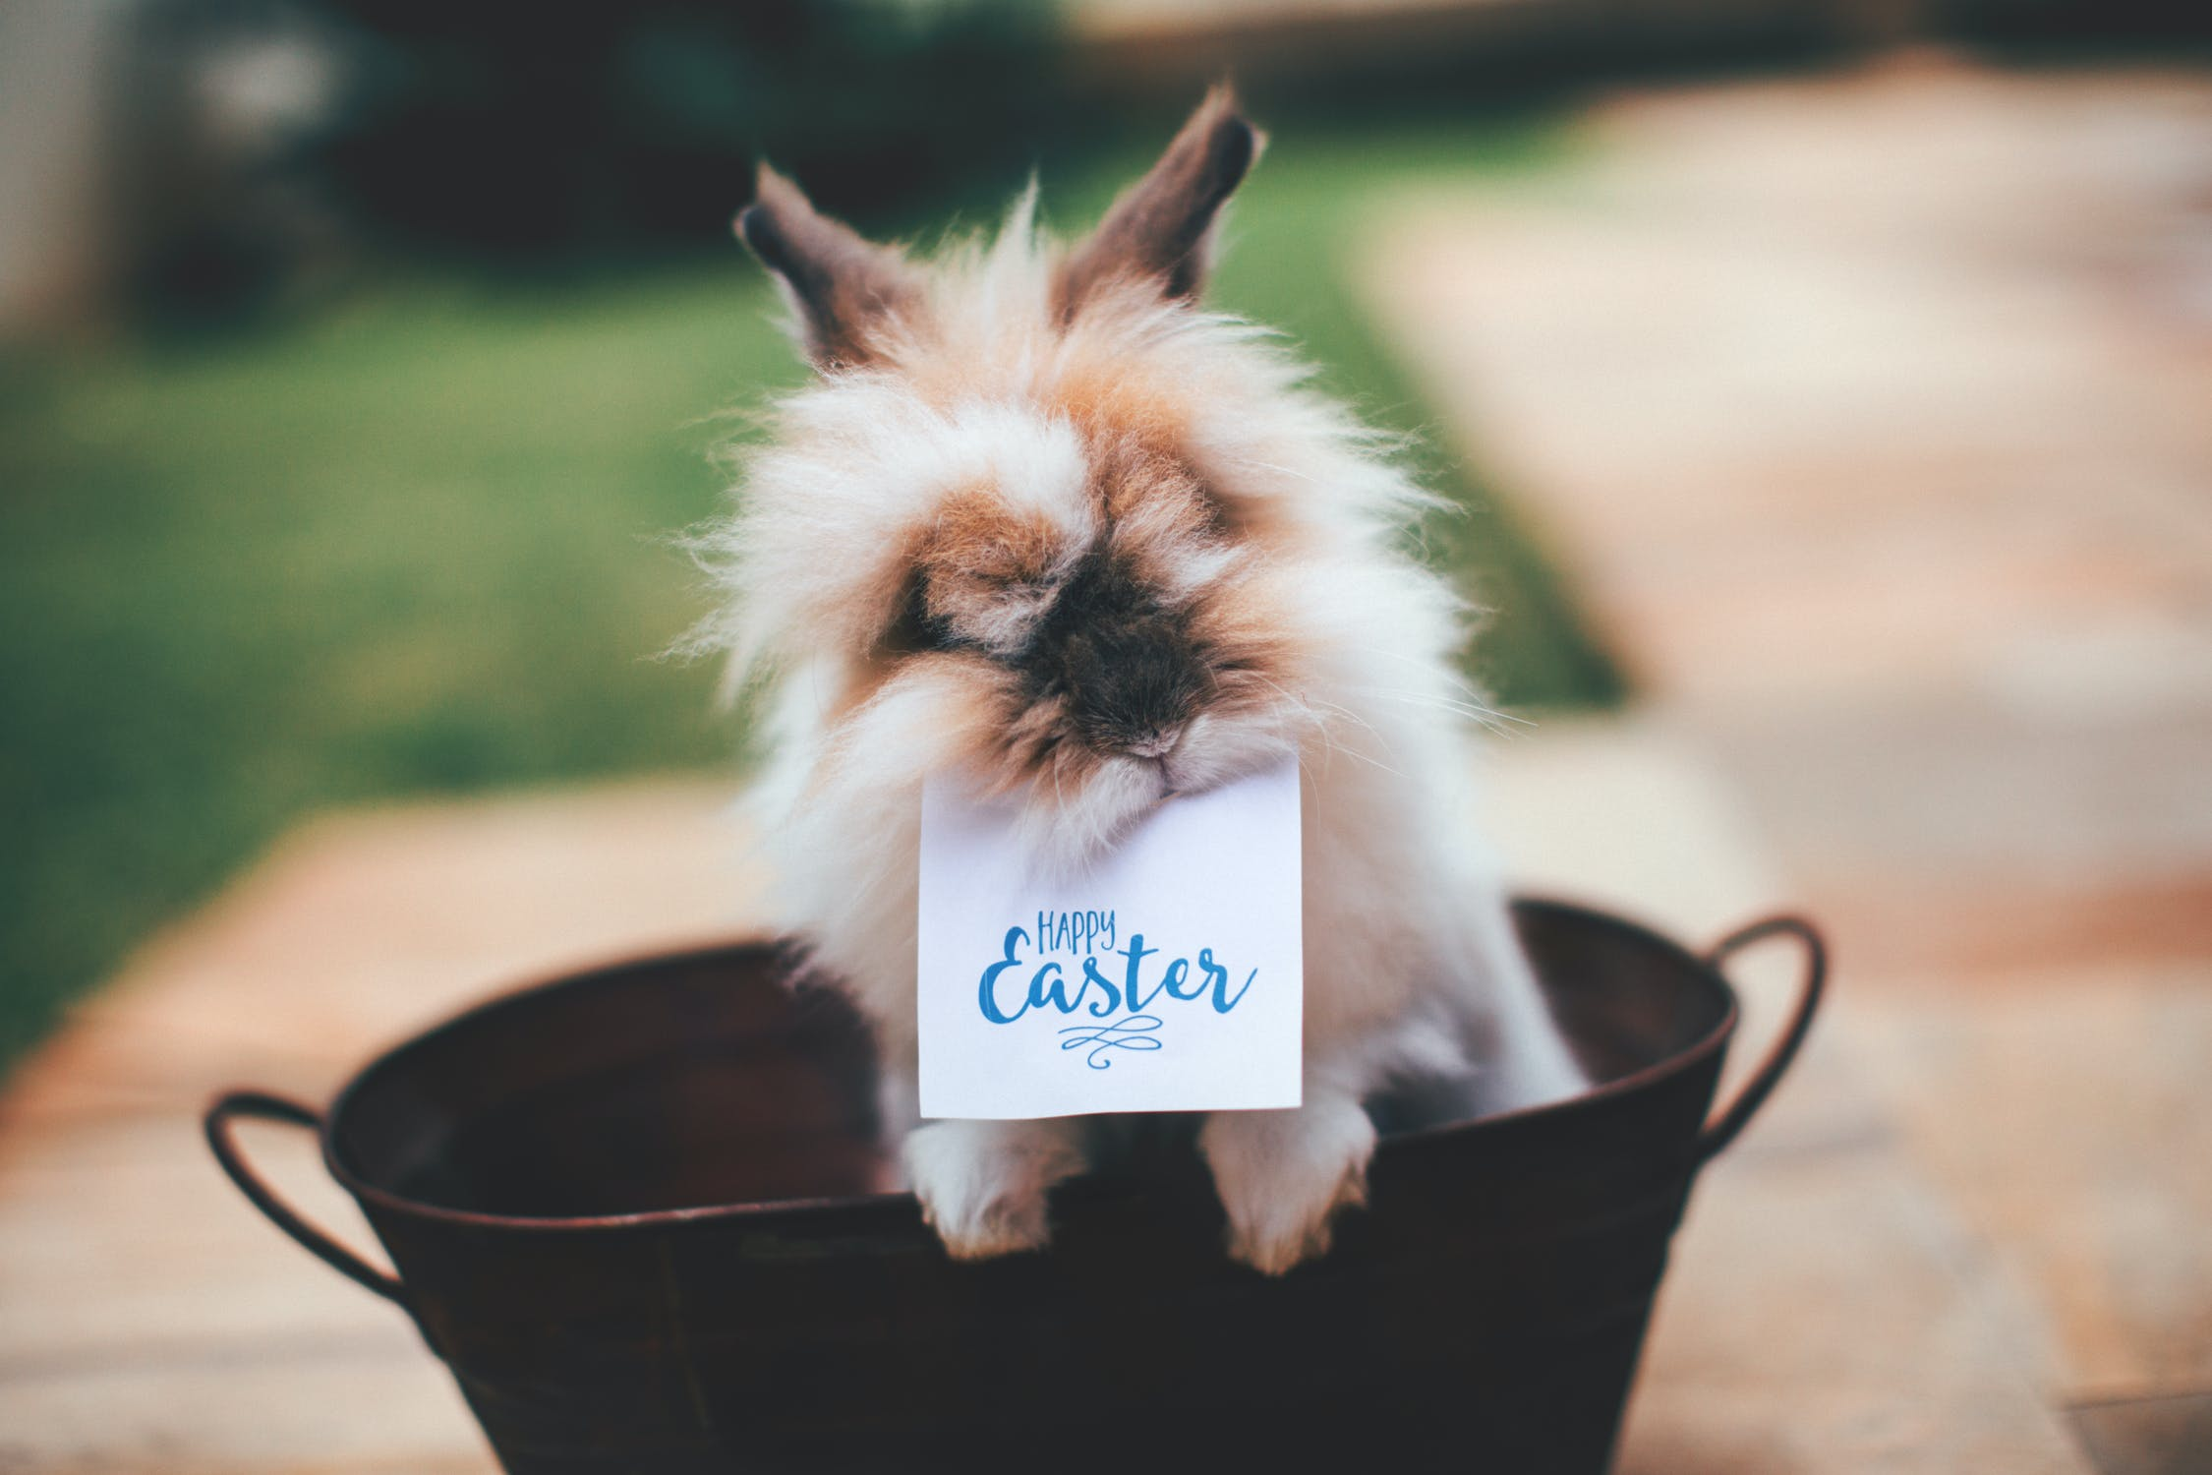
Y Pasg gan Freddie a Louis-Jay
This Photo by Unknown author is licensed under CC BY-NC-ND.

Slide 2
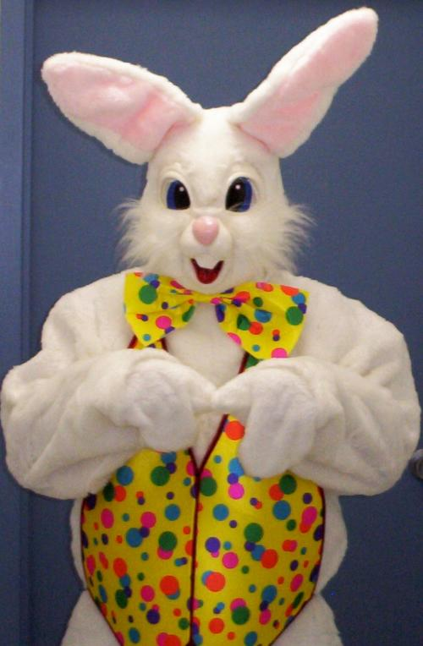
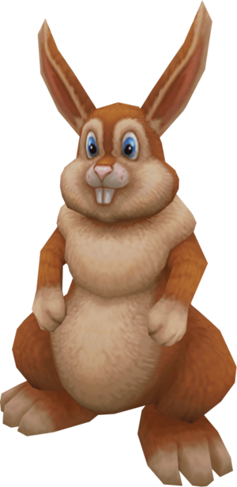
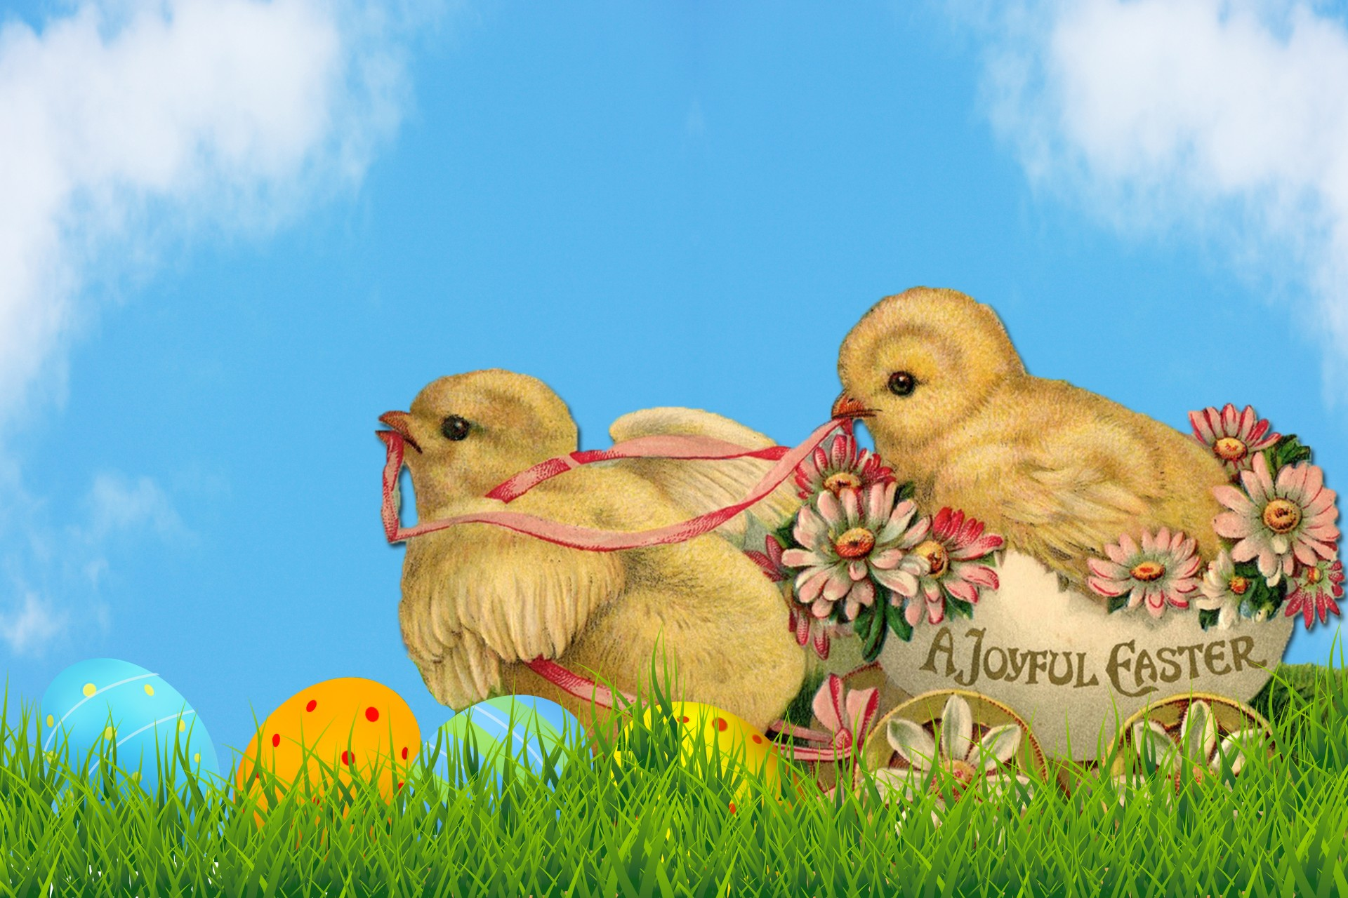
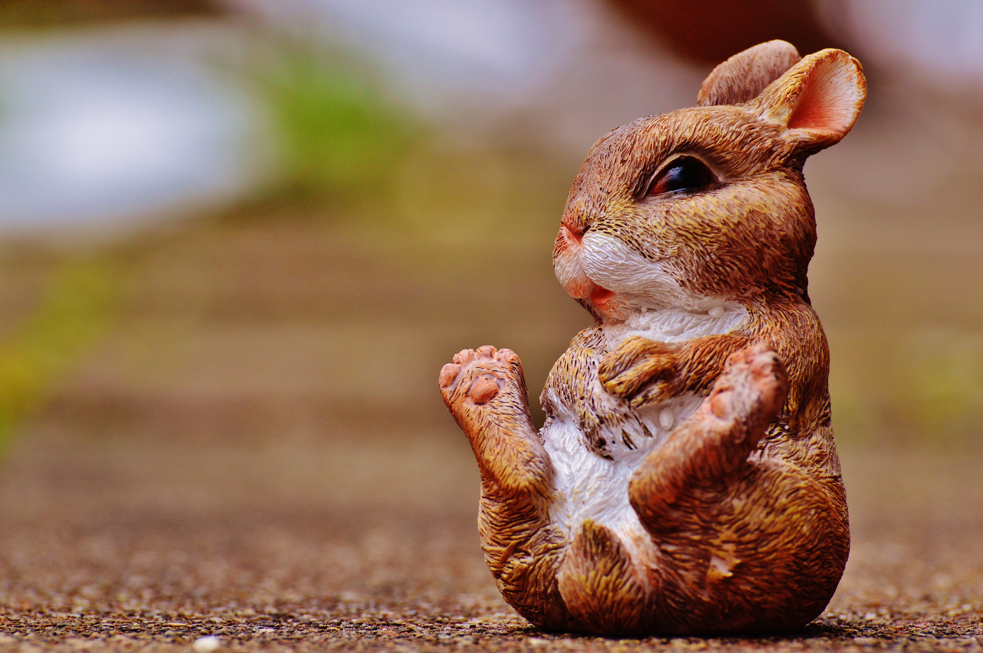
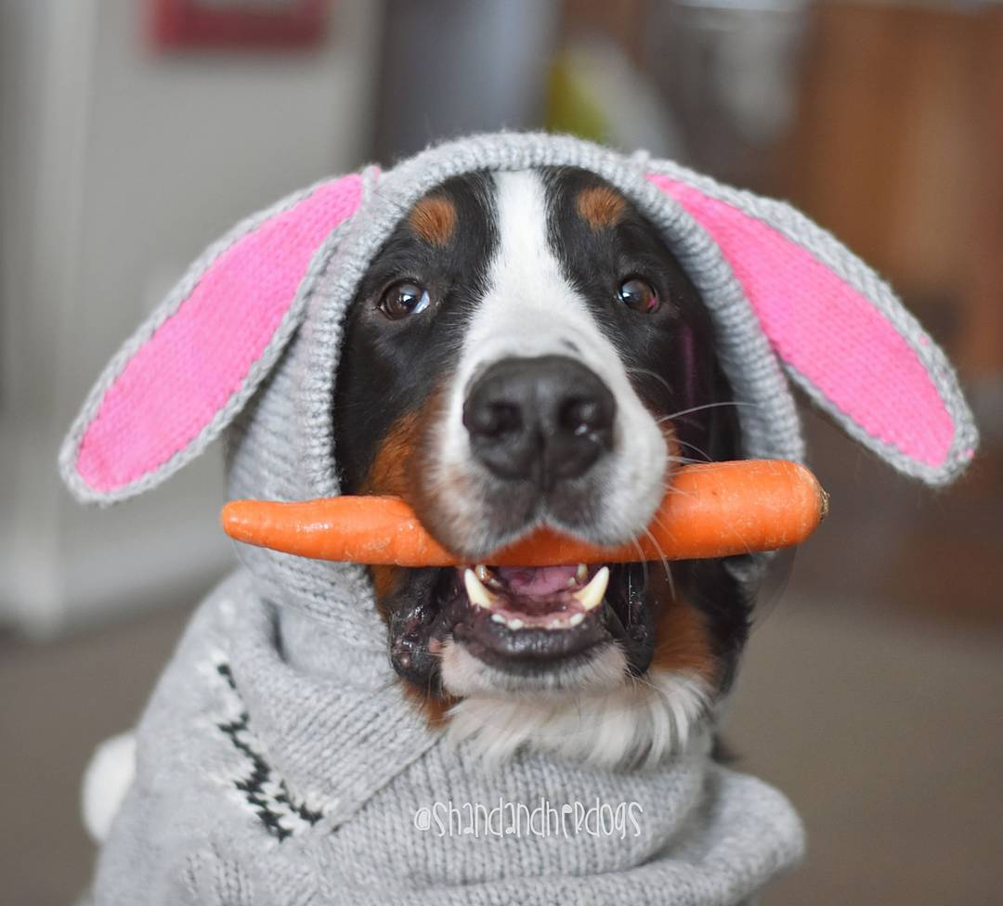
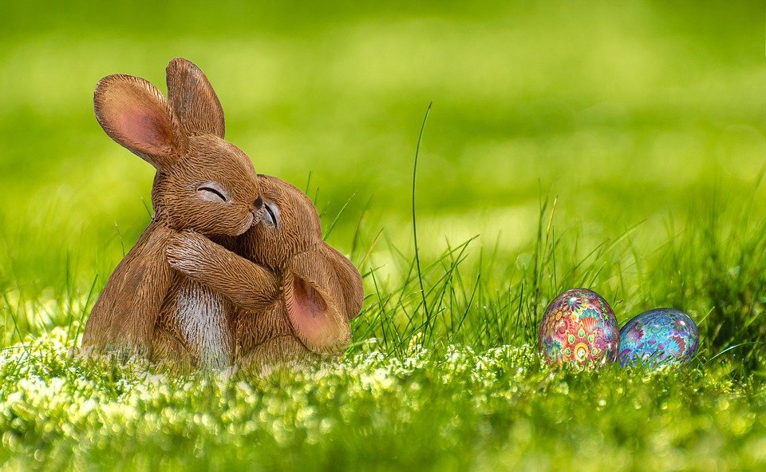
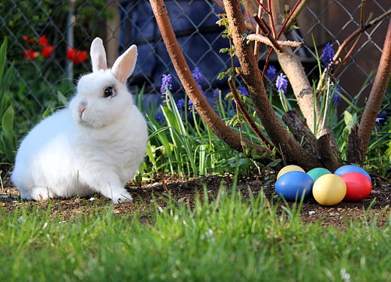
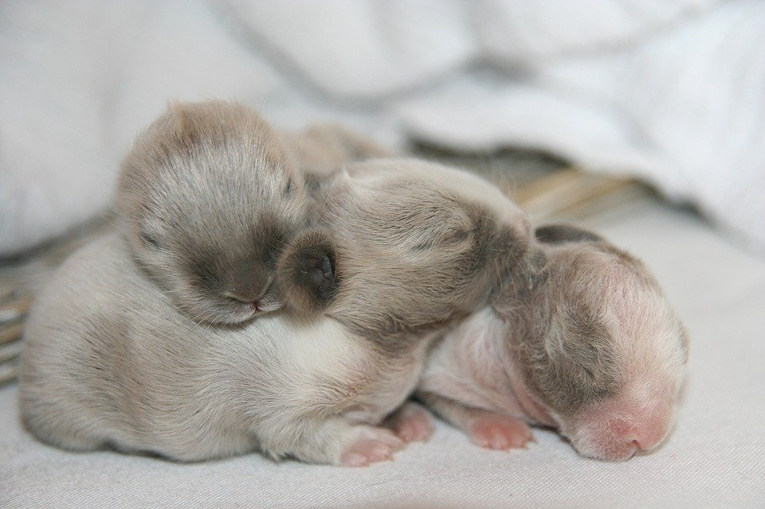
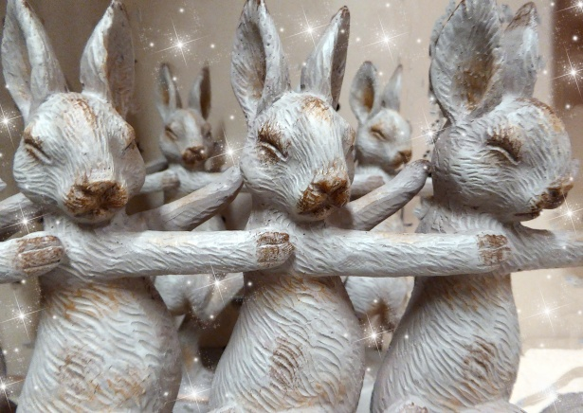
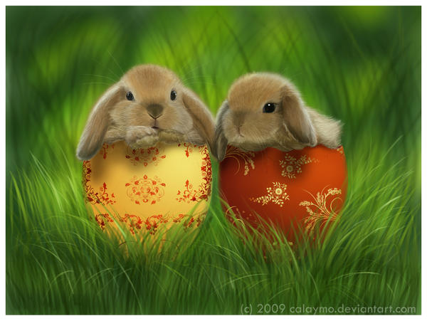
Byth ydy'r gwningen Pasg yn edrych fel?

Slide 3
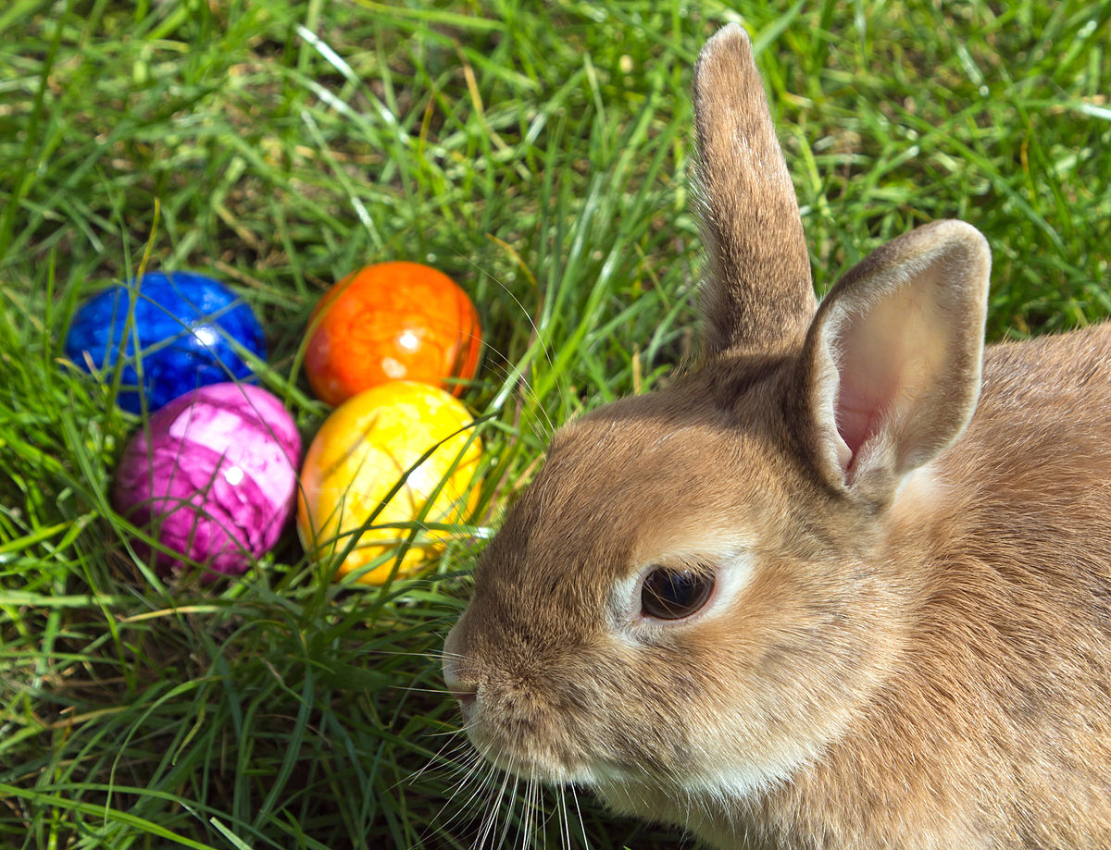

Beth ydy'r gwningen pasg yn gwneud?
Maen rhoi wyau pasg i bawb.
This Photo by Unknown author is licensed under CC BY-SA.

Slide 4
Y diwedd
This Photo by Unknown author is licensed under CC BY-NC-ND.

