Slide 1
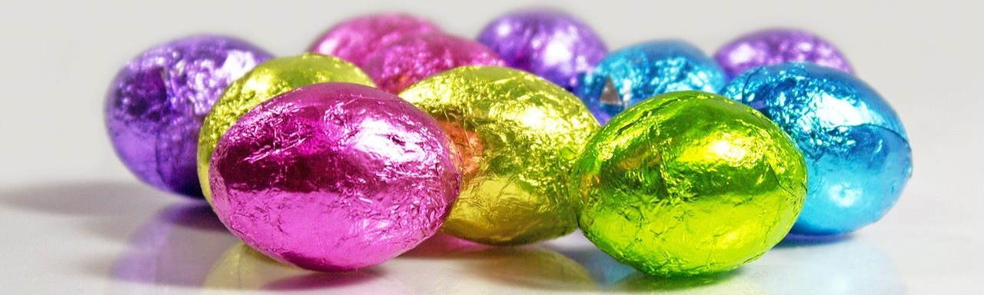

Y Pasg
Gan Dilshad a Dexter

Slide 2
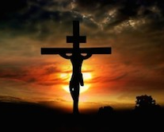
Pam yr ydym ni yn dathlu y Pasg?
Achos marwodd Iesu ar y groes.
This Photo by Unknown author is licensed under CC BY-NC-ND.

Slide 3
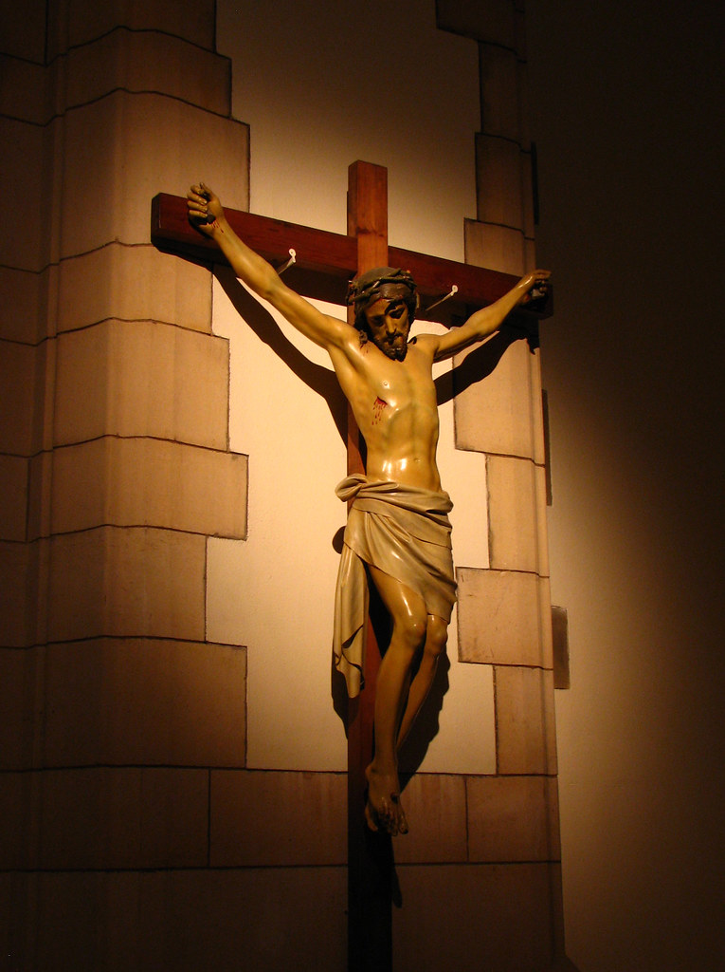
Sut wnaeth Iesu farw??
Fe gafodd ei groeshoelio ar ddydd Gwener y Groglith.
Doedd ganddo ddim bwyd neu ddwr.
Roedd Iesu wedi cail ei drin yn wael
Iawn.
This Photo by Unknown author is licensed under CC BY-NC.

Slide 4
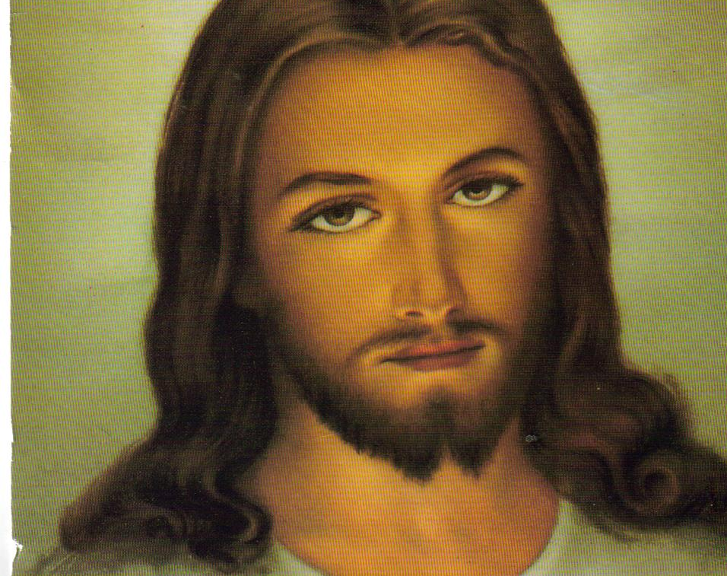
Ar y ddydd sul fe atgyfododd Iesu
A dyna pam nin dathlu y pasg
This Photo by Unknown author is licensed under CC BY-SA-NC.

Slide 5
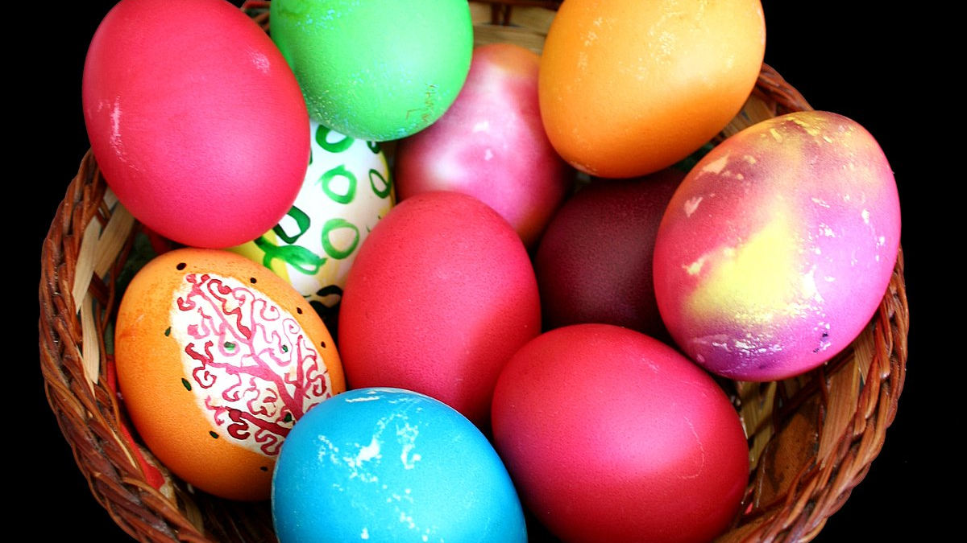
Y diwedd
This Photo by Unknown author is licensed under CC BY-SA.

