Slide 1
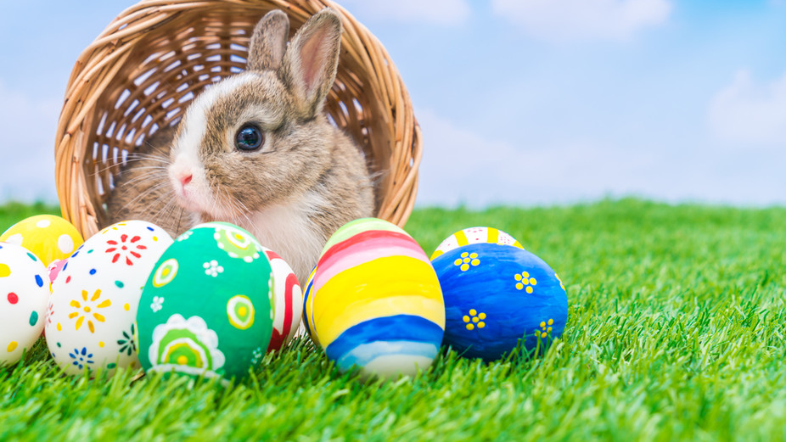
Y Pasg
Gan Mari a Gwen
This Photo by Unknown author is licensed under CC BY-SA-NC.

Slide 2
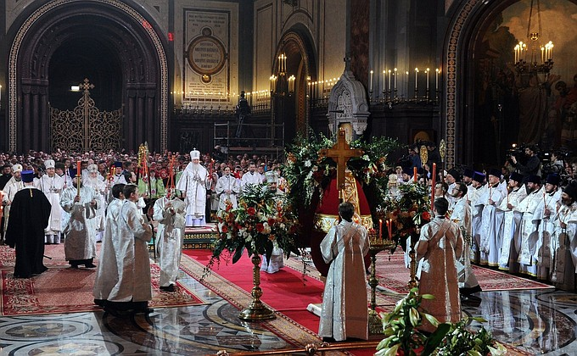
Pwy sy'n dathlu,r Pasg?
This Photo by Unknown author is licensed under CC BY.

Slide 3
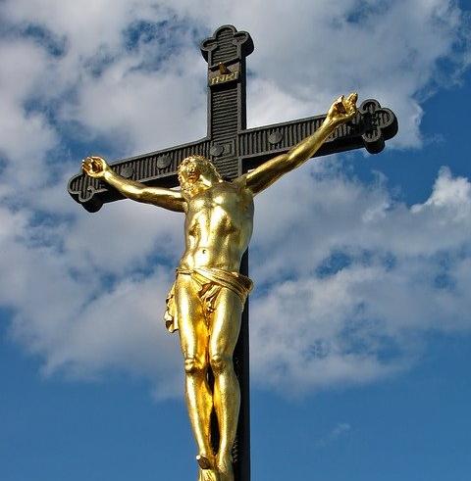
Pam ydi ni yn dathlu y Pasg??

Slide 4
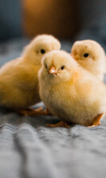
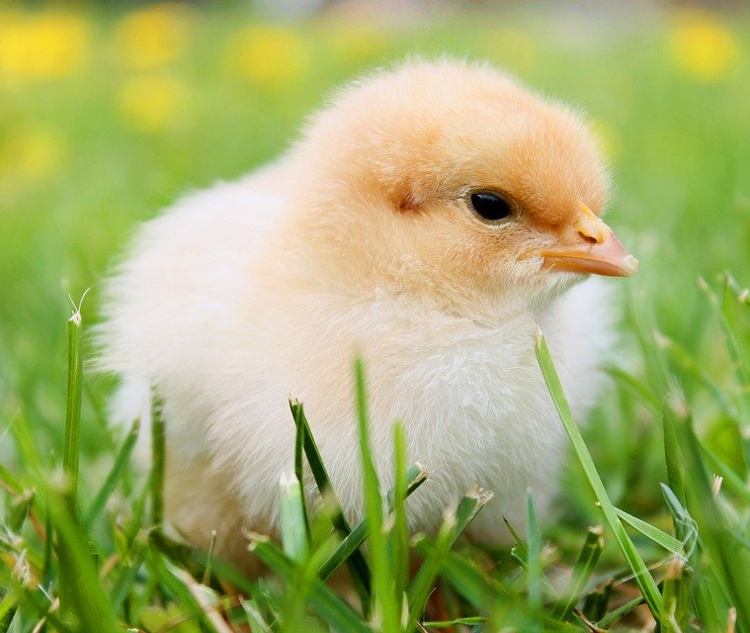
Mae bywyd newydd yn dod ar adeg y Pasg! Ond pam?

Slide 5
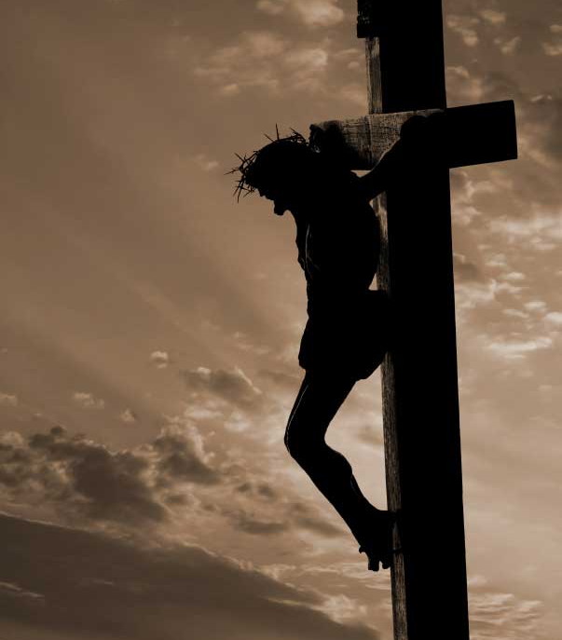
Achos farwodd Iesu ar y groes.
This Photo by Unknown author is licensed under CC BY-NC-ND.

Slide 6

Dyma'r Gwningen Pasg.
Mae neb yn gwbod pryd bydd y cwningen Pasg yn dod.
This Photo by Unknown author is licensed under CC BY.

Slide 7
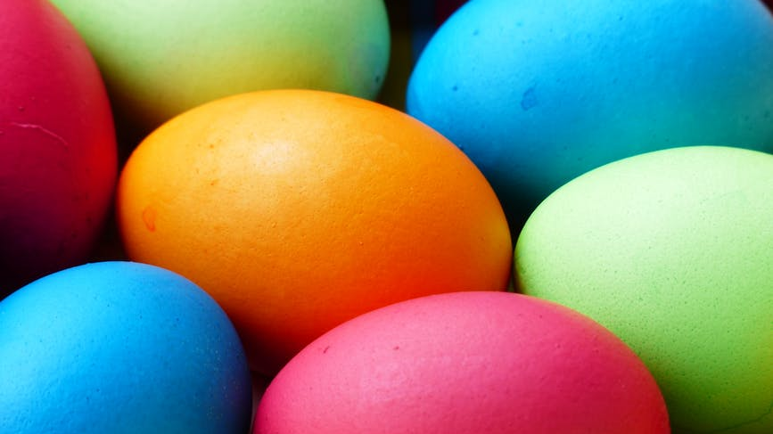
Mae yna lawer o wyiau Pasg i gasglu!!

Slide 8
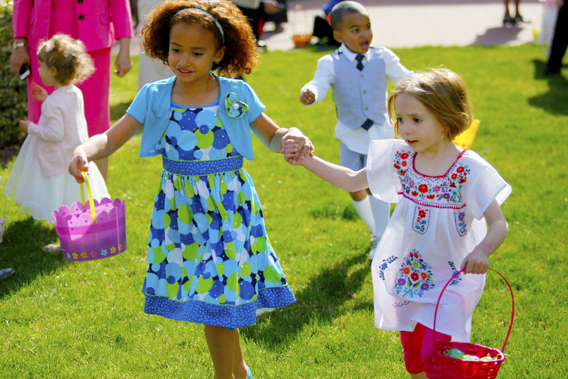
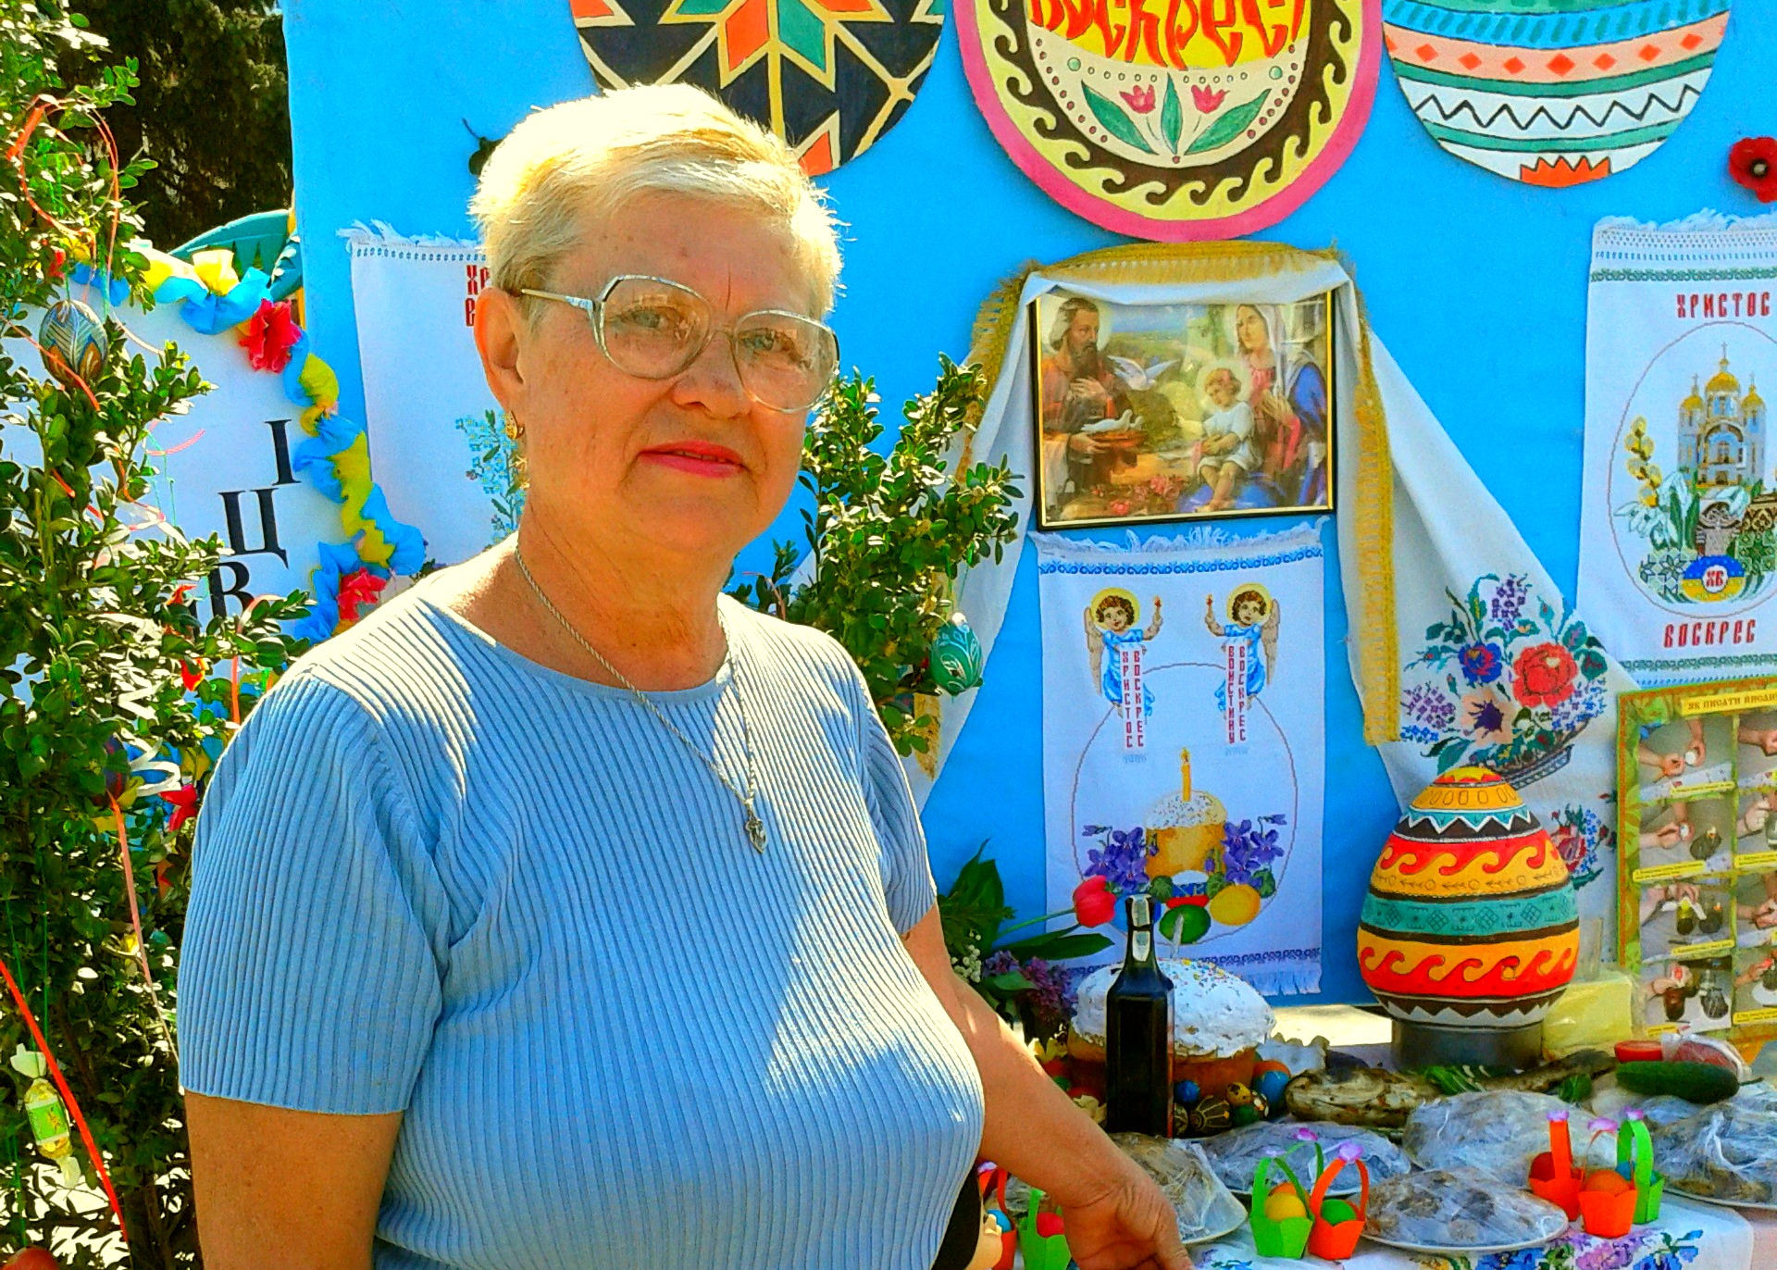
Wyt ti,n hoffi dathlu,r Pasg ?
This Photo by Unknown author is licensed under CC BY-SA-NC.
This Photo by Unknown author is licensed under CC BY-SA.

Slide 9
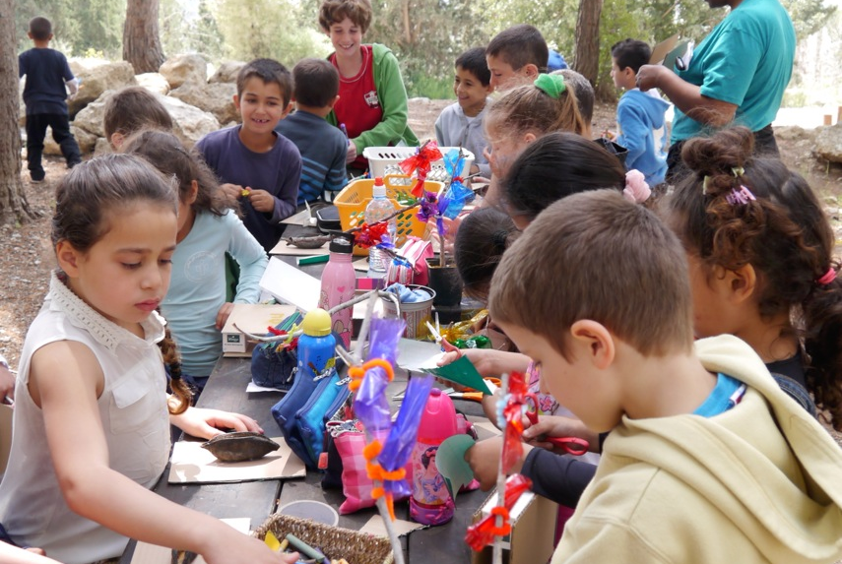
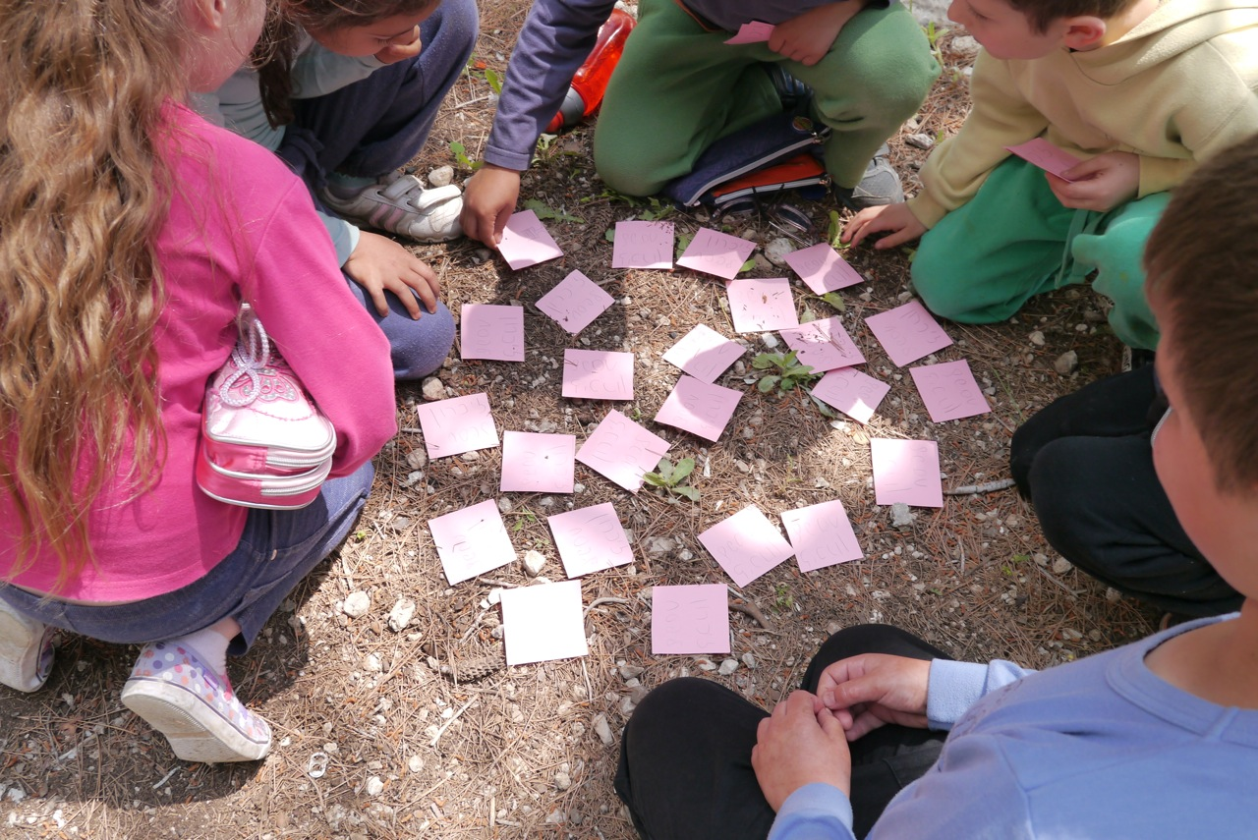
Wyt ti,n dathlu y Pasg yn yr ysgol ?
This Photo by Unknown author is licensed under CC BY.
This Photo by Unknown author is licensed under CC BY.

Slide 10
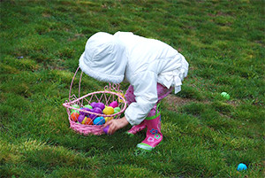
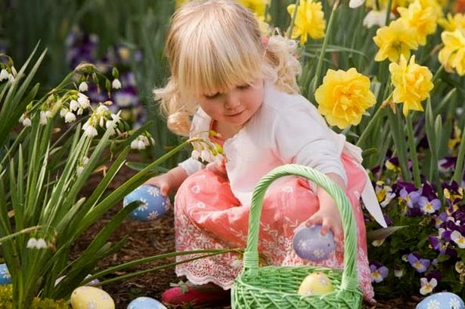
Ble wyt ti,n dathlu,r Pasg ?
This Photo by Unknown author is licensed under CC BY-SA.
This Photo by Unknown author is licensed under CC BY-SA-NC.

Slide 11
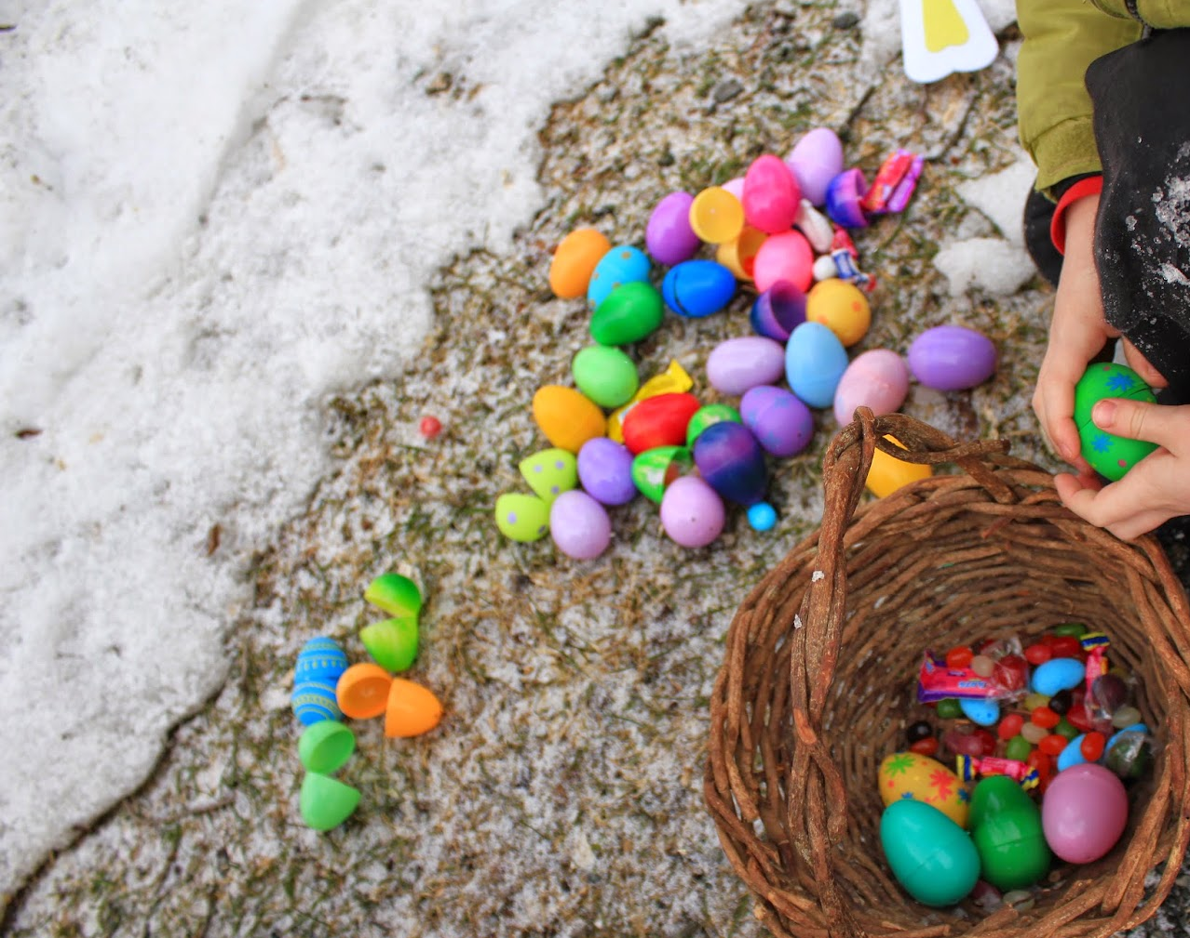
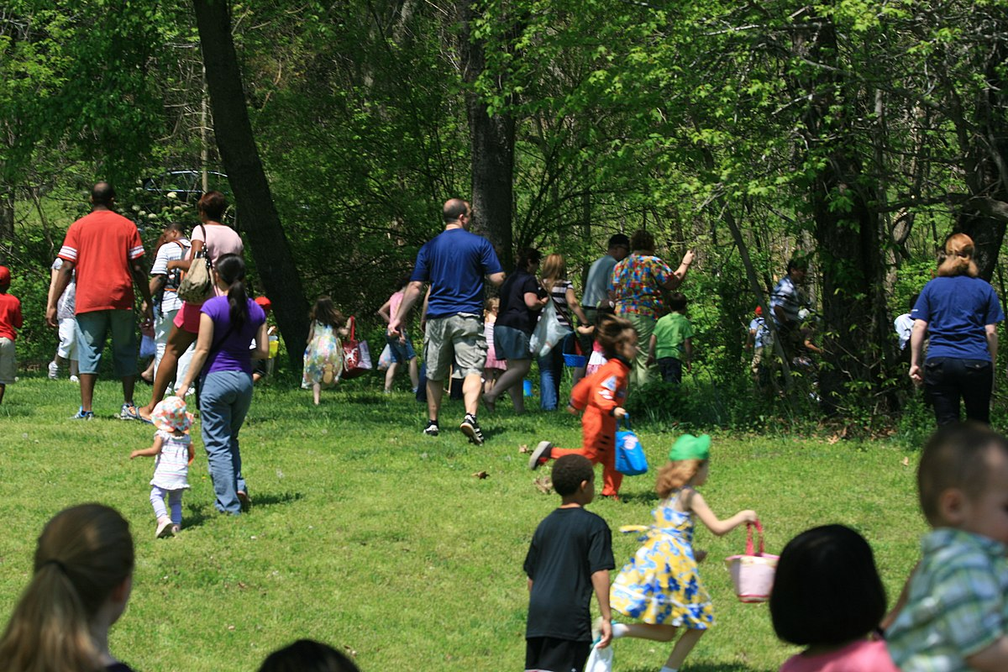
Wyt ti,n hoffi neid helfa wyiau ?
This Photo by Unknown author is licensed under CC BY-SA.
This Photo by Unknown author is licensed under CC BY-SA.

Slide 12
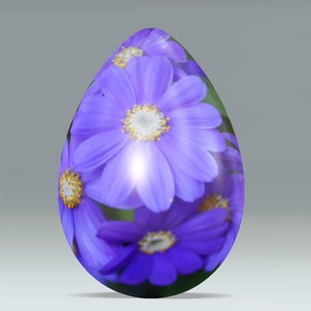
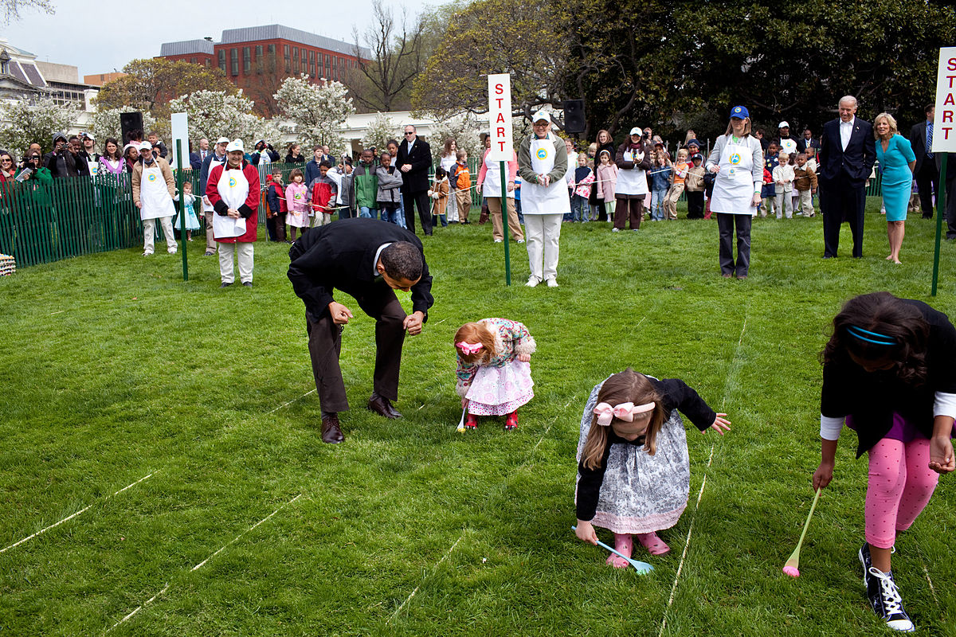
Wyt ti,n hoffi,r Pasg ?
This Photo by Unknown author is licensed under CC BY-SA.
This Photo by Unknown author is licensed under CC BY-NC.

Slide 13
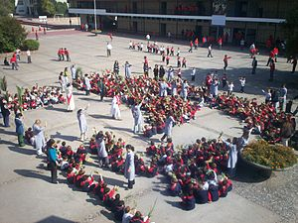
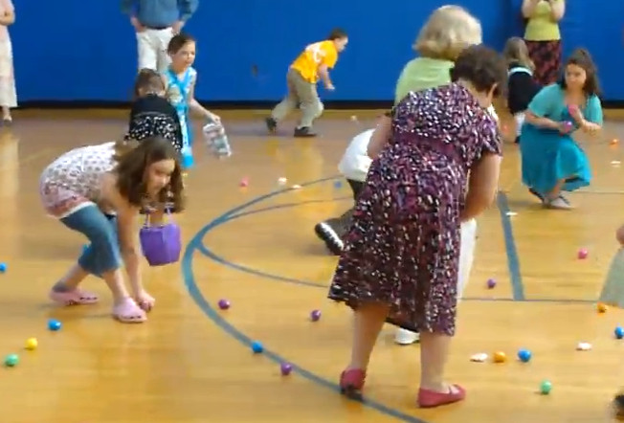
Dewch I ddathlu,r Pasg gyda ni yn ysgol bryn y Mor.
This Photo by Unknown author is licensed under CC BY-SA-NC.
This Photo by Unknown author is licensed under CC BY-SA.

Slide 14
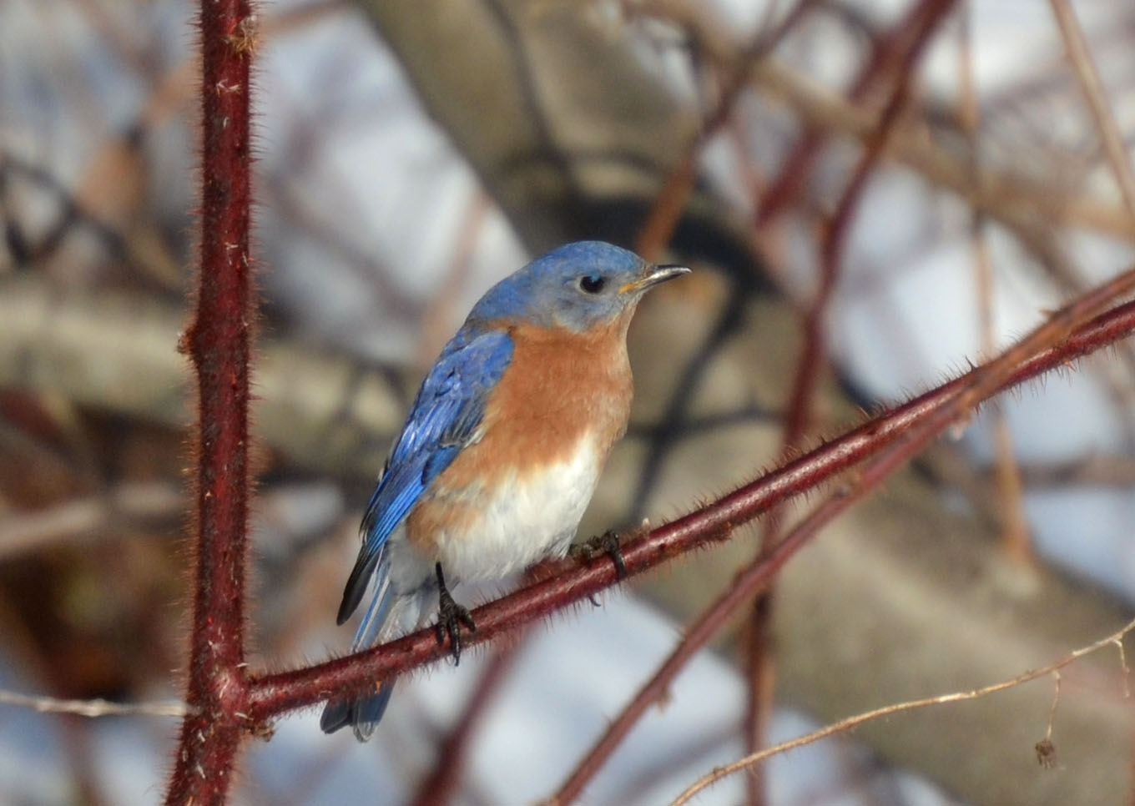
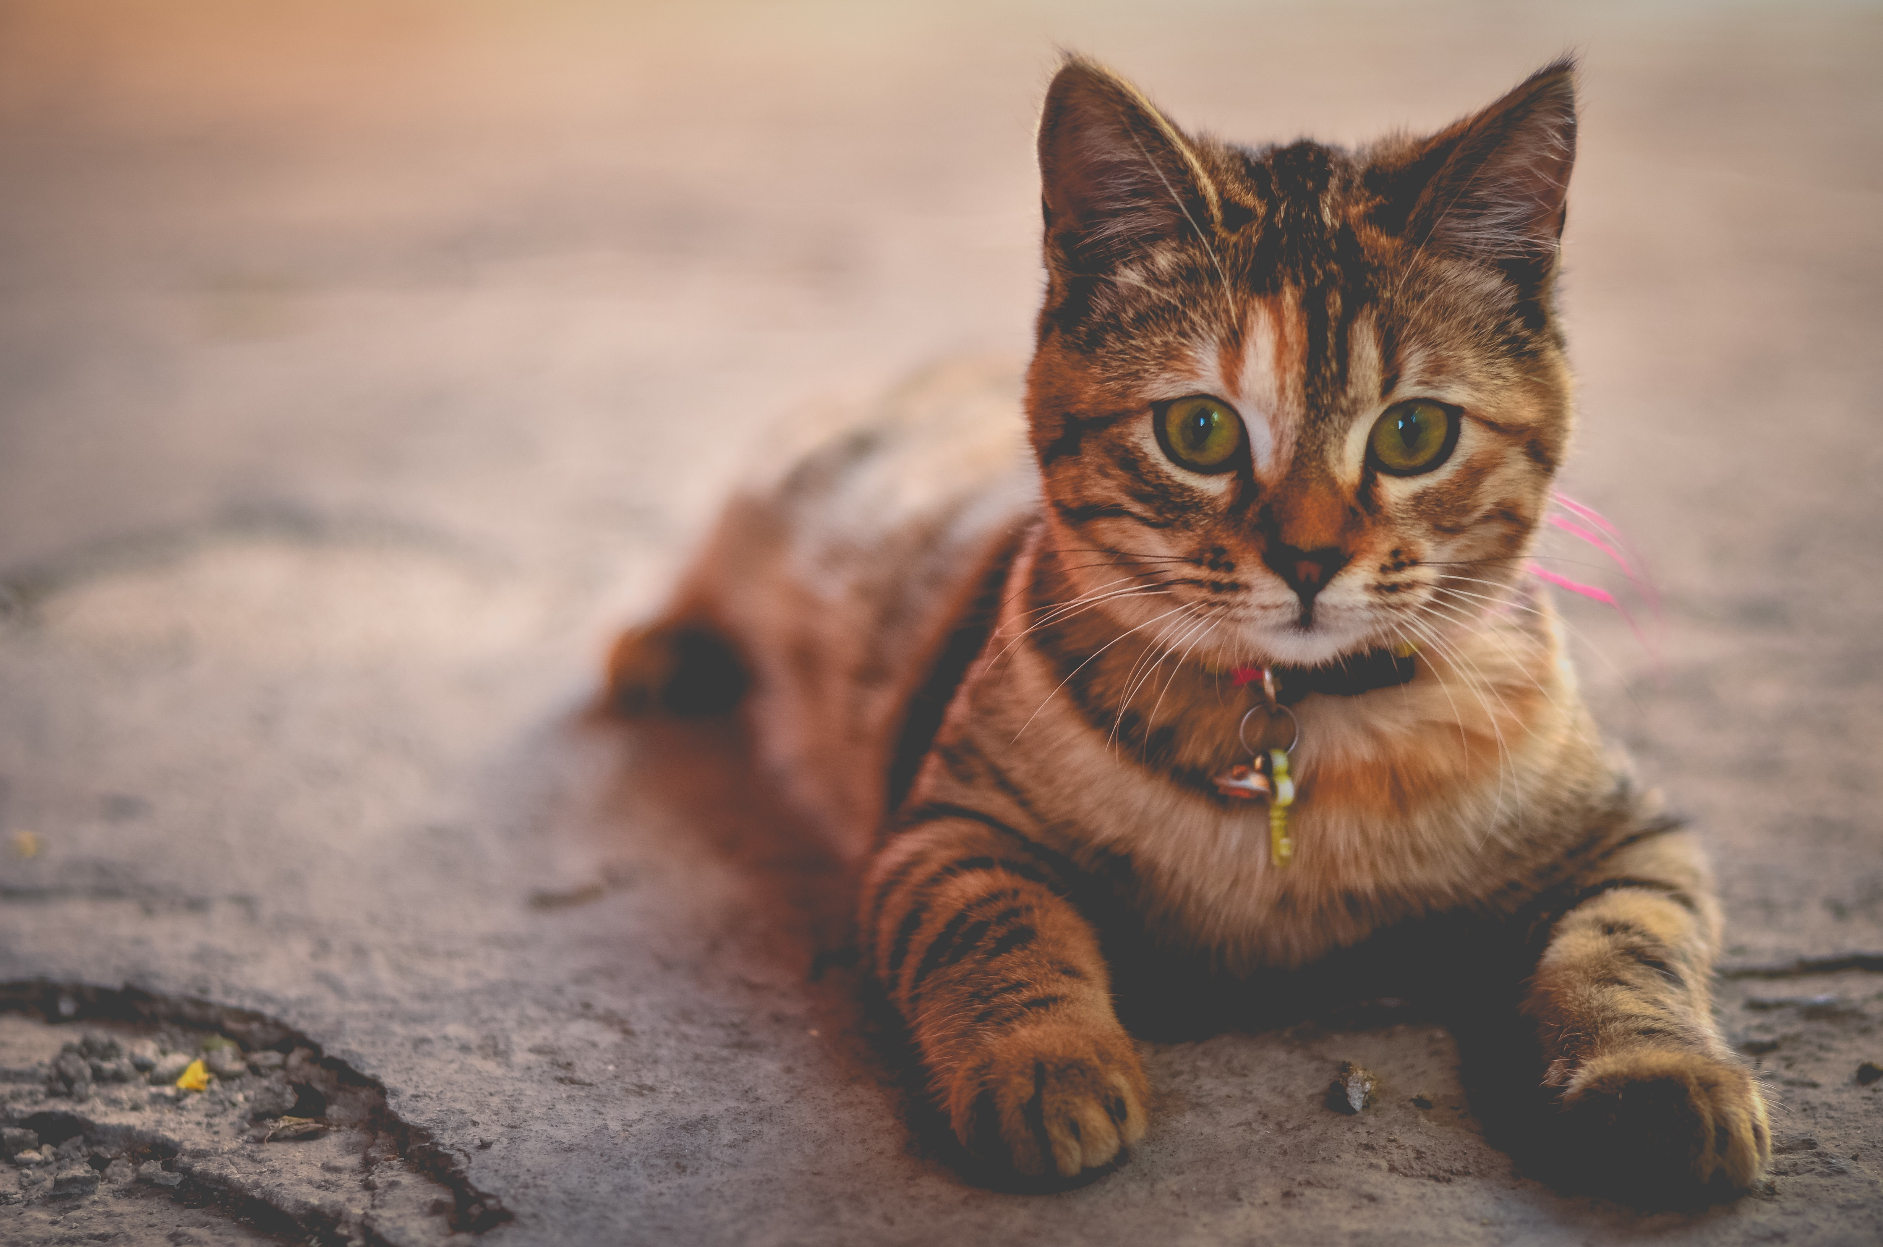
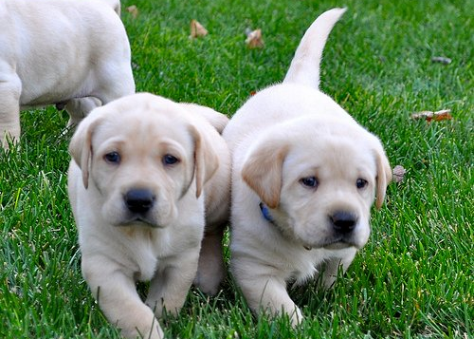
Beth os mae,r anifeliaud yn dathlu,r Pasg ?
This Photo by Unknown author is licensed under CC BY-SA-NC.
This Photo by Unknown author is licensed under CC BY-SA.

Slide 15
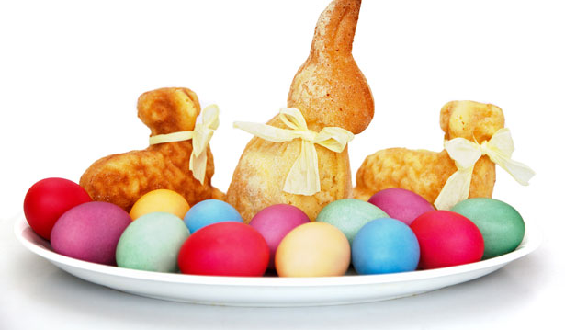
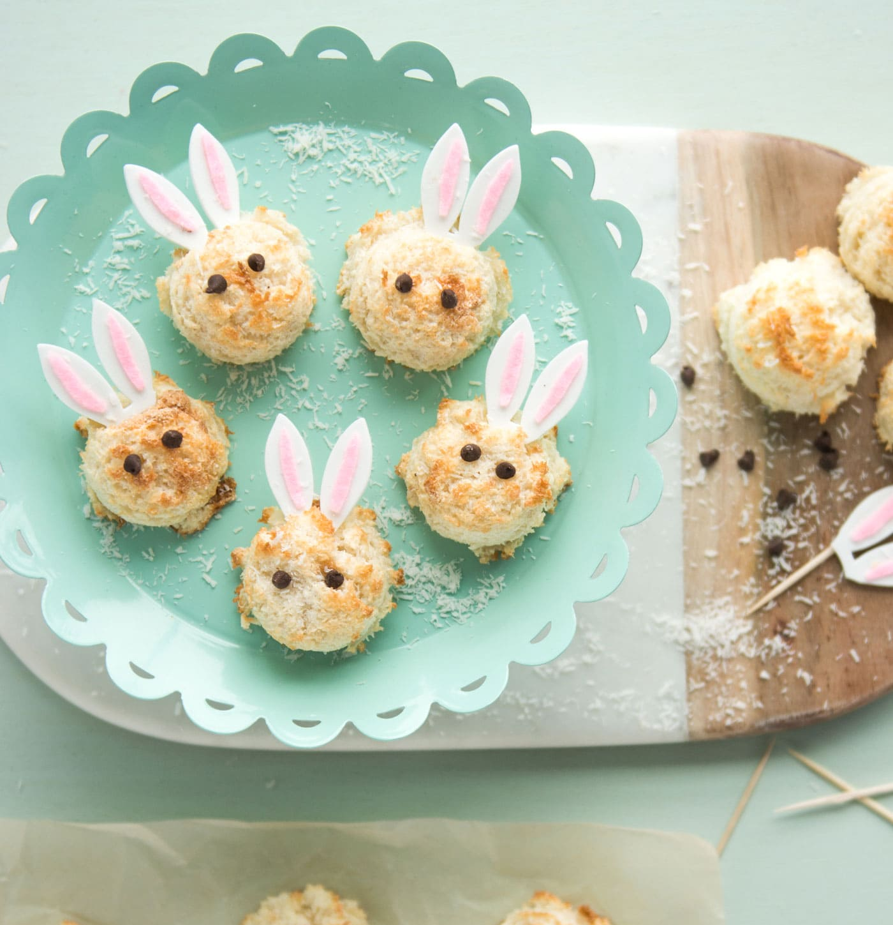
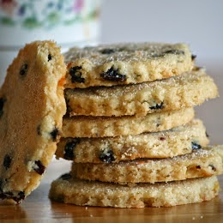
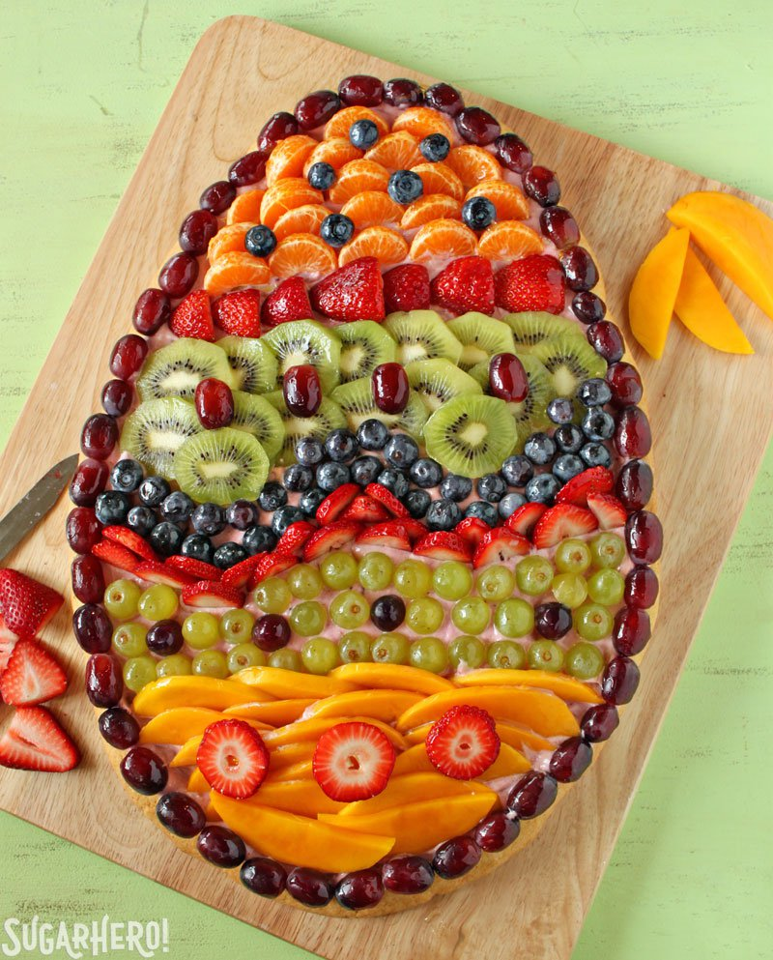
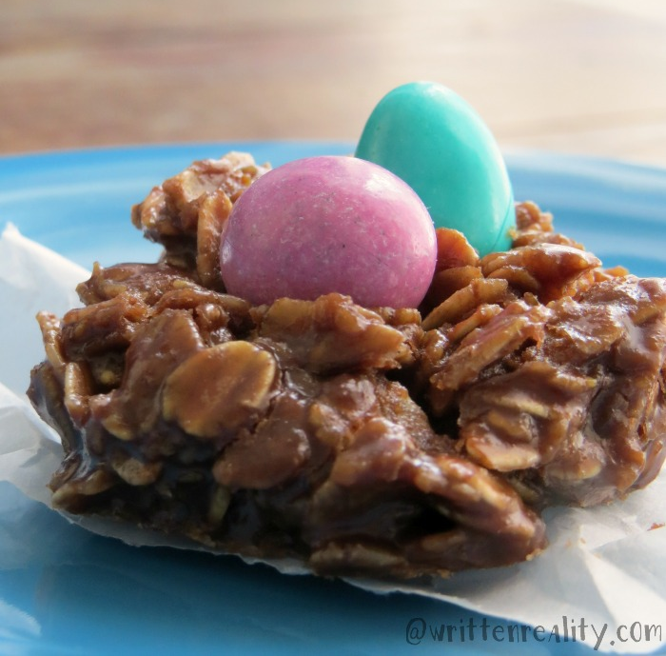
Wyt ti,n hoffi,r bwyd Pasg ?
This Photo by Unknown author is licensed under CC BY-NC-ND.
This Photo by Unknown author is licensed under CC BY-SA-NC.
This Photo by Unknown author is licensed under CC BY-SA-NC.
This Photo by Unknown author is licensed under CC BY.

Slide 16
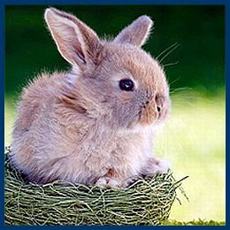
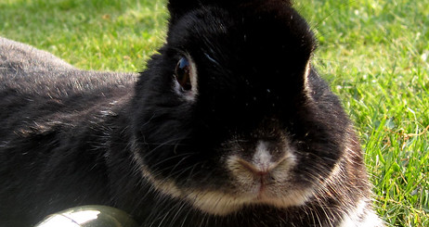
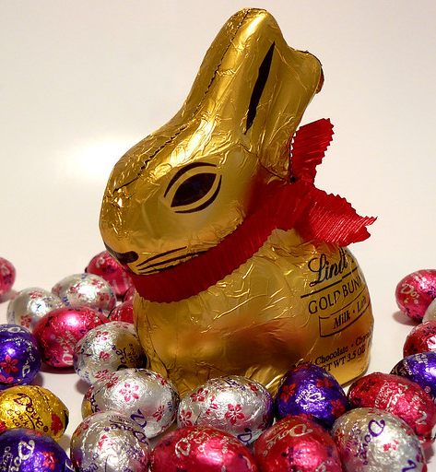
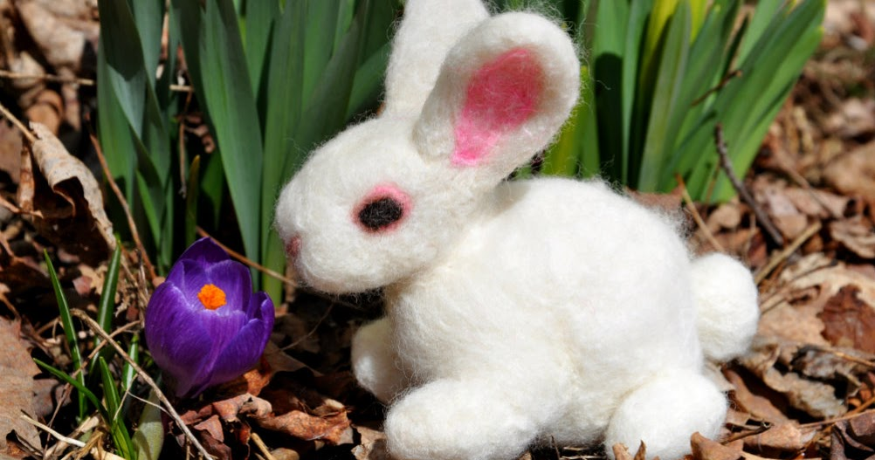
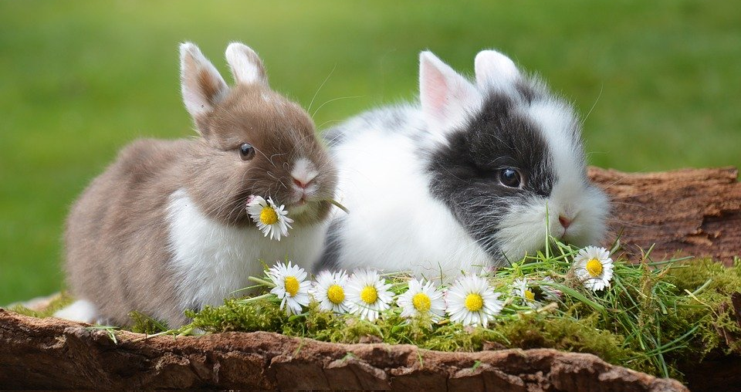
Wyt ti,n hoffi,r cwningen Pasg ?
This Photo by Unknown author is licensed under CC BY.
This Photo by Unknown author is licensed under CC BY-SA-NC.
This Photo by Unknown author is licensed under CC BY-ND.
This Photo by Unknown author is licensed under CC BY-NC-ND.

Slide 17
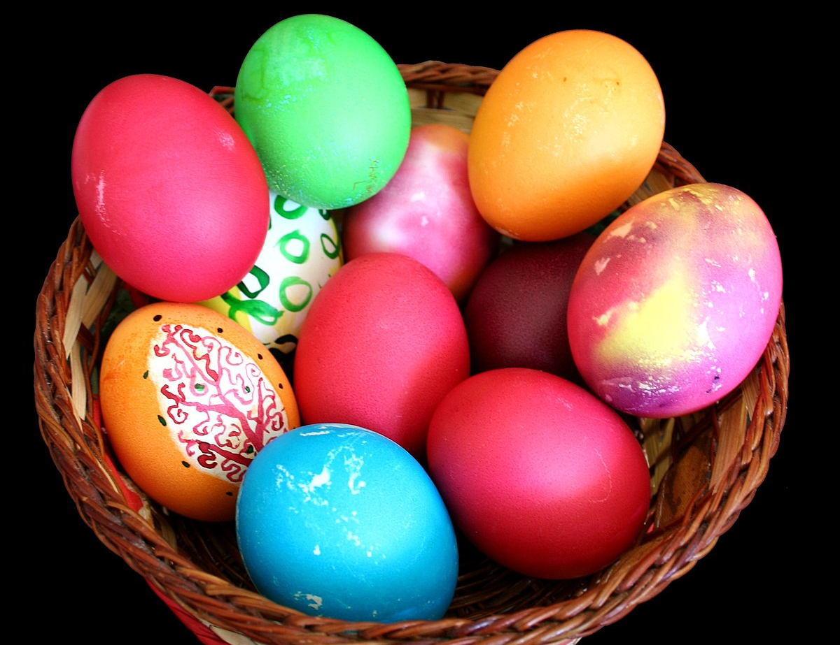
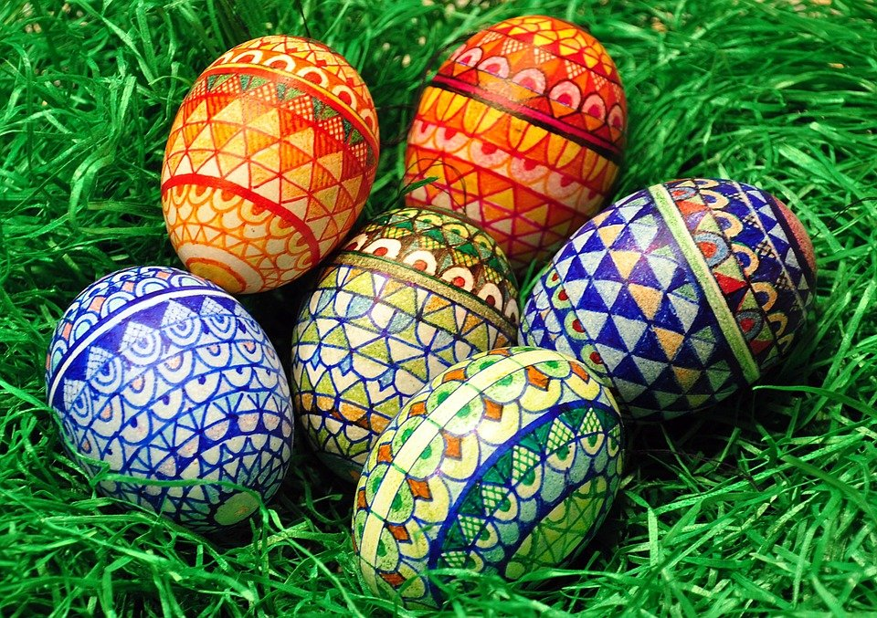

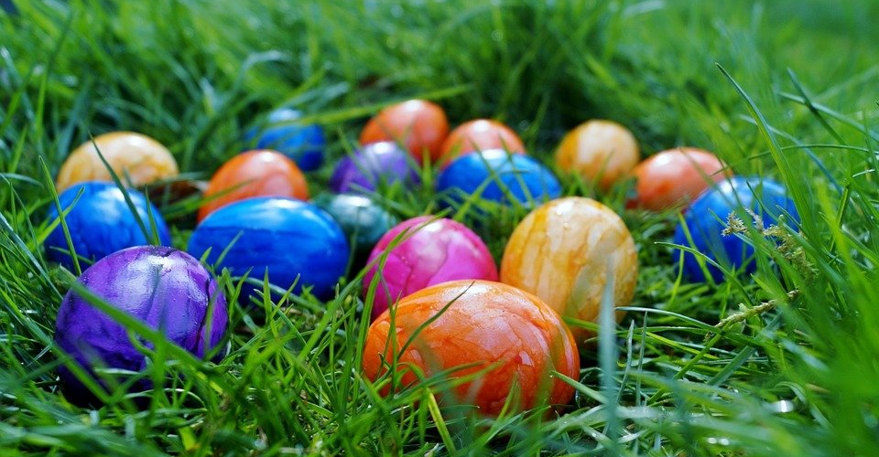
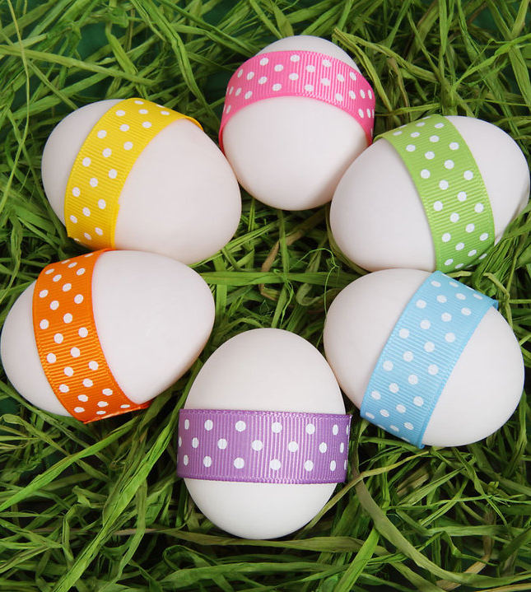
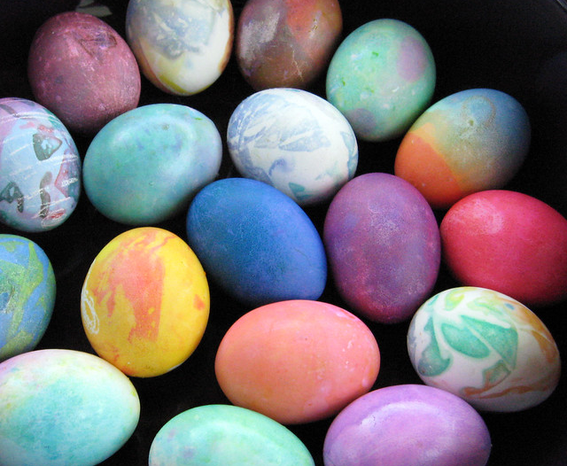
Wyt ti,n hoffi wyai Pasg ?
This Photo by Unknown author is licensed under CC BY-SA.
This Photo by Unknown author is licensed under CC BY.
This Photo by Unknown author is licensed under CC BY.

Slide 18



Y dwedd
This Photo by Unknown author is licensed under CC BY-SA.
This Photo by Unknown author is licensed under CC BY.

