Slide 1
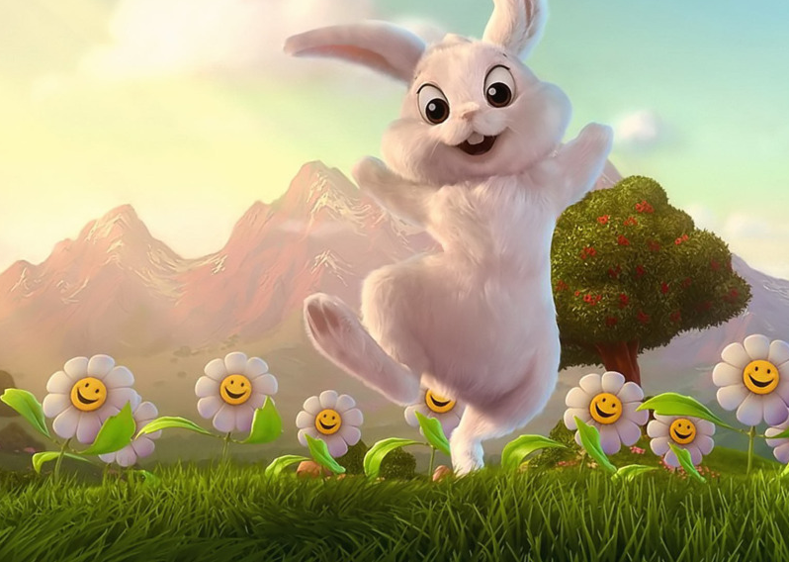
Pasg
Gan Lucian a Mali.
This Photo by Unknown author is licensed under CC BY.

Slide 2
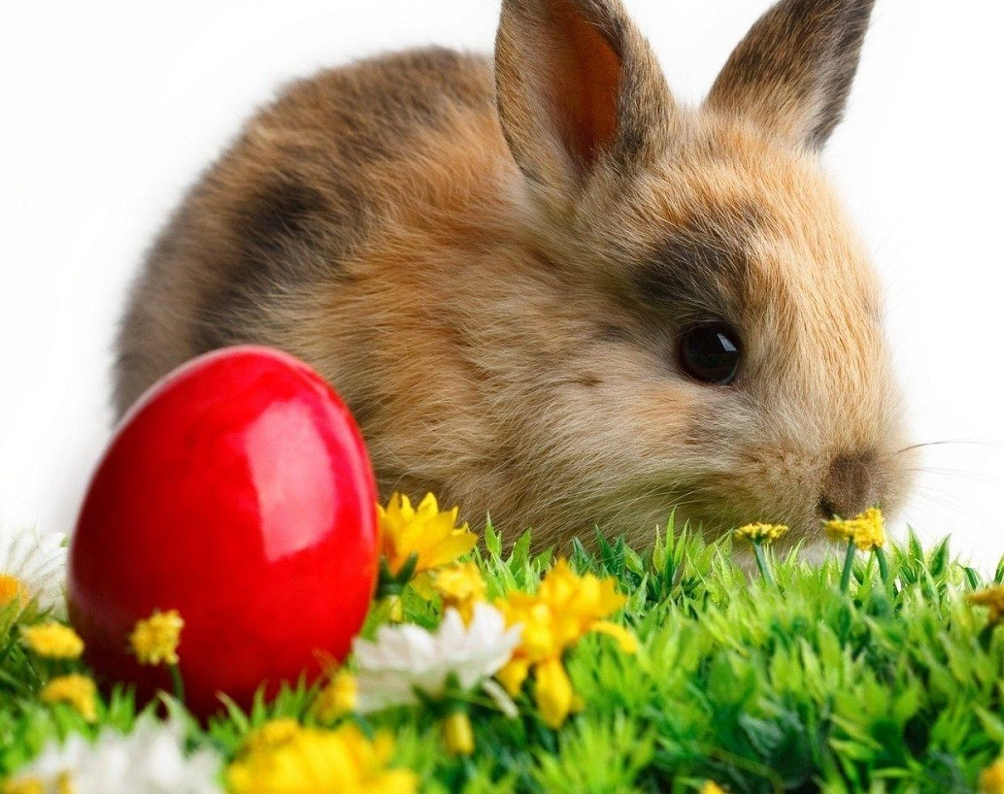
Mae'r cwningen Pasg yn dod a wyau I bawb.
Dyma llun o'r cwningen pasg.
This Photo by Unknown author is licensed under CC BY-SA.

Slide 3
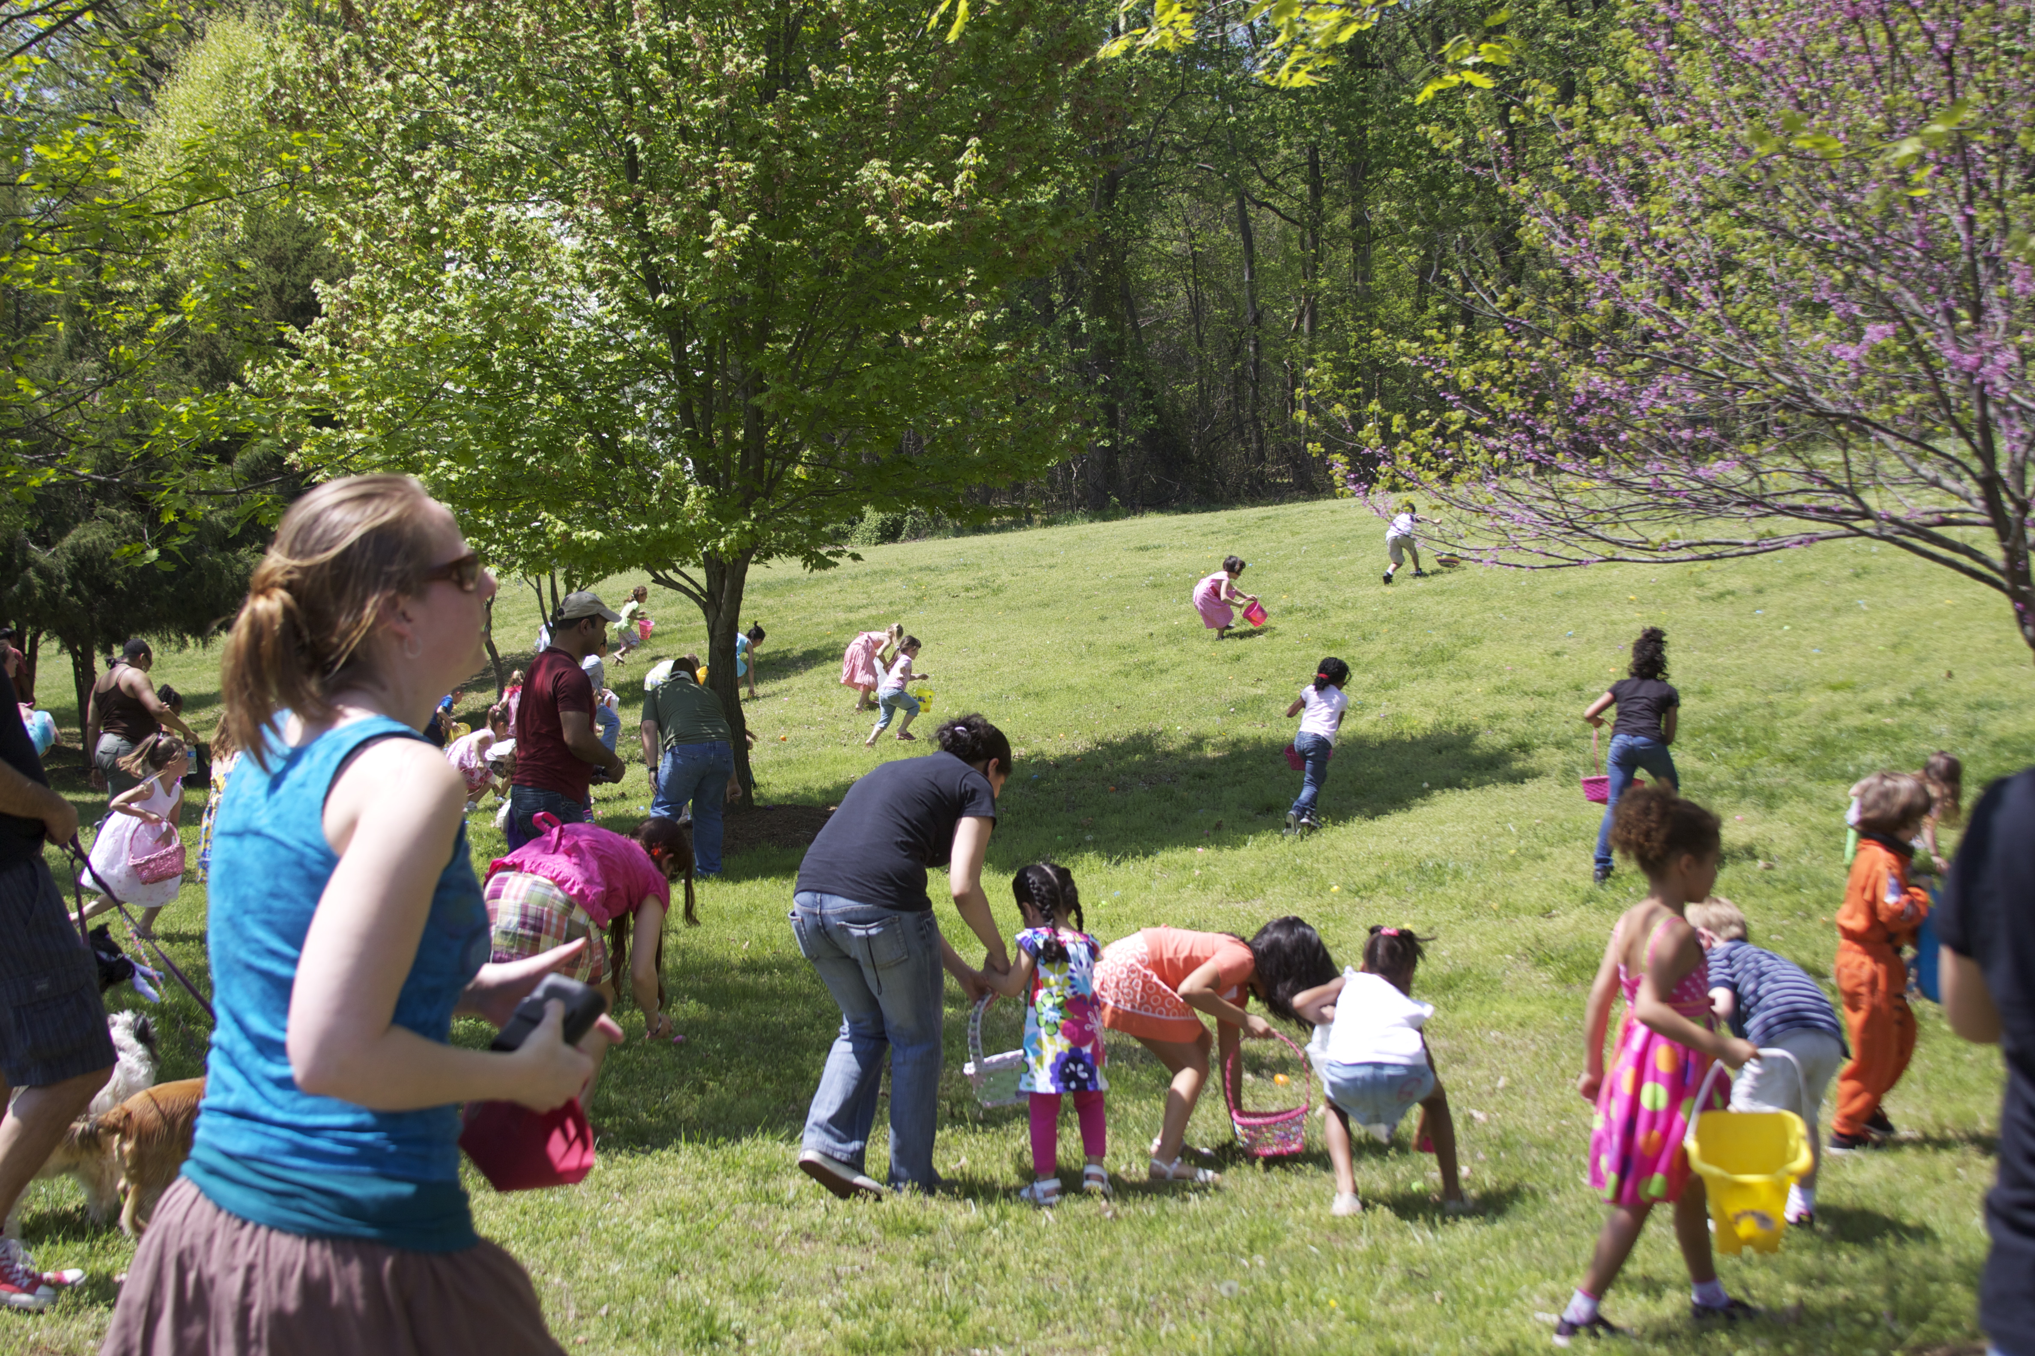
Rydym yn cael helfa wyau.
Dyma llun o helfa wyau.
This Photo by Unknown author is licensed under CC BY-SA.

Slide 4

Rwyn carur Pasg
Dyma llun y croes.
This Photo by Unknown author is licensed under CC BY-SA.

Slide 5
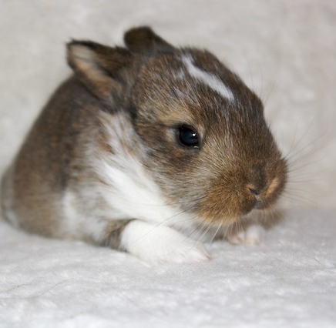
Mae anifeliaid yn atgofodi.
Dyma llun o cwningen.
This Photo by Unknown author is licensed under CC BY-SA-NC.

Slide 6
Pasg
Gan Lucian a Mali
This Photo by Unknown author is licensed under CC BY.

