Slide 1
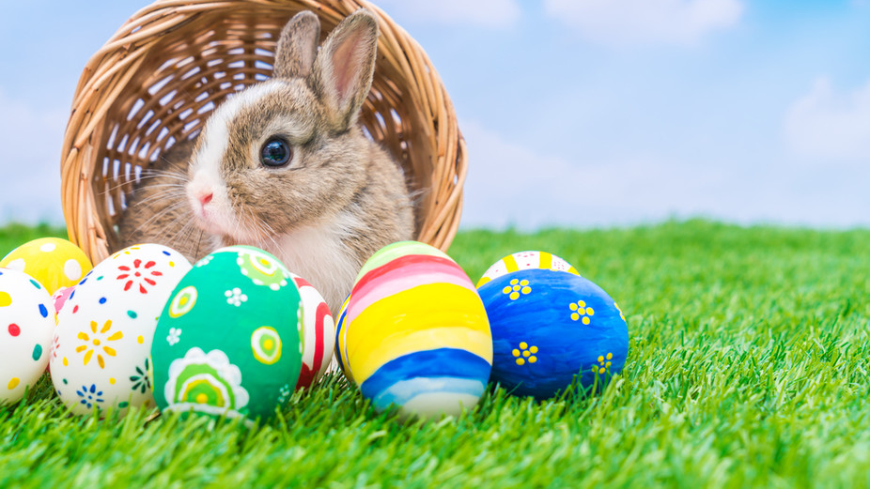
Y Pasg
Gan Lawson +Milo
This Photo by Unknown author is licensed under CC BY-SA-NC.

Slide 2
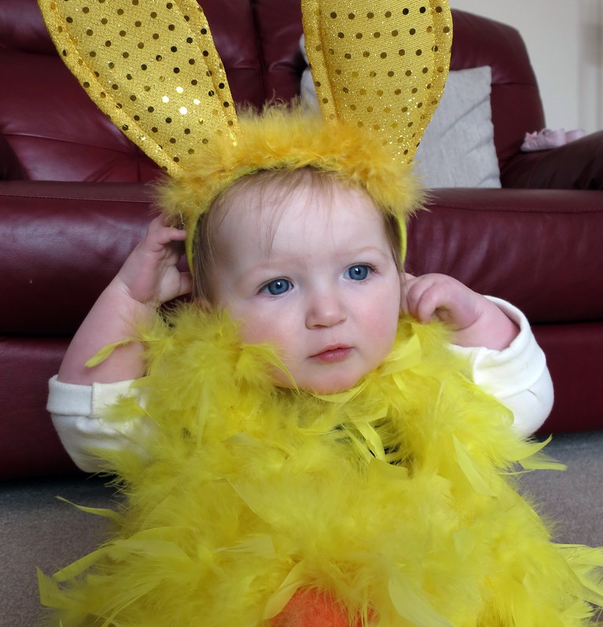
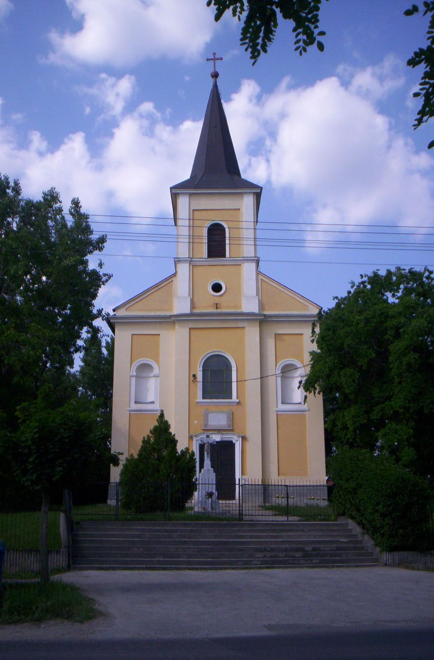
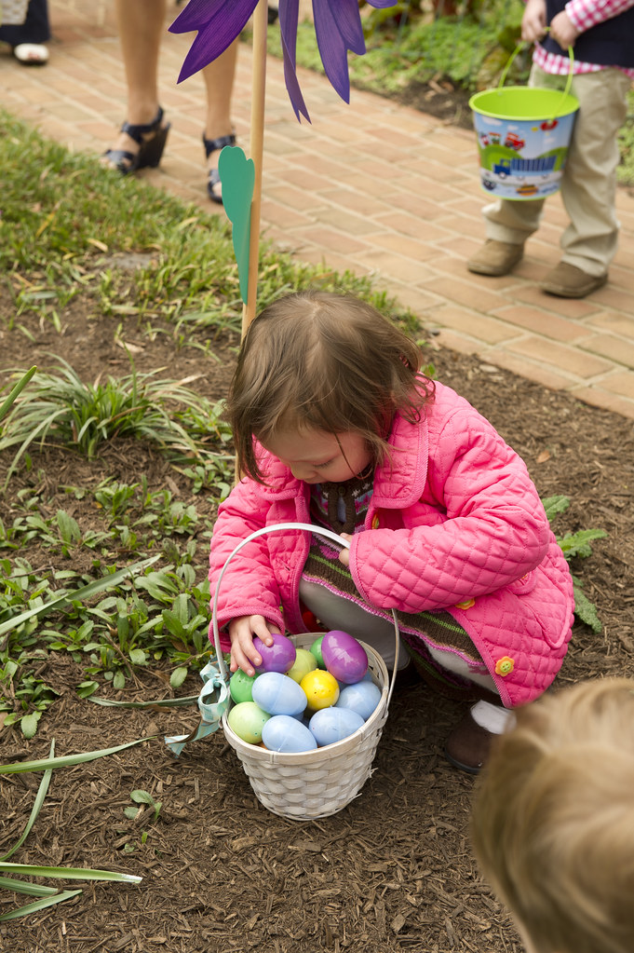
Sut ydyn ni dathlu Pasg?
Rydyn ni'n gallu mynd I'r capel neuaros gatref.
SA-NC.

Slide 3
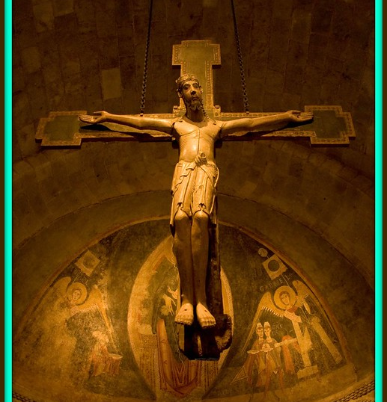
Pam ydyn ni'n dathlu'r Pasg?
I ddatthlu Iesu Grist yn
Atgyfodi.
I ddatlu bywyd newydd.
This Photo by Unknown author is licensed under CC BY.

Slide 4
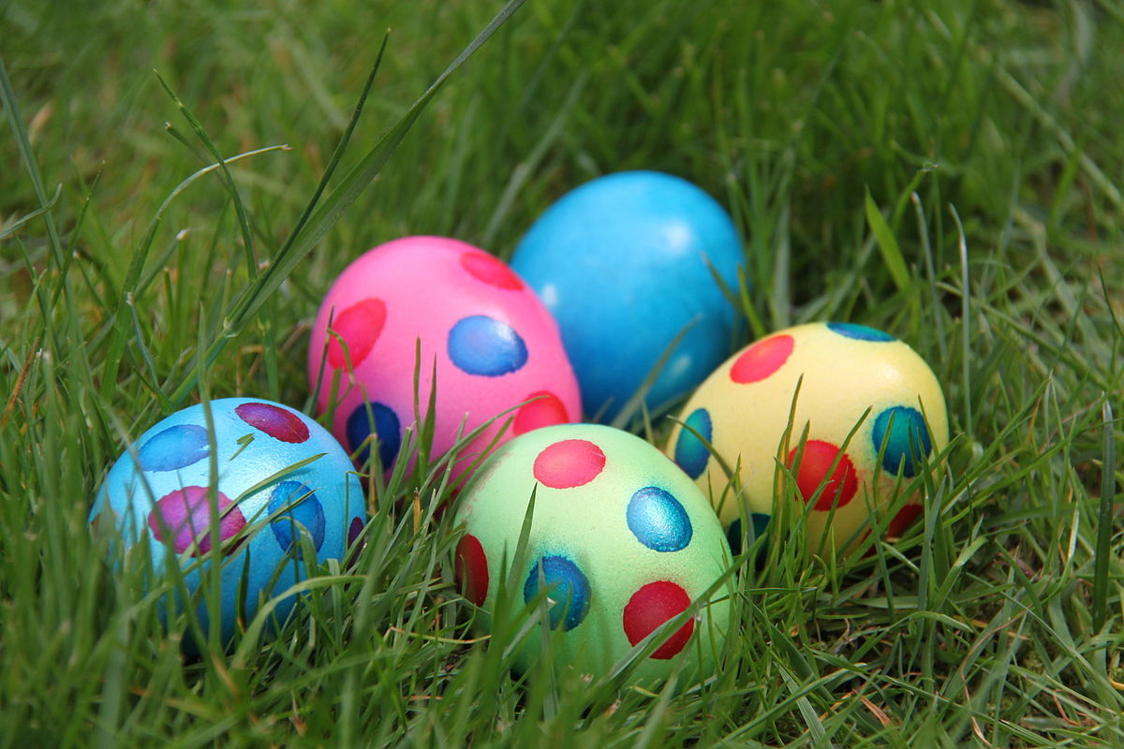
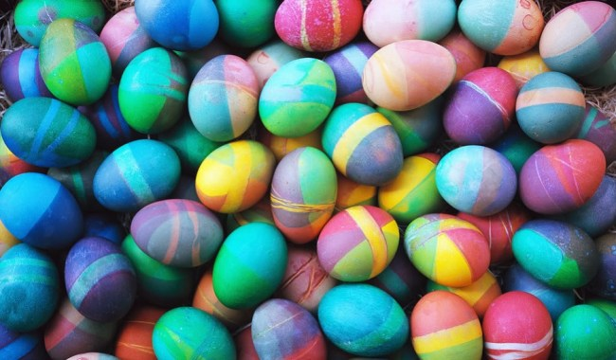
Rwy'n caru'r Pasg!
Wyau bach flasis
YUM YUM YUM!!
This Photo by Unknown author is licensed under CC BY-NC-ND.
This Photo by Unknown author is licensed under CC BY-SA.

