Slide 1
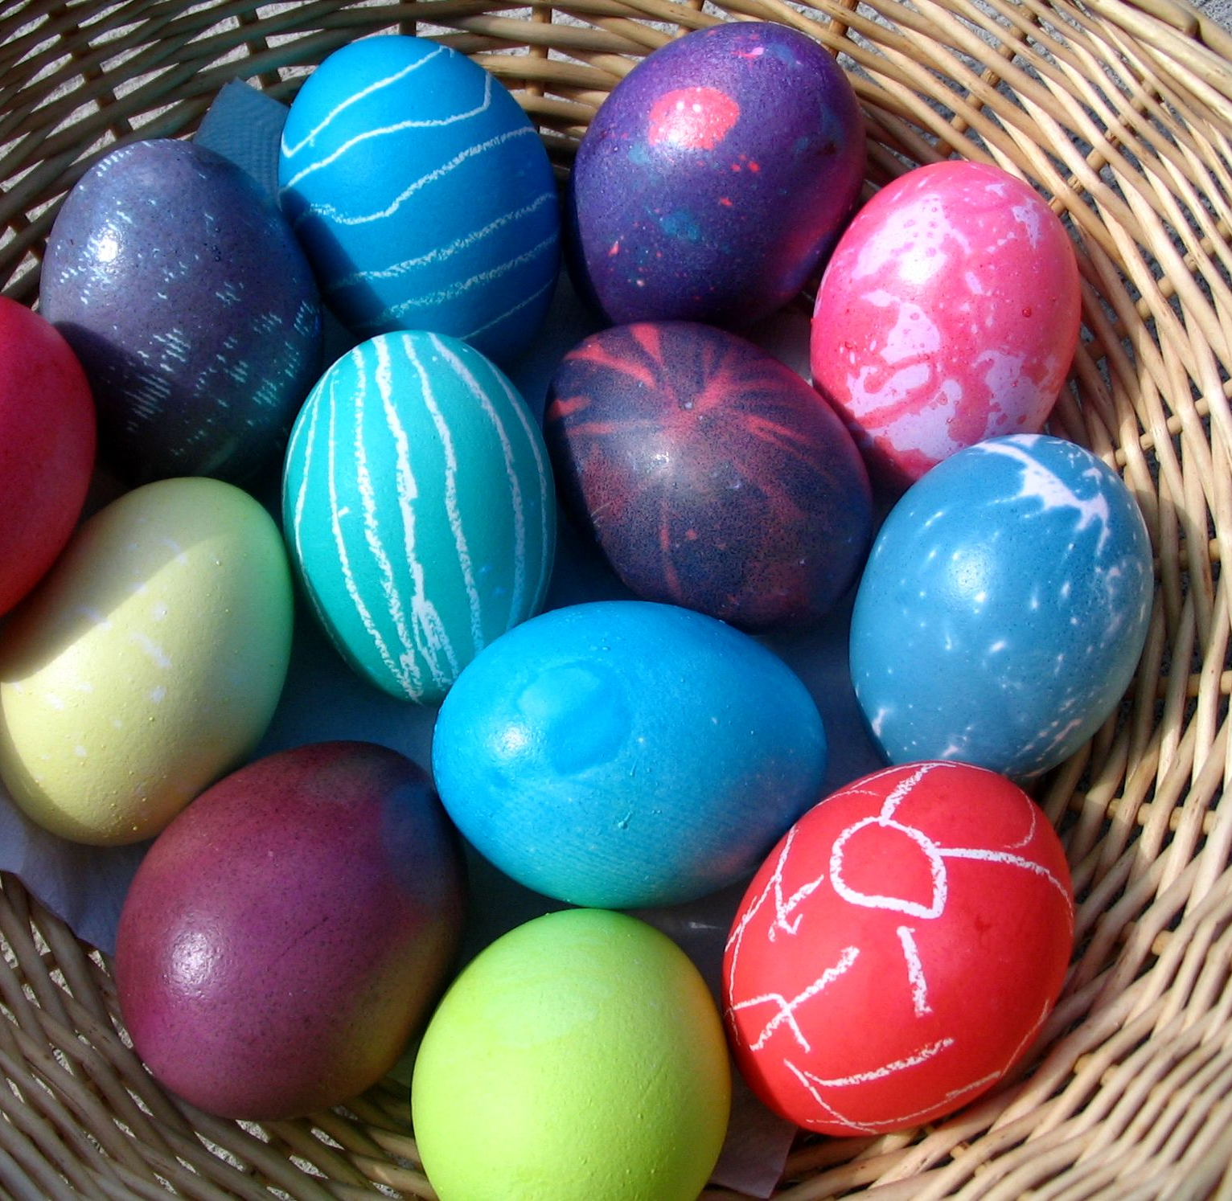
Y Pasg
Gan Ruby a Damien
This Photo by Unknown author is licensed under CC BY-SA.

Slide 2
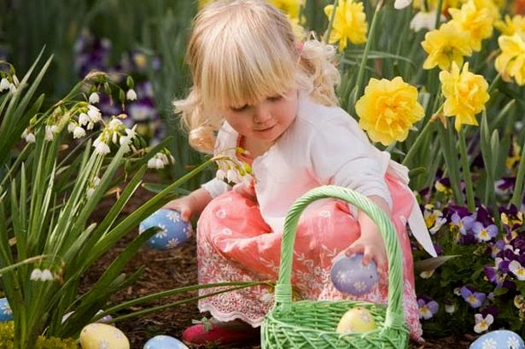
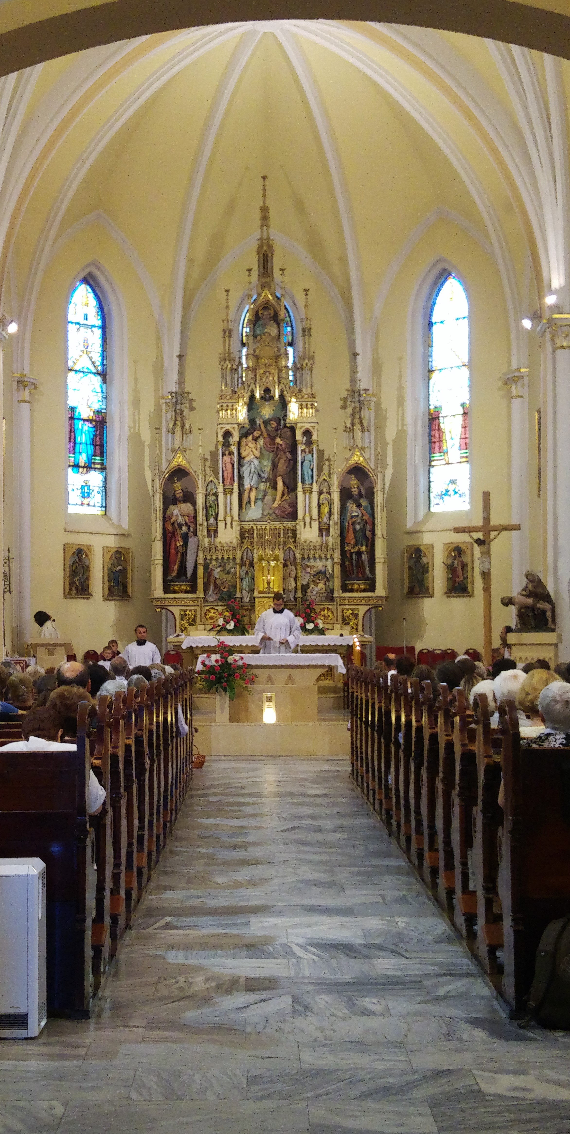
Ble mae pobol yn dathlu pasg?
gatref
Mewn eglwys
This Photo by Unknown author is licensed under CC BY-SA-NC.
This Photo by Unknown author is licensed under CC BY-SA.

Slide 3
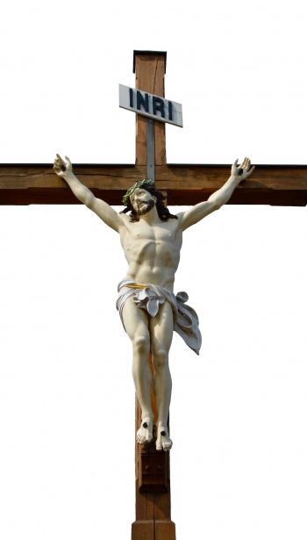

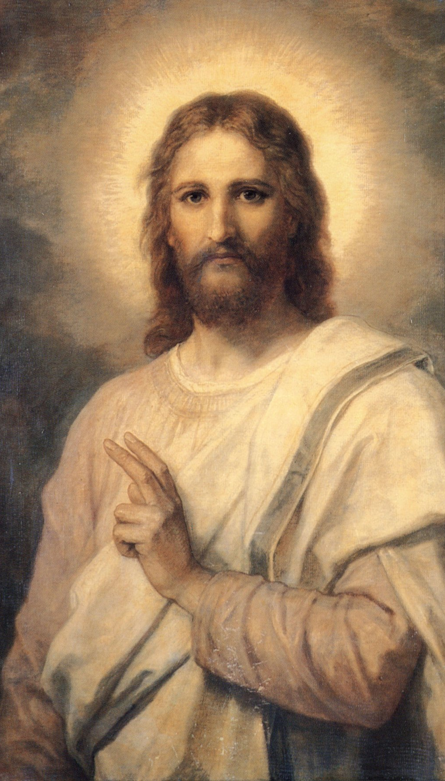
sssssssssssssssssssssssssss
Roedd Iesu Grist wedi marw ar y groes ond roedd 'e wedi dod nol I fyw.
This Photo by Unknown author is licensed under CC BY-SA.

Slide 4
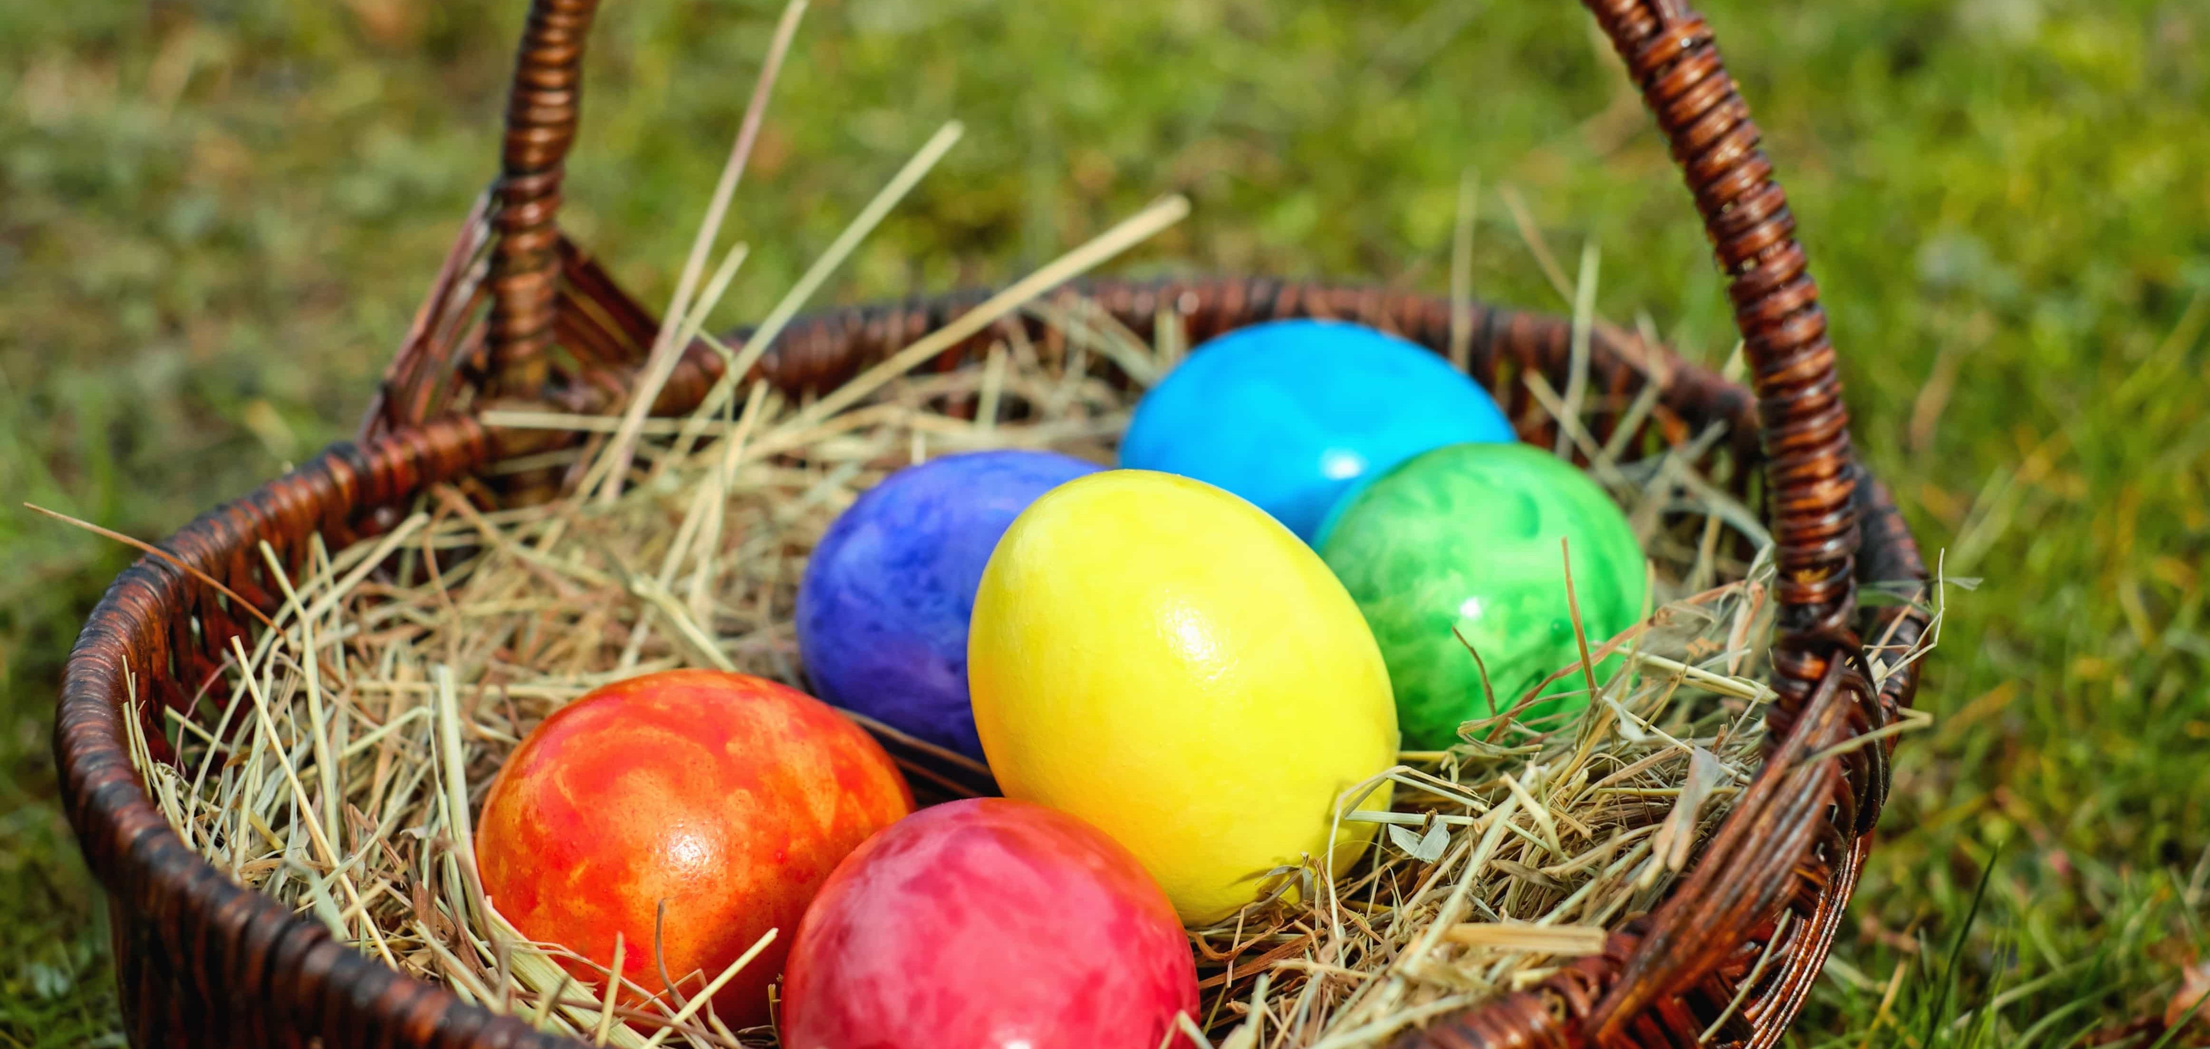
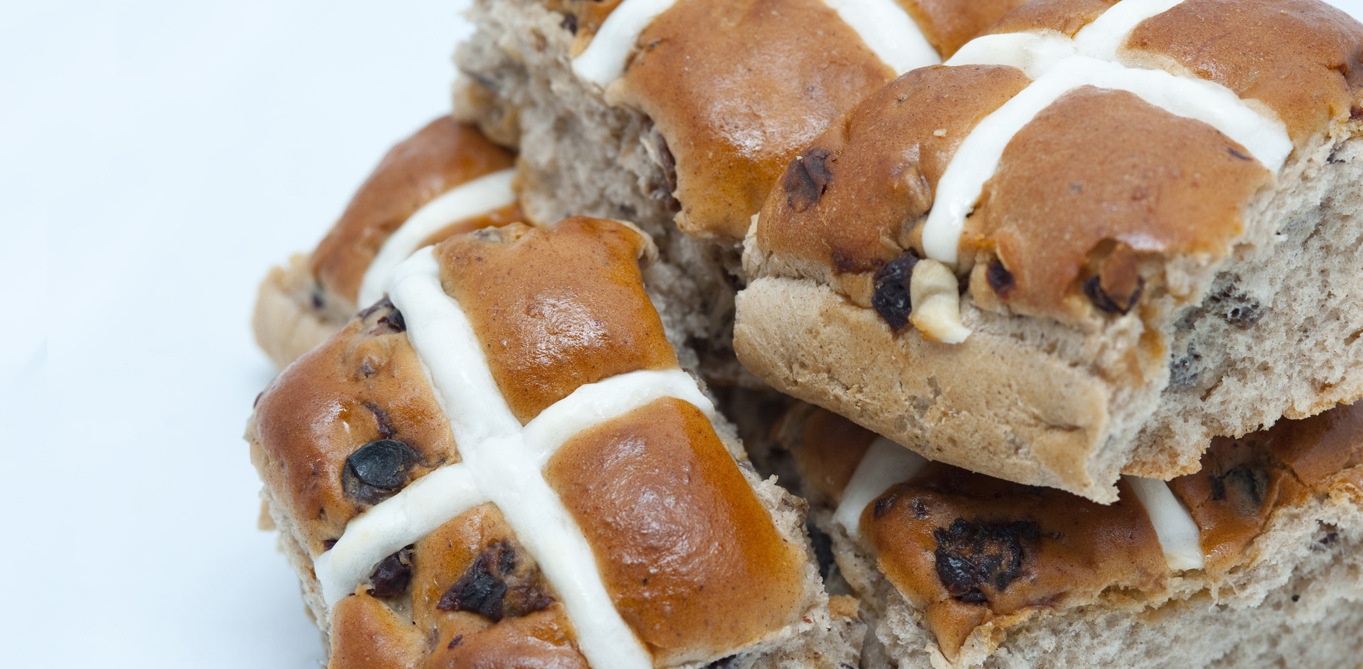
Bwyd Pasg.
Rydim yn bwyta wyau Pasg
A Bunsen croes poeth. Yum yum
This Photo by Unknown author is licensed under CC BY.

Slide 5
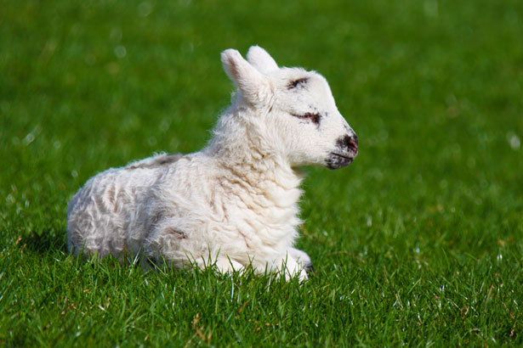
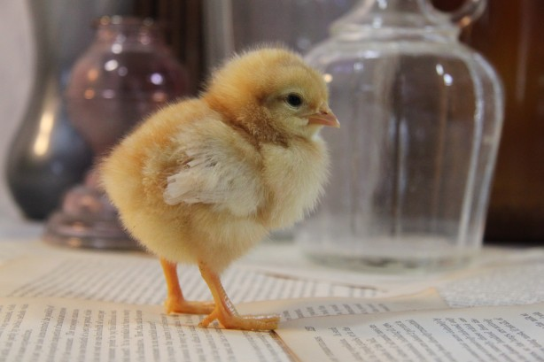
Anifailiad Pasg.
Mae wyn yn cael ei geni.
Ac mae cywion yn cael ei geni hefyd.

Slide 6
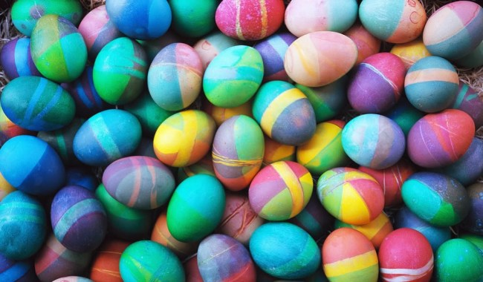
Y diwedd
This Photo by Unknown author is licensed under CC BY-NC-ND.

