Slide 1
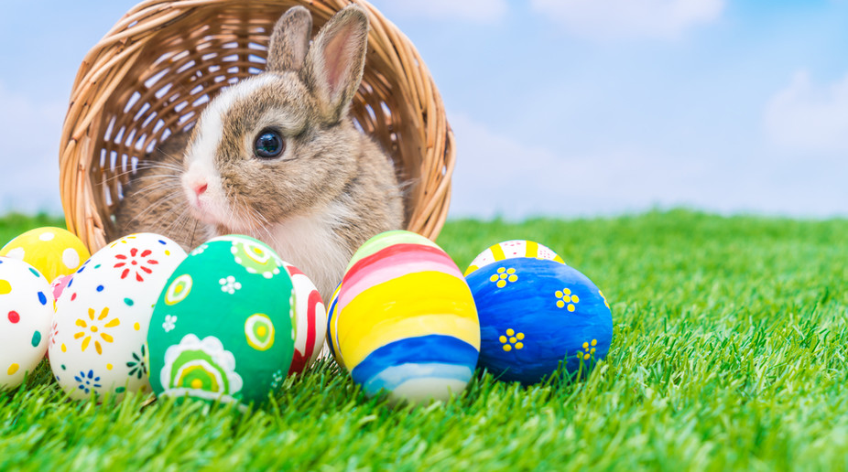
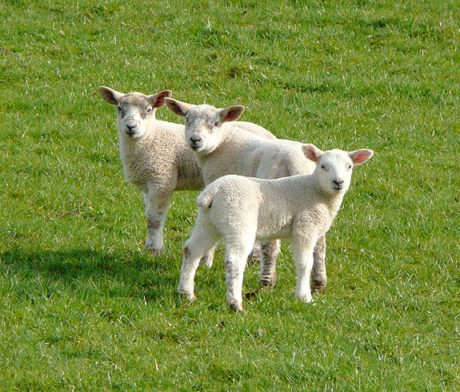
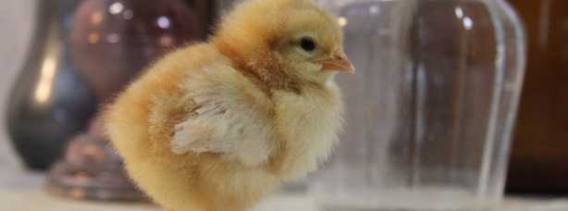
Y Pasg
Gan Anwen a Soffia
This Photo by Unknown author is licensed under CC BY-SA.
This Photo by Unknown author is licensed under CC BY-SA-NC.

Slide 2
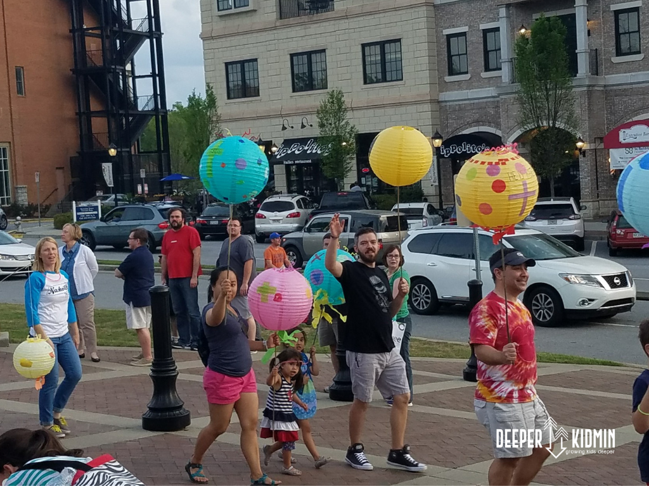
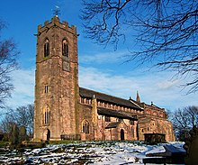
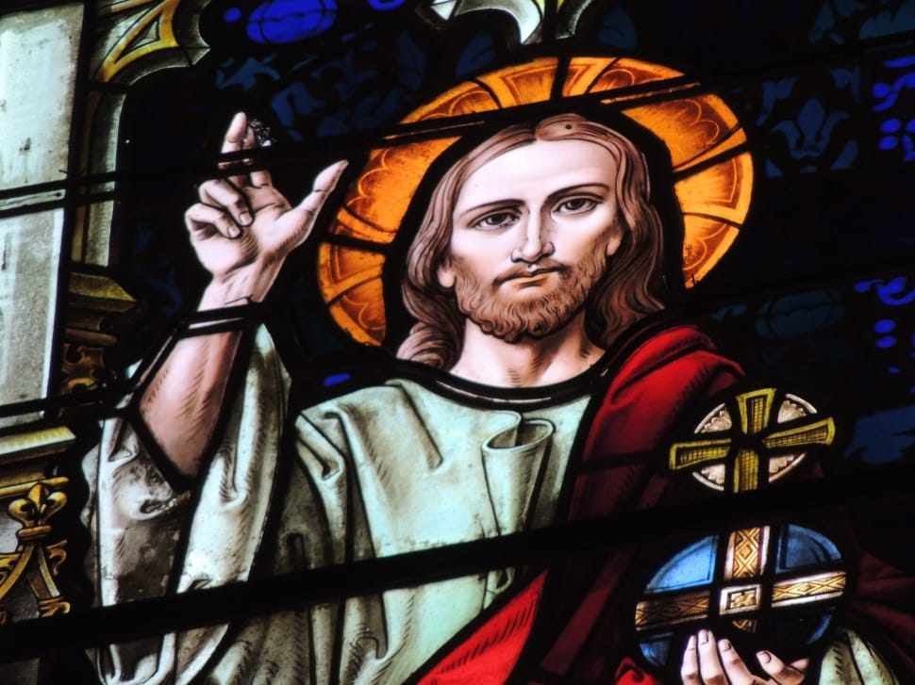
Pwy sy' n dathlu'r Pasg?
Mae pawb yn gallu dathlur Pasg!!!!!!!!!!!!
Stim ots pwy ti yn.
This Photo by Unknown author is licensed under CC BY-NC.
This Photo by Unknown author is licensed under CC BY-SA.

Slide 3
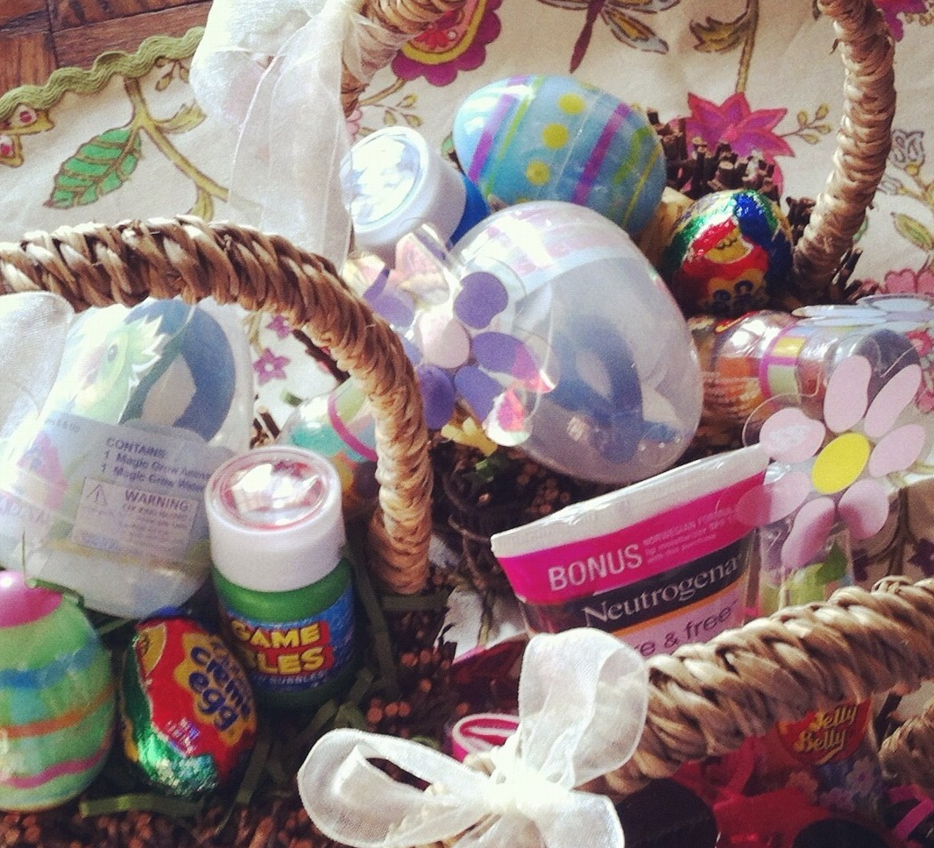
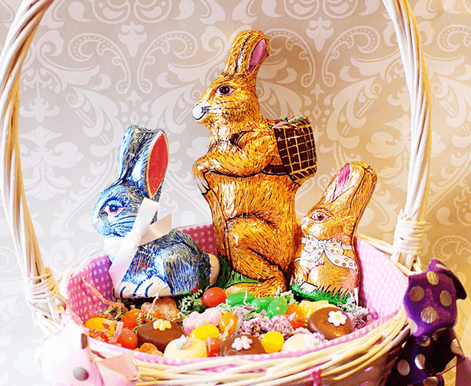
Ble wyt ti' n dathlu'r Pasg?
This Photo by Unknown author is licensed under CC BY-NC-ND.
This Photo by Unknown author is licensed under CC BY.

Slide 4
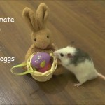
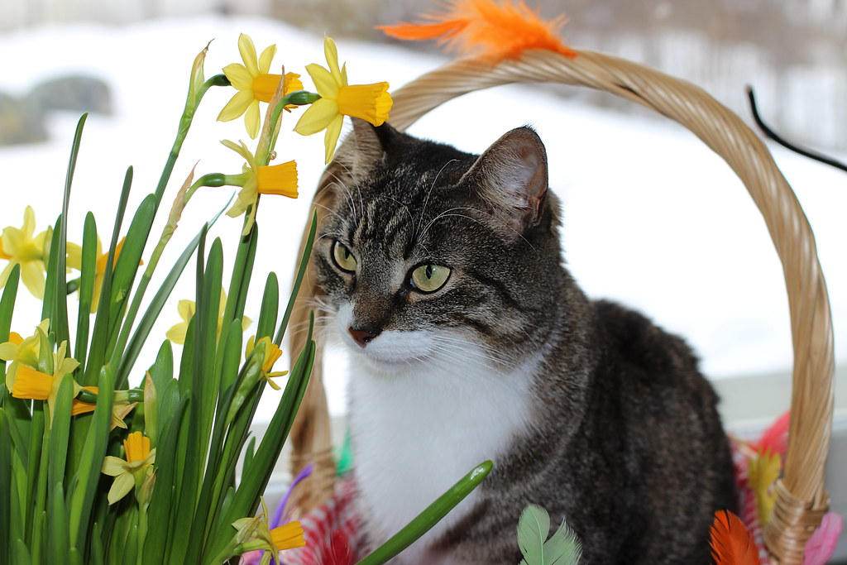
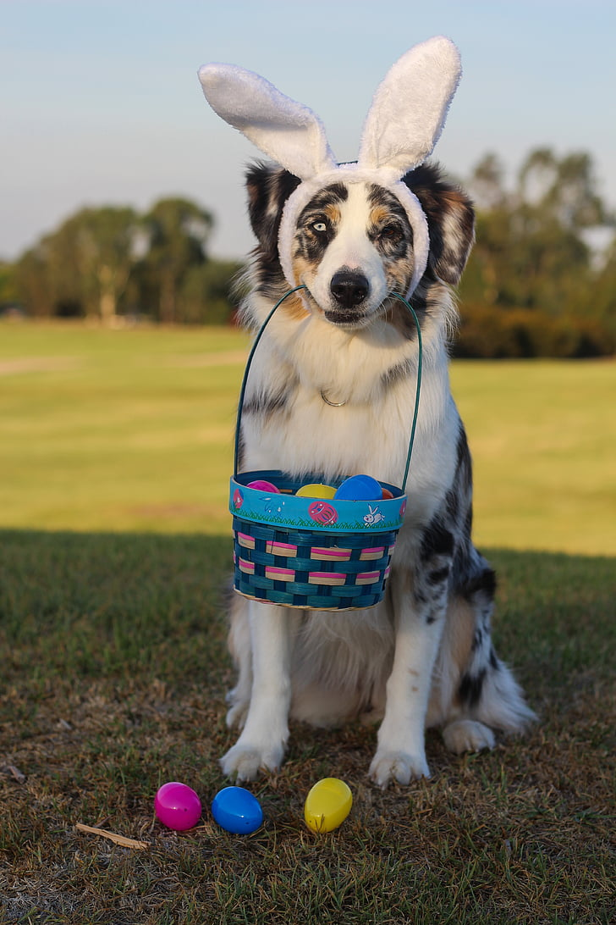
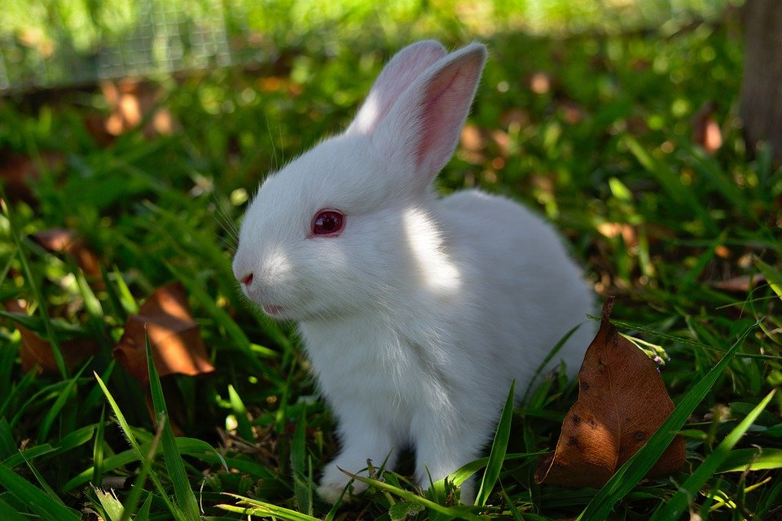
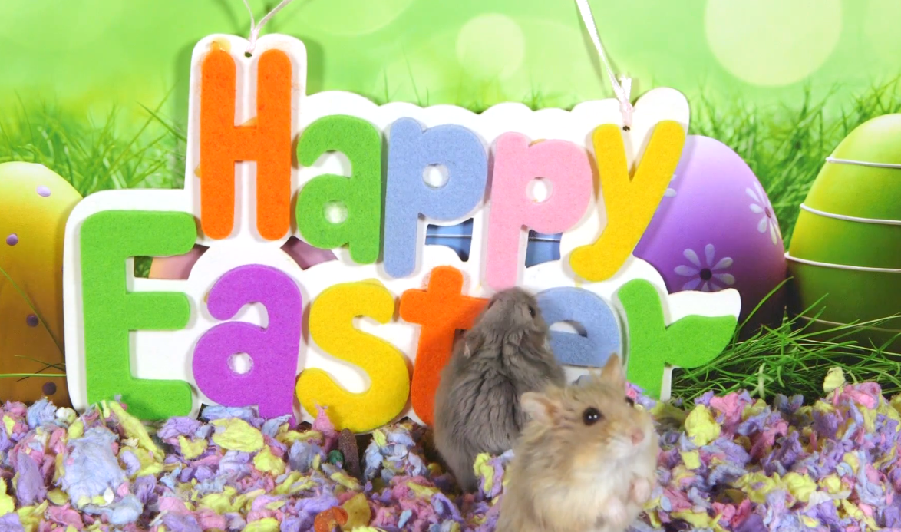
Beth am ddathlu'r Pasg gyda anifeiliaid?
Fel cath, ci, bochdew a llygoden a cwningen.
This Photo by Unknown author is licensed under CC BY-NC-ND.
This Photo by Unknown author is licensed under CC BY-SA-NC.

Slide 5
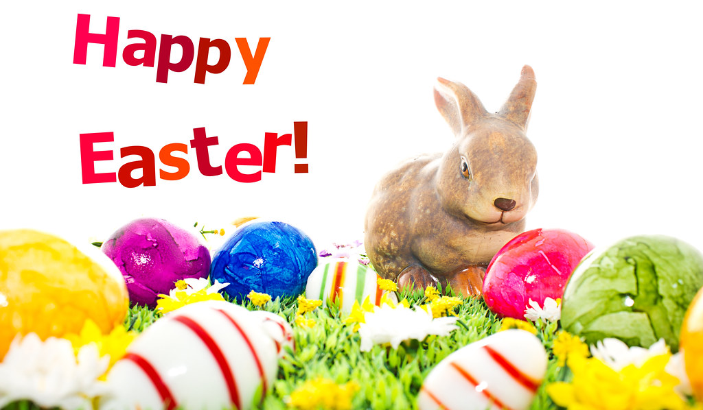


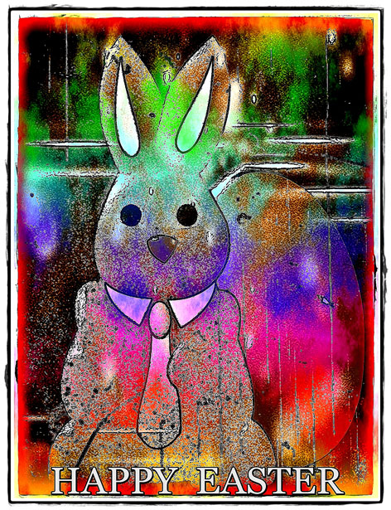

Pasg hapus!!!!!!
Happy Easter!!!!!!!
This Photo by Unknown author is licensed under CC BY.
This Photo by Unknown author is licensed under CC BY-ND.

