Slide 1
Sut fyddwch yn mesur…… ?

Slide 2
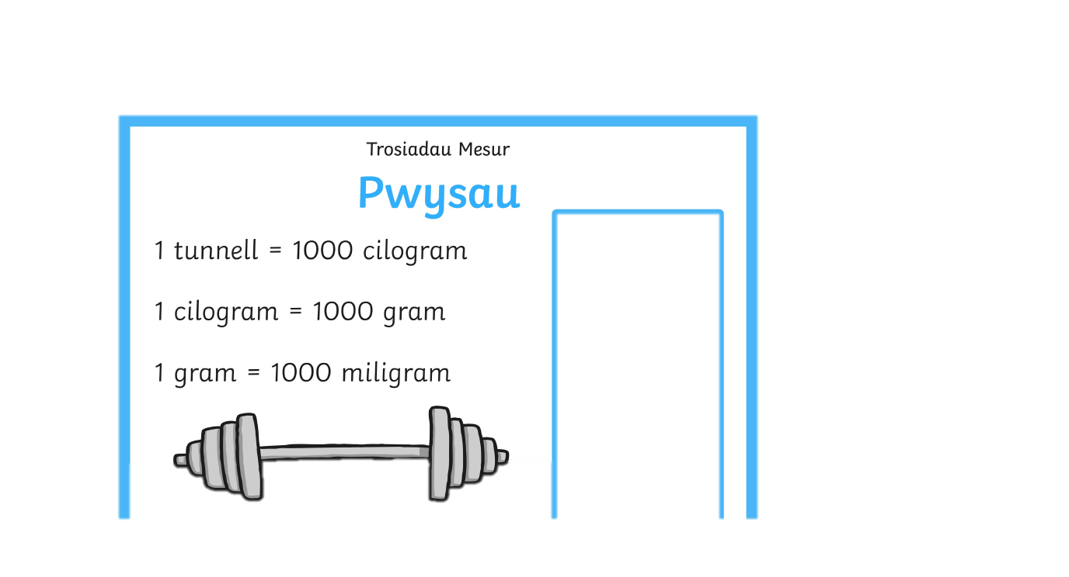

Slide 3
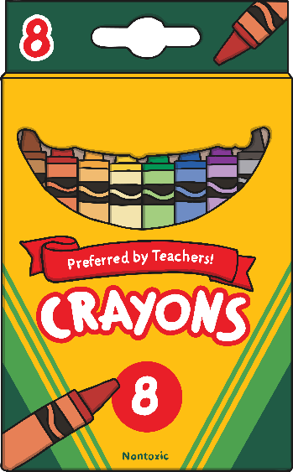
Pecyn o greonau…a packet of crayons?
Cliciwch yr ateb cywir isod/ Click on the correct answer below
g
cg/kg
tunnell ton

Slide 4

Da iawn! Well done!

Slide 5

Ceisiwch eto.Try again.

Slide 6
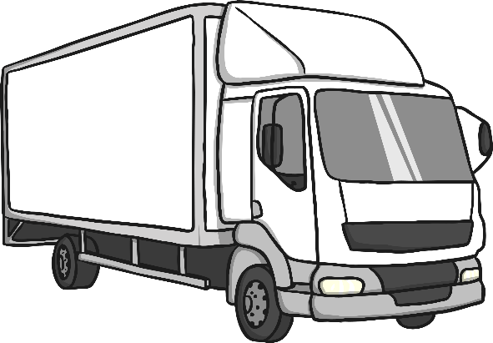
lori…a lorry?
g
cg/kg
tunnell ton

Slide 7
Gwych! Well done!

Slide 8
Ceisiwch eto.Try again.

Slide 9
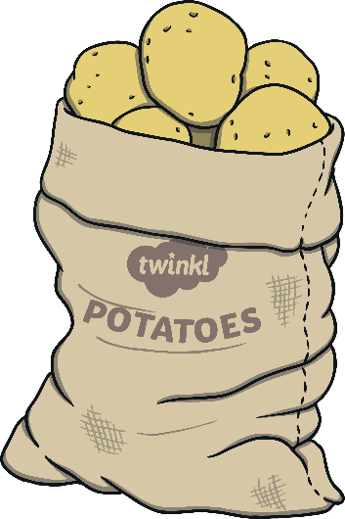
Sach o datws…a bag of potatoes?
g
cg/kg
tunnell ton

Slide 10
Arbennig! Well done!

Slide 11
Ceisiwch eto.Try again.

Slide 12

Pensil…a pencil?
g
cg/kg
tunnell ton

Slide 13
Ardderchog! Well done!

Slide 14
Ceisiwch eto.Try again.

Slide 15
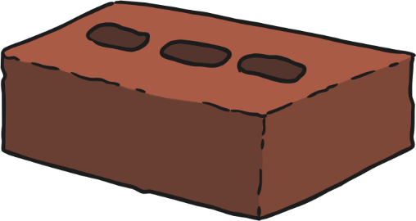
Bricsen…a brick?
g
cg/kg
tunnell ton

Slide 16
Campus!Well done!

Slide 17
Ceisiwch eto.Try again.

Slide 18
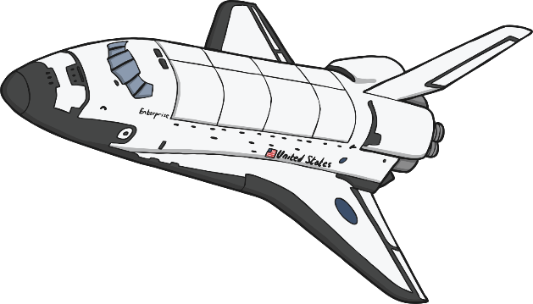
Llong ofod…a space shuttle?
g
cg/kg
tunnell ton

Slide 19
Cywir! Well done!

Slide 20
Ceisiwch eto.Try again.

Slide 21
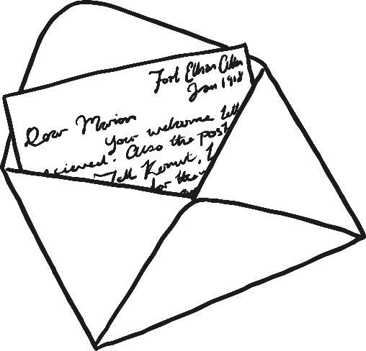
Llythyr…a letter?
g
cg/kg
tunnell ton

Slide 22
Gwych!Well done!

Slide 23
Ceisiwch eto. Try again.

Slide 24

Cês lawn dillad…a packed suitcase?
g
cg/kg
tunnell ton

Slide 25
Da iawn! Well done!

Slide 26
Cesiwch eto. Try again.

Slide 27
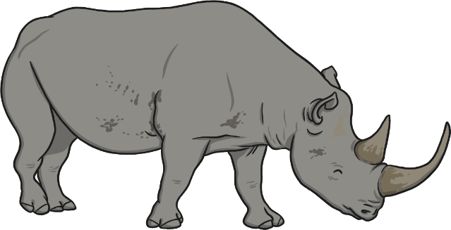
Rhinoseros…a rhinoceros?
g
cg/kg
tunnell ton

Slide 28
Grêt! Well done!

Slide 29
Ceisiwch eto.Try again.

Slide 30
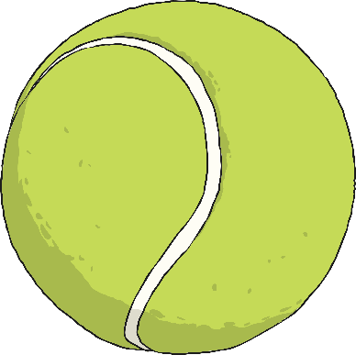
Pêl denis…a tennis ball?
g
cg/kg
tunnell ton

Slide 31
Arbennig! Well done!

Slide 32
Ceisiwch eto. Try again.

