Slide 1
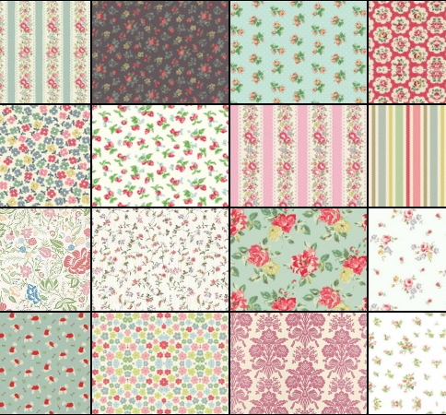
Wednesday June 19th
Laura Ashley
By Zosia Carys Poreba

Slide 2
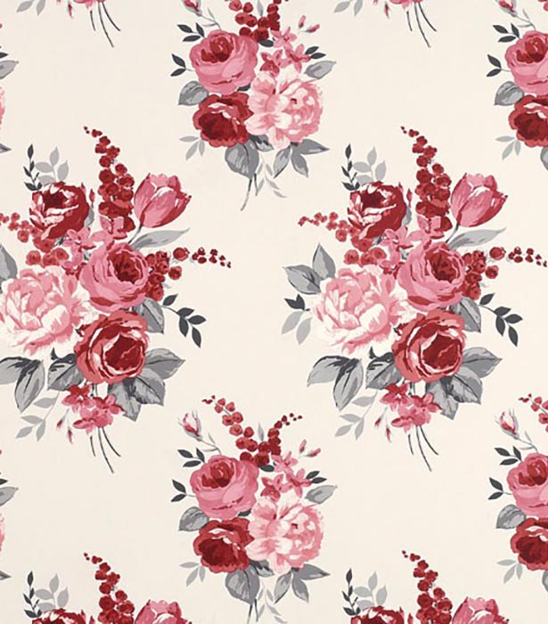
Patterns
Laura Ashley designed lots of dresses & patterns. She had a machine that made all of the patterns to make the dresses.

Slide 3
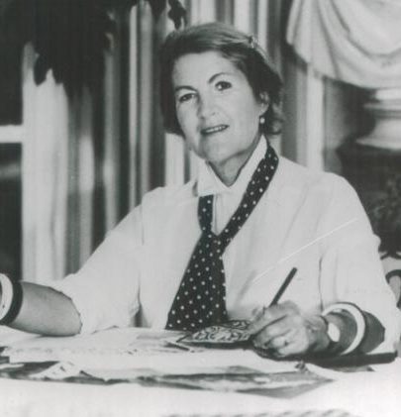
Early life
Laura Ashley was born in her grandmother's house in Dowlais, Methyr Tydfil. She was christened Laura Mountney.She went to Marshall's school in Merthyr and later Elmwood school in Croydon, London.

Slide 4
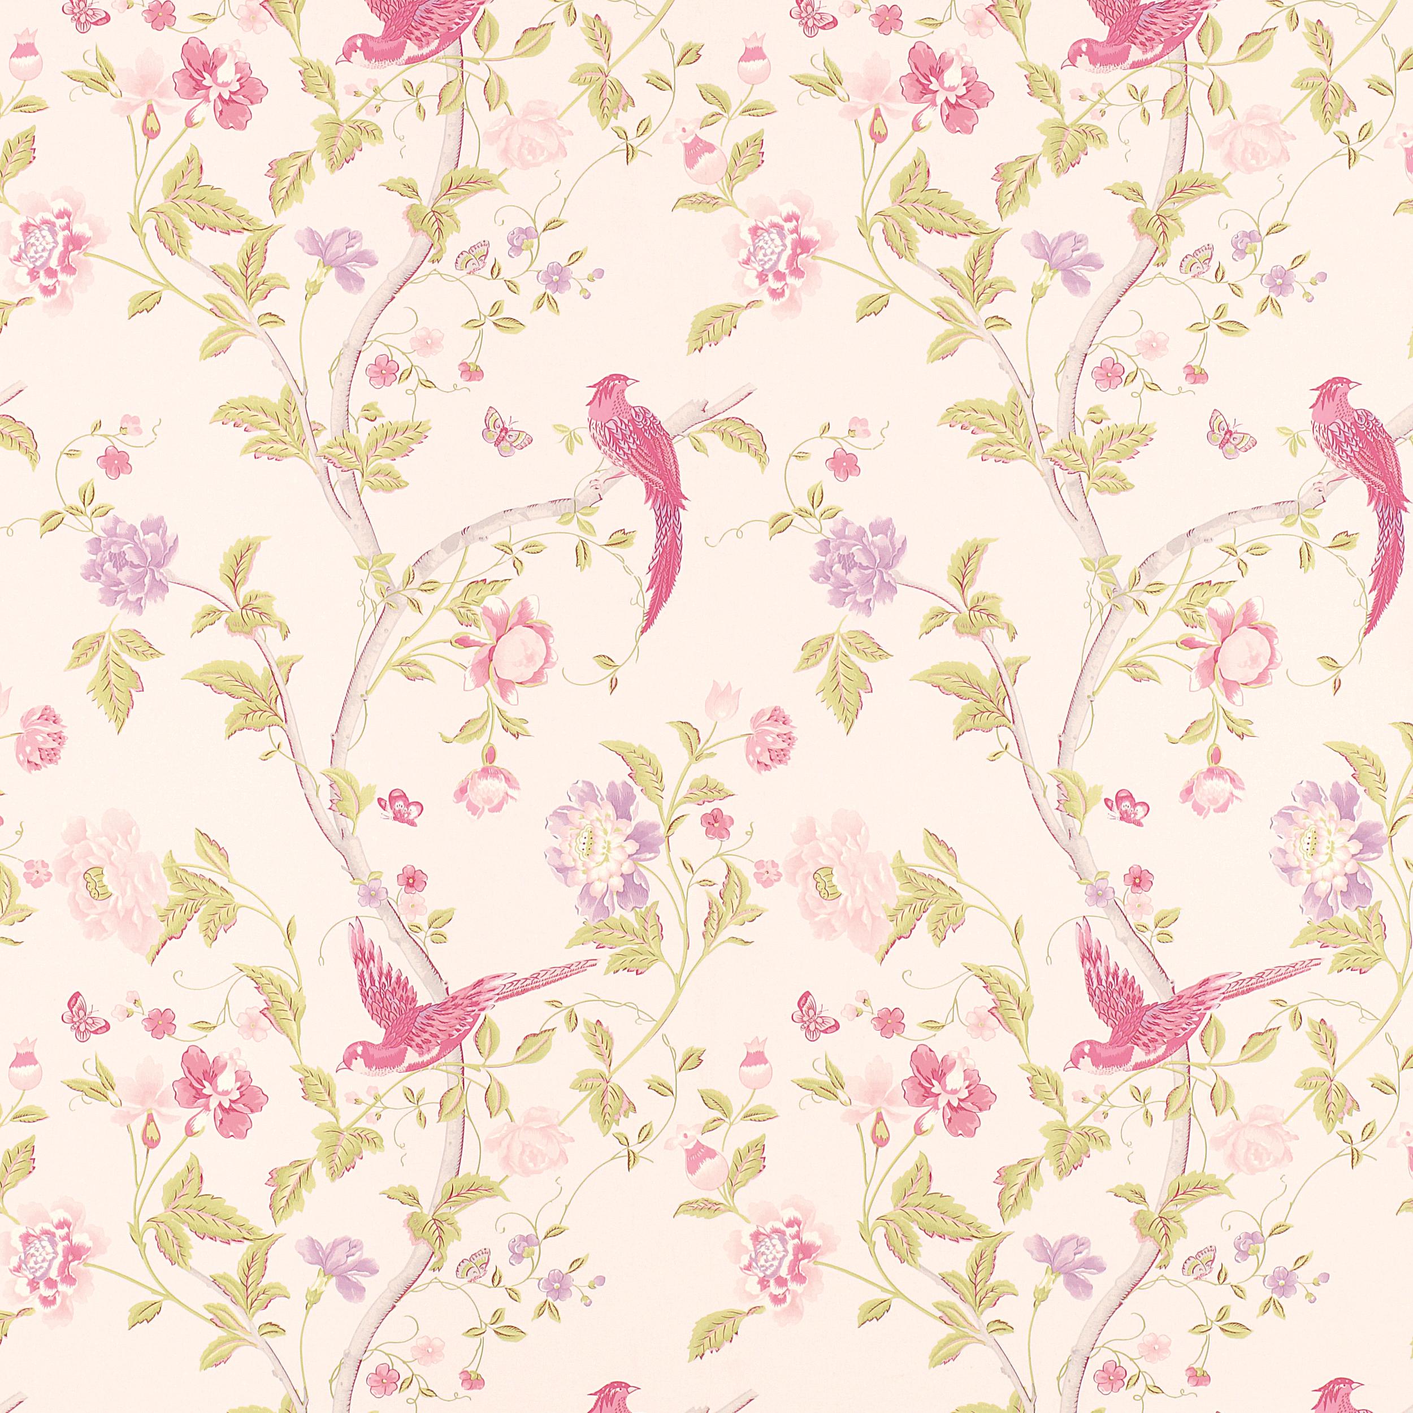
2nd world war
When Laura was 14 the 2nd world war. Airaplains Where shooting bombs on London, and lots of people died. Laura's parents decaided to Laura go to Merthyr to live with her grand-mother in her house where she was born.They hoped that Laura would be safe until the end of the war.

Slide 5

When she married.
In 1949 Laura Mountney married with Bernard Ashley, and so she beacame Laura Ashley
This Photo by Unknown author is licensed under CC BY-SA.

Slide 6
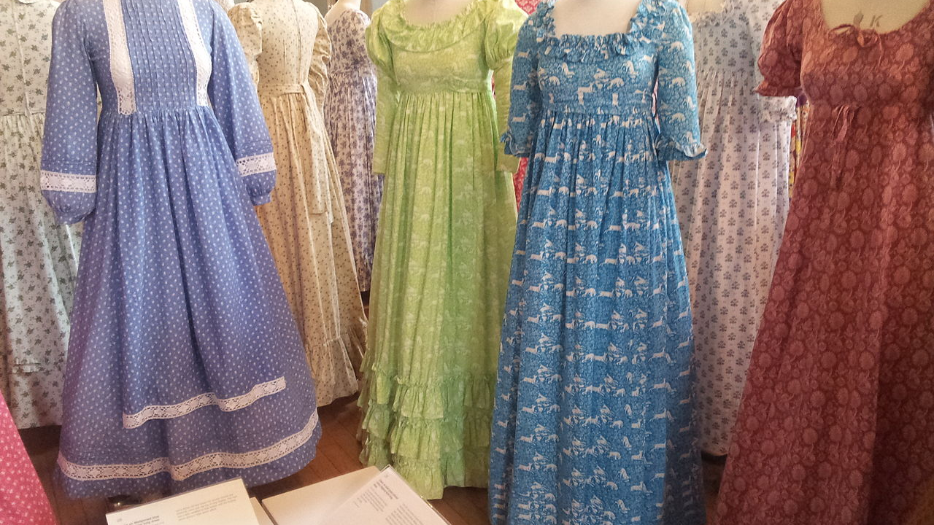
Working in London
She was working in London as a writer, but her dream was become a fabric designer. She saw some pictures of beautiful flowers in old book's.She really liked them.
This Photo by Unknown author is licensed under CC BY-SA.

Slide 7
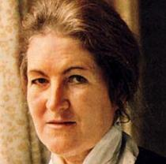
When she died
One day Laura fell down the stairs and then went to the hospital .After 10 day's later she sadlydied on the 7th of September 1985.
This Photo by Unknown author is licensed under CC BY-SA.

