Slide 1
Laura Ashley
Wednesday June 19th

Slide 2
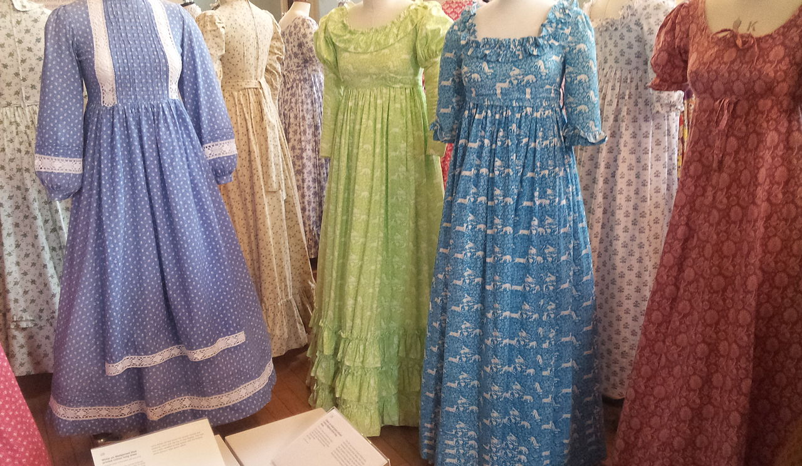
Laura was a fashion designer.
Laura Ashley

Slide 3
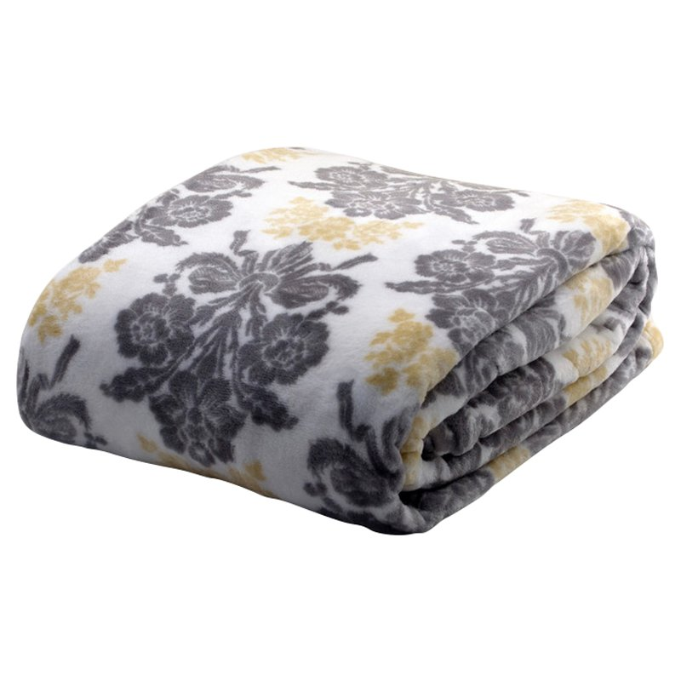
Laura was also a home designer.
Laura Ashley

Slide 4

This is a picture of Laura Ashley.
Laura Ashley

Slide 5
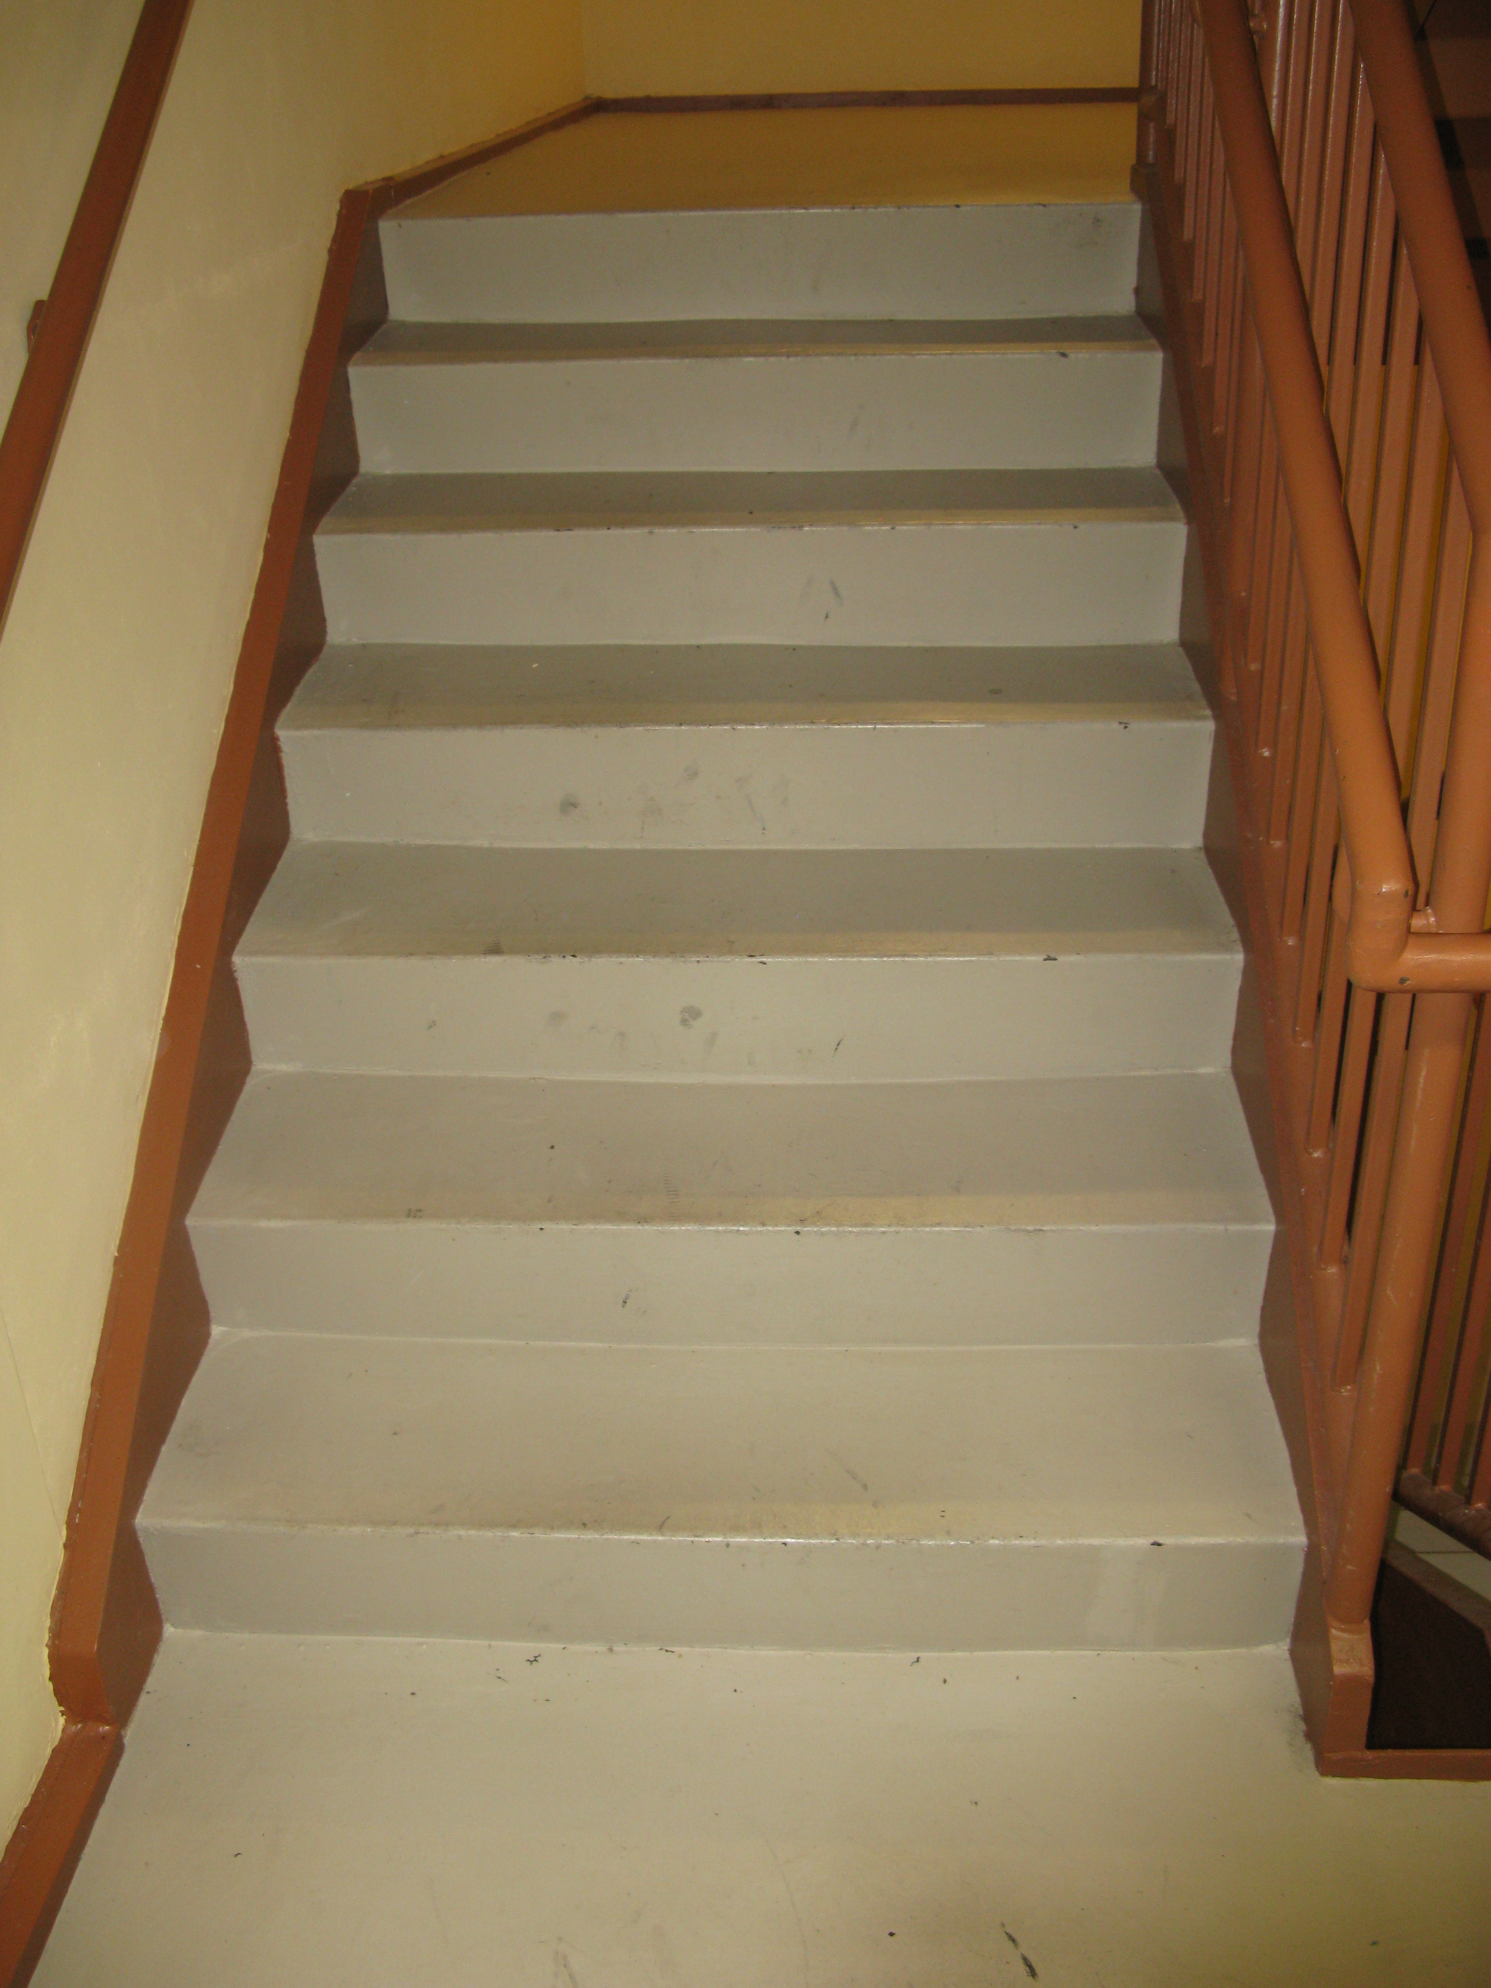
Laura Ashley
Laura was born on the 7th of September 1835 and she died on the 17th of September 1835. She fell down the stairs in an accident.

