Slide 1
Wednesday June 19th
Laura Ashley
By Elliw

Slide 2
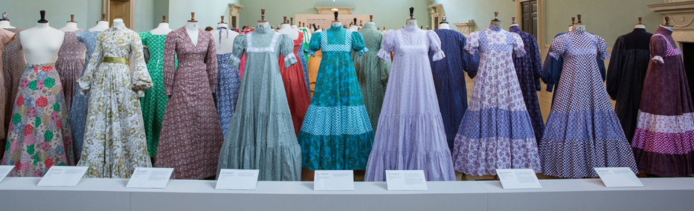
Patterns
Laura Ashly designed lots of dresses and patterns.She was born on7th September 1925.Laura Ashly died 17th September 1985 (aged 60 ).Resting place:st.John the Baptist Church.
This Photo by Unknown author is licensed under CC BY-NC-ND.

Slide 3
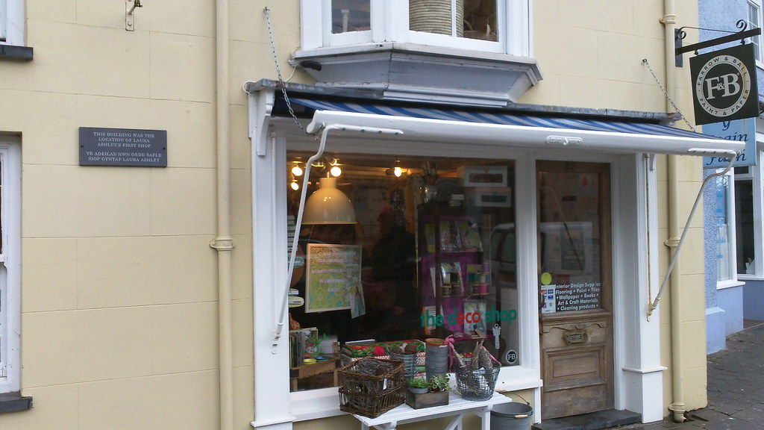
This was her first Shop.
This Photo by Unknown author is licensed under CC BY.

Slide 4
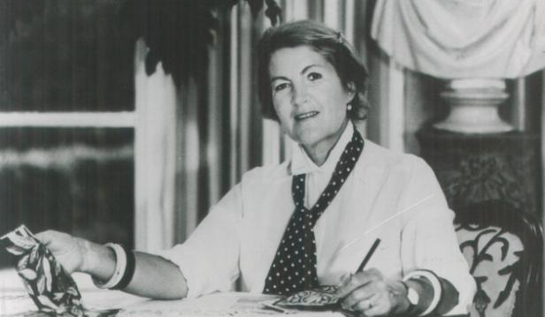
Laura Ashly
Laura Ashly fell dawn the stairs and died.1925:Laura was born in her grandmother's house in Dowlais.

Slide 5
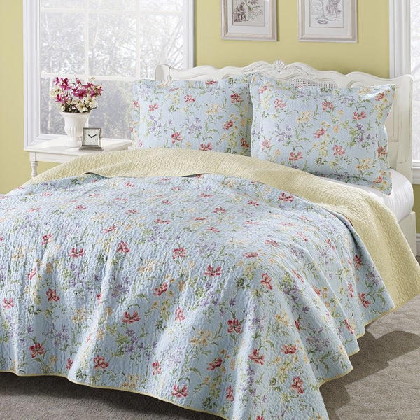
Beds
Laura designed beds too.
This Photo by Unknown author is licensed under CC BY-NC-ND.

Slide 6
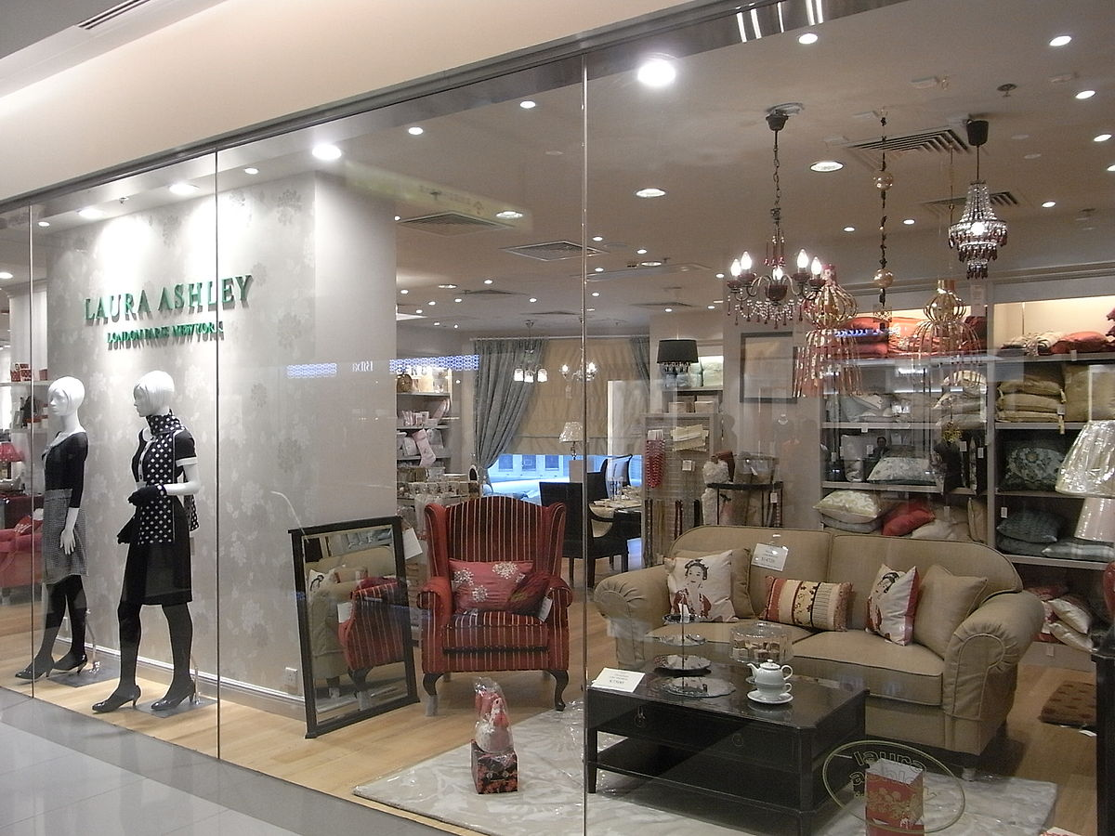

These are more of Laura Ashley's shop's around the world.
This Photo by Unknown author is licensed under CC BY-SA.
This Photo by Unknown author is licensed under CC BY-SA.

Slide 7
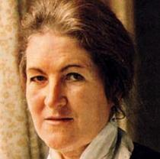
Facts about Laura Alshley
Laura Ashley designed lots of bed covers and dresses too.
This Photo by Unknown author is licensed under CC BY-SA.

Slide 8

Laura Ashley
Laura Ashley married Bernard.
This Photo by Unknown author is licensed under CC BY-SA.

Slide 9

The end
This Photo by Unknown author is licensed under CC BY-NC-ND.

