Slide 1
Laura Ashley
Gan Martha Lane

Slide 2
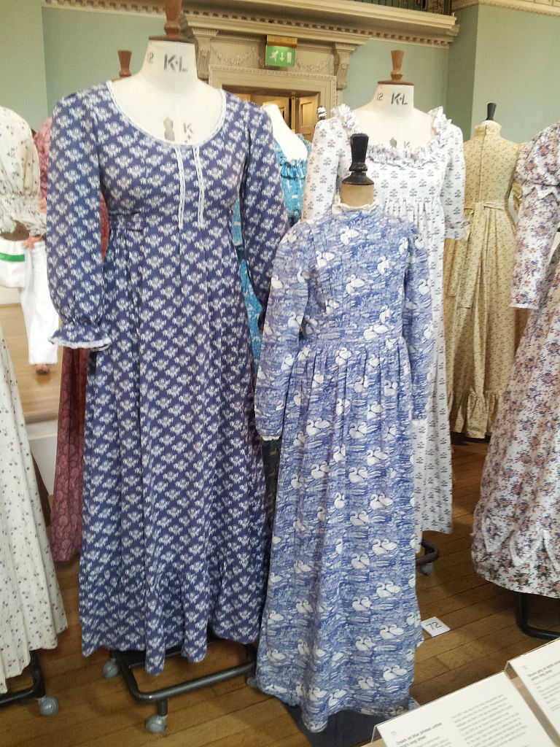

Roedd Laura Ashley wedi dylunio ffrociau.
This Photo by Unknown author is licensed under CC BY-NC.
This Photo by Unknown author is licensed under CC BY-SA.

Slide 3
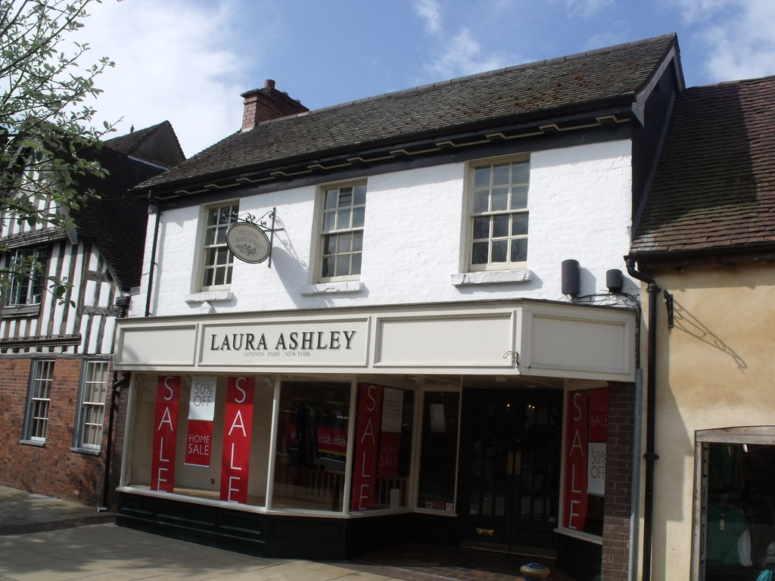
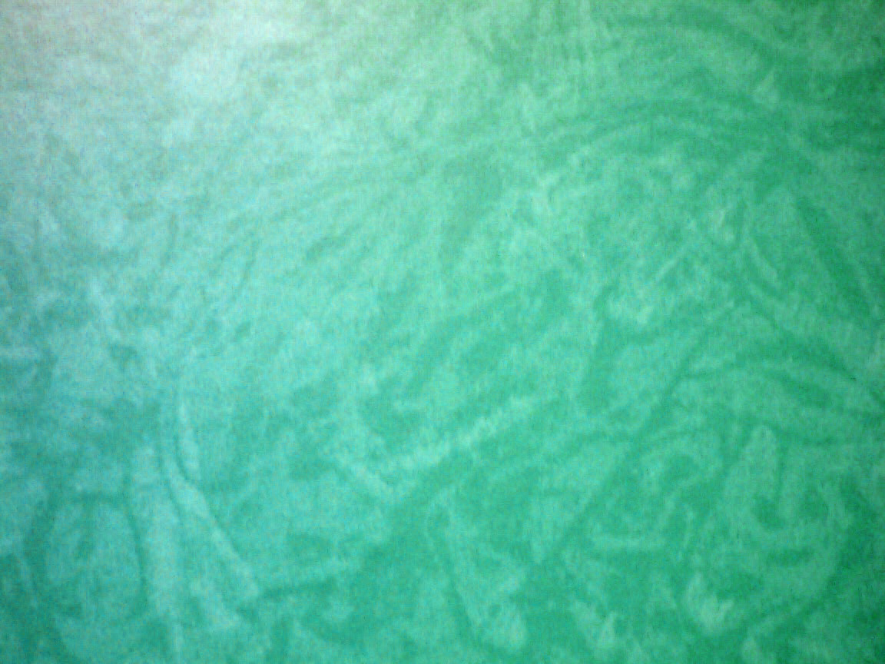
Roedd Laura Ashley wedi creu siop o'r enw Laura Ashley.
This Photo by Unknown author is licensed under CC BY.
This Photo by Unknown author is licensed under CC BY.

Slide 4
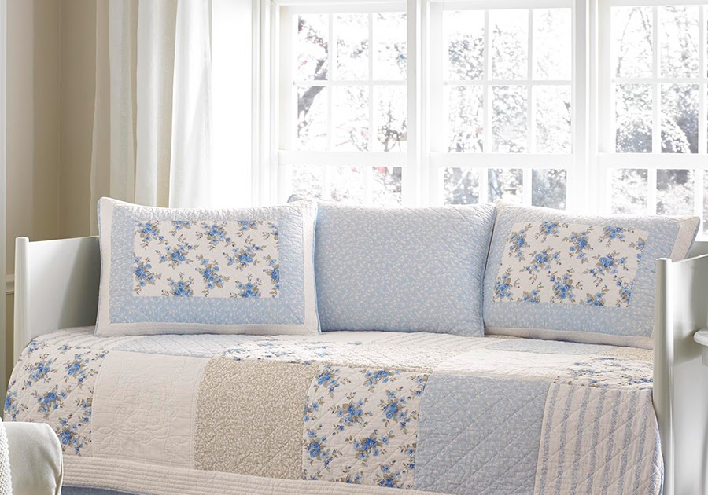

Roedd Laura Ashley wedi creu celfi i'r ty.
This Photo by Unknown author is licensed under CC BY-NC-ND.

Slide 5
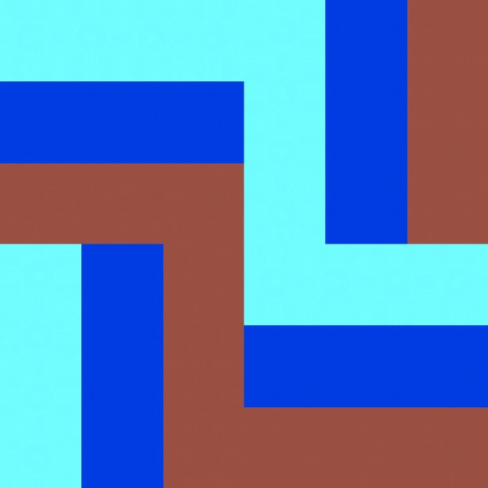
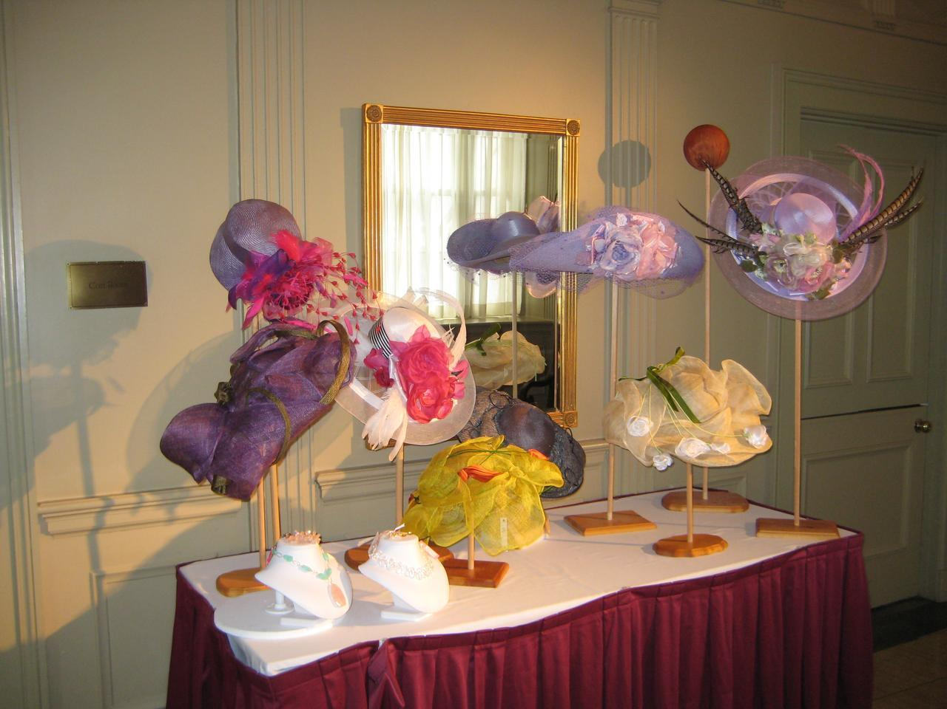
Roedd Laura Ashley wedi gwneud hetiau.
This Photo by Unknown author is licensed under CC BY-ND.

Slide 6


Un dydd roedd Laura Ashley wedi cwmpo lawr y grisiau a marw. Dyma rhai o'I phatrymau.
This Photo by Unknown author is licensed under CC BY.

