Slide 1
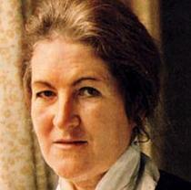
Laura Ashley
This Photo by Unknown author is licensed under CC BY-SA.
By Harry Morris

Slide 2
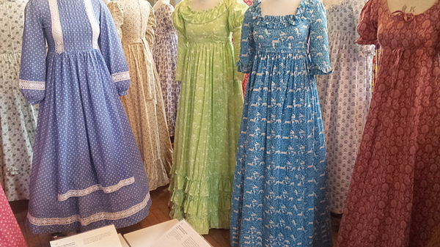
Laura designed dresses and furniture and they had patterns on them.
This Photo by Unknown author is licensed under CC BY-SA.

Slide 3
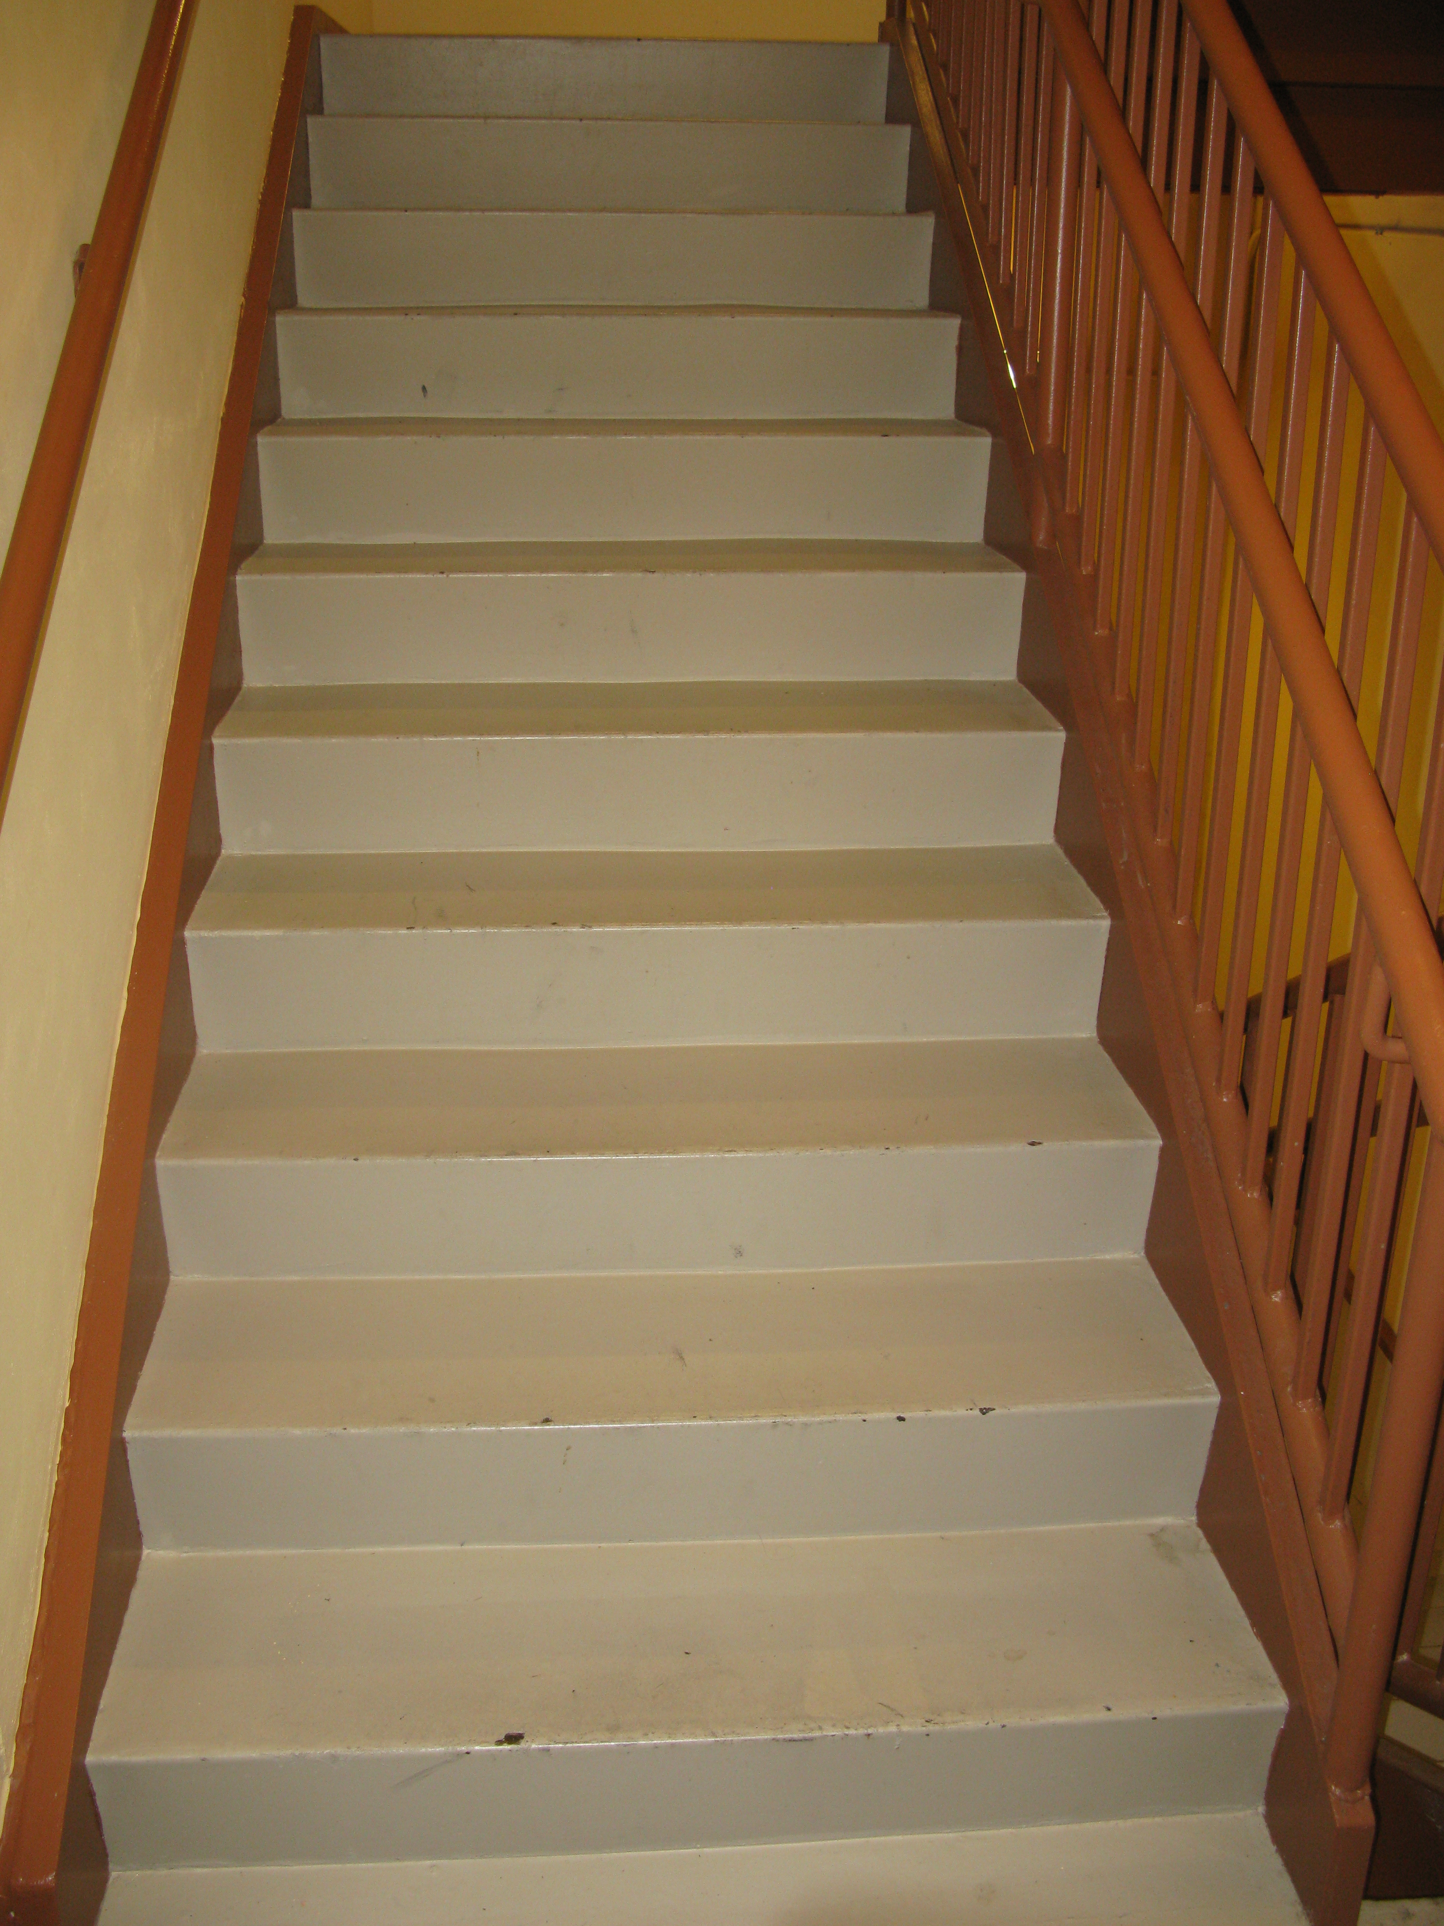

Laura died because she fell down, she went to hospital but she did not make it she died.
This Photo by Unknown author is licensed under CC BY-SA.
This Photo by Unknown author is licensed under CC BY-SA.

Slide 4

Laura was born in Wales. When she was growing up she did not speak welsh but she liked the sound of it. She liked listening to Welsh singing.
This Photo by Unknown author is licensed under CC BY-SA.

Slide 5
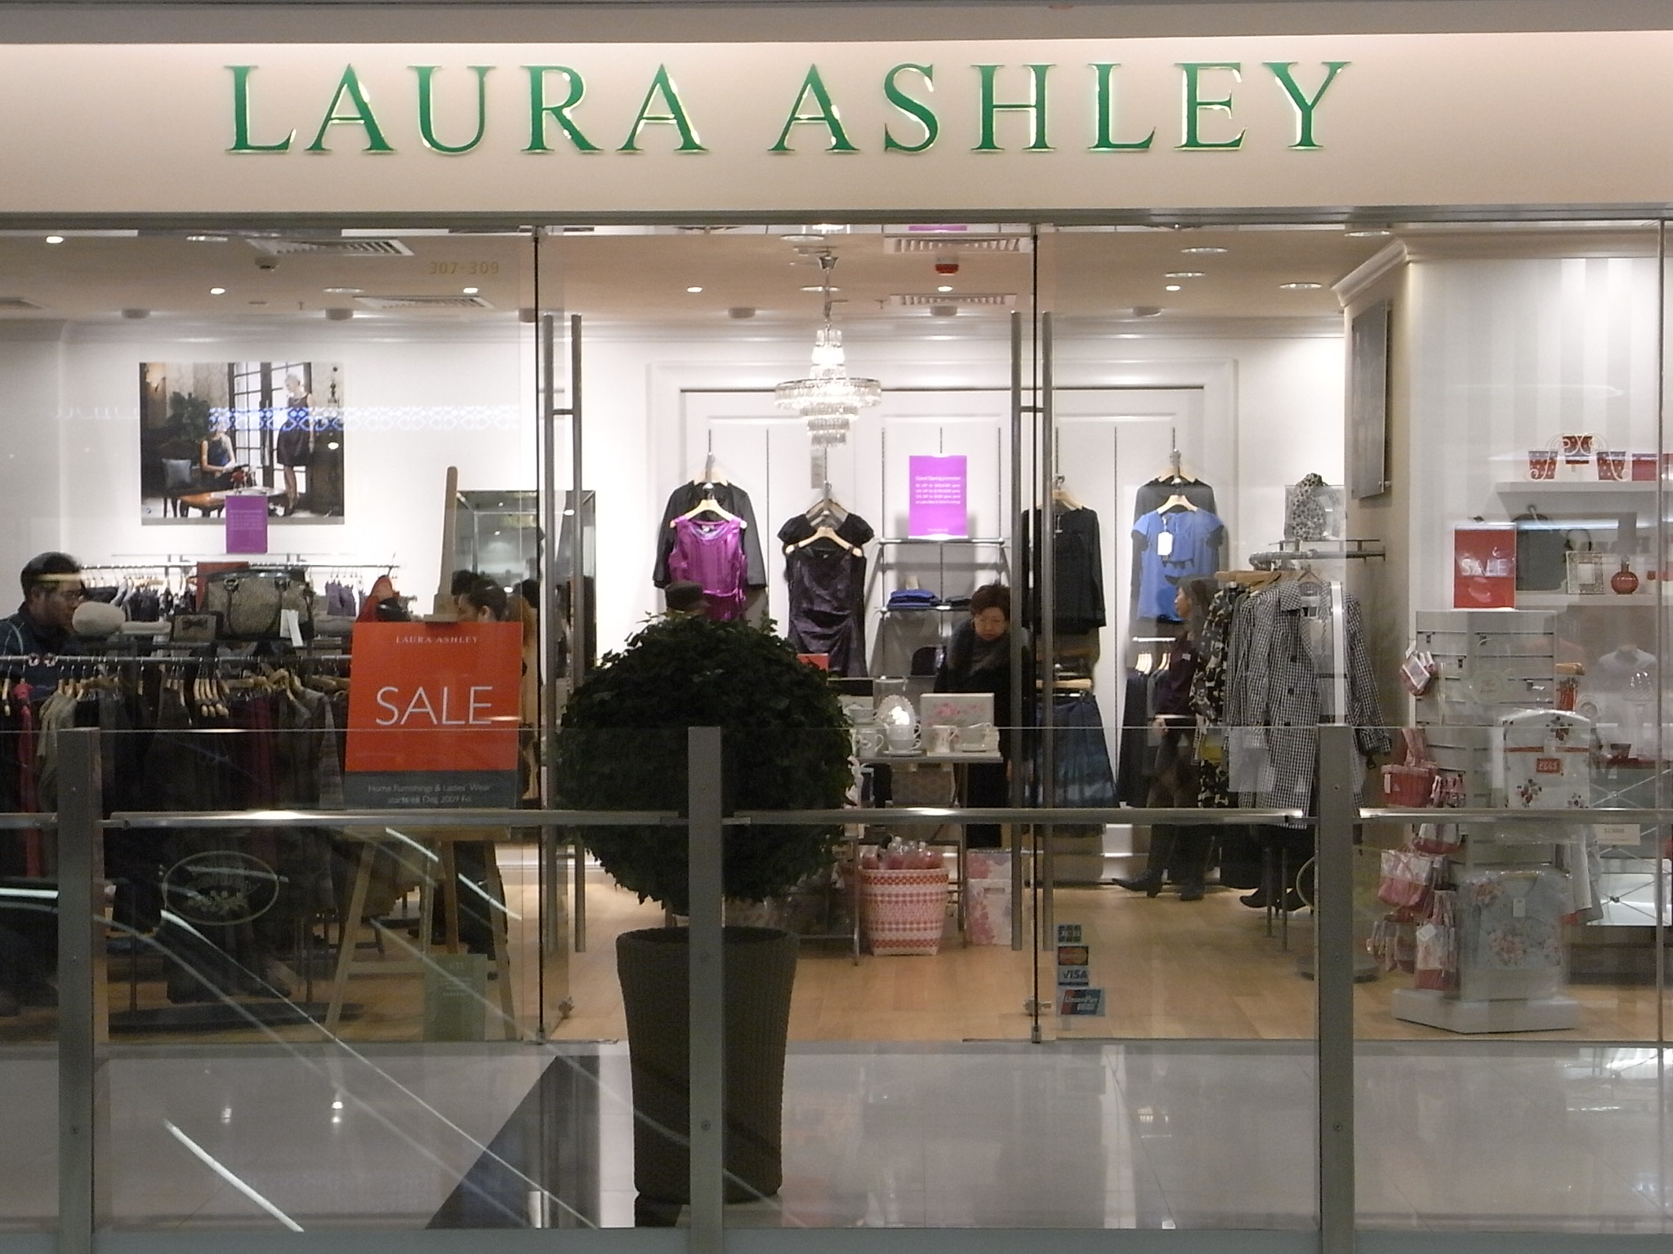
Laura Ashley had shops all around the world wen she was not around any more.
The shops were in different countries like New York ,Paris, England and more.
This Photo by Unknown author is licensed under CC BY-SA.

Slide 6

The end

