Slide 1

By Carys Louise Bendle
Laura Ashley
This Photo by Unknown author is licensed under CC BY-SA-NC.
This Photo by Unknown author is licensed under CC BY-SA-NC.
This Photo by Unknown author is licensed under CC BY-SA-NC.
This Photo by Unknown author is licensed under CC BY-SA-NC.

Slide 2

.Laura was born September 7th 1925
.Laura fell down the stairs and died on the 17th ,1985
This Photo by Unknown author is licensed under CC BY.
This Photo by Unknown author is licensed under CC BY.

Slide 3
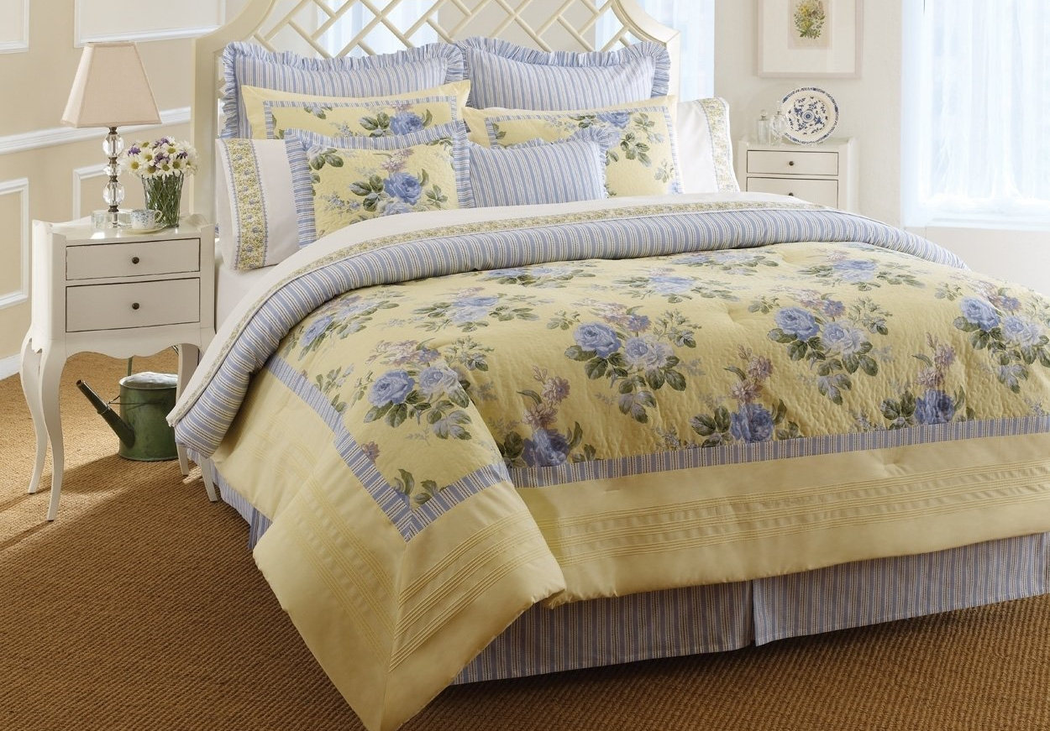
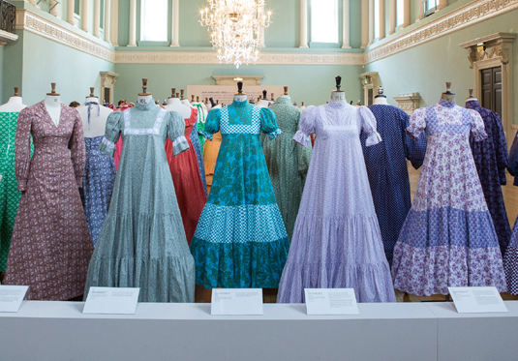
Laura designed bed's,dresses.....
This Photo by Unknown author is licensed under CC BY-NC-ND.

Slide 4

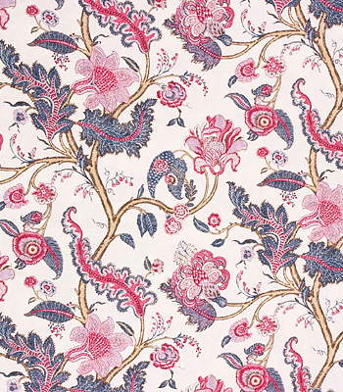
And pretty patterns.
This Photo by Unknown author is licensed under CC BY-SA-NC.

