Slide 1
Dydd Mercher Mehefin 19eg
Laura Ashley gan Shae sarine spooner

Slide 2

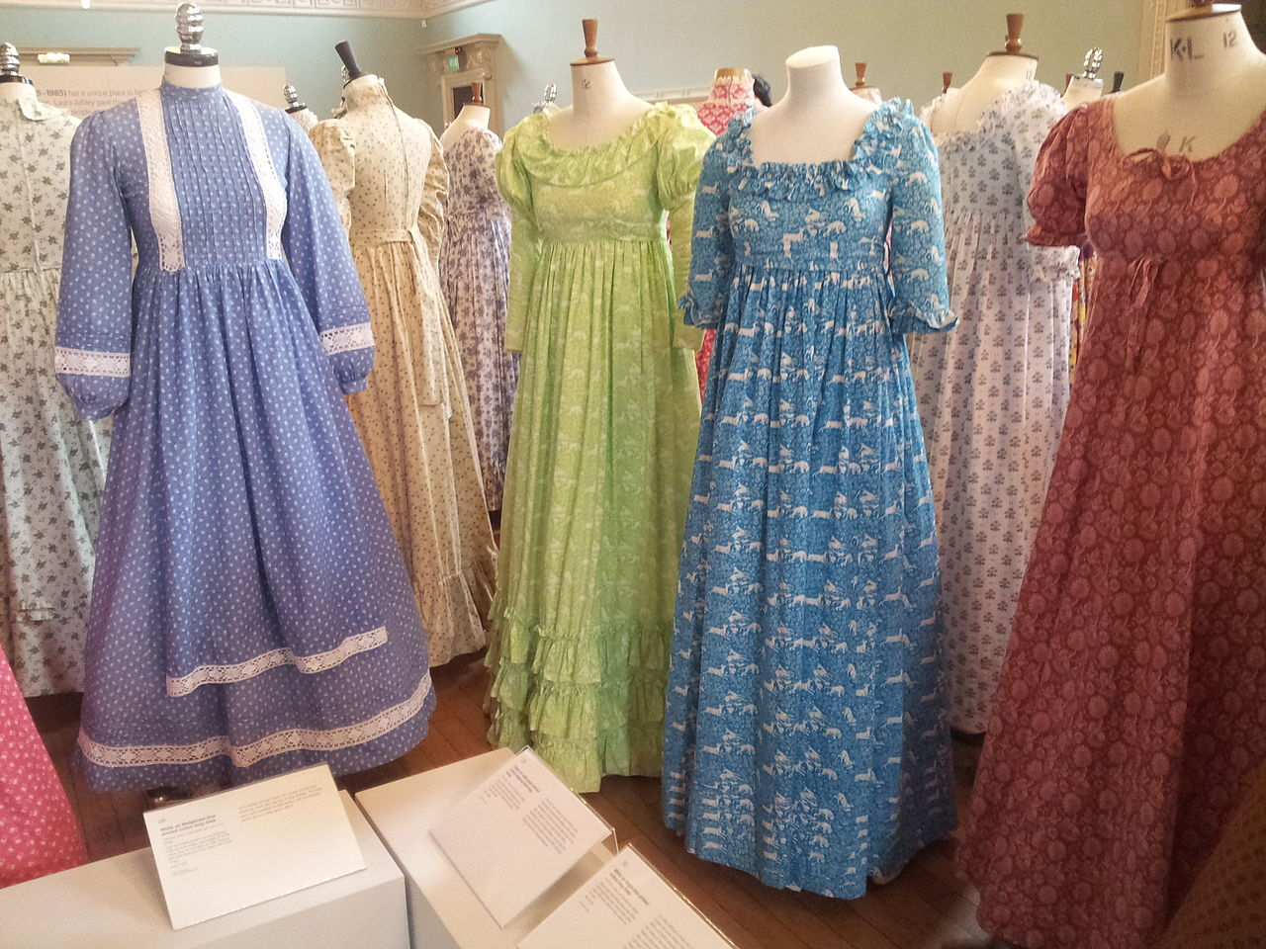
Dyma ffociau Laura Ashley.
Mae he'n greadigol iawn!
Mae'r ffrociau yma yn edrich yn lliwgar iawn!
This Photo by Unknown author is licensed under CC BY-SA.
This Photo by Unknown author is licensed under CC BY-NC-ND.
This Photo by Unknown author is licensed under CC BY-NC-ND.

Slide 3
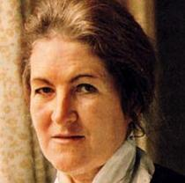
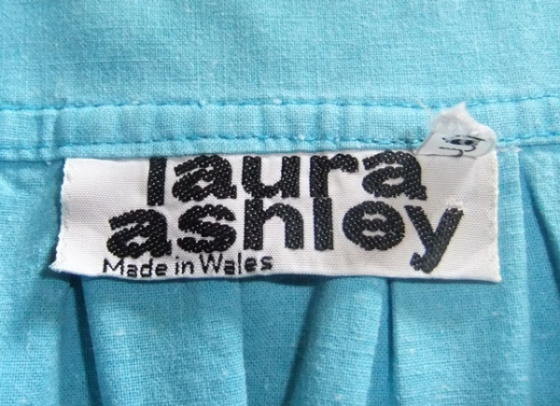
Dyma lun o dag Laura Ashley.
My hon wedi cael I gwaneind yn Cymru.

Slide 4




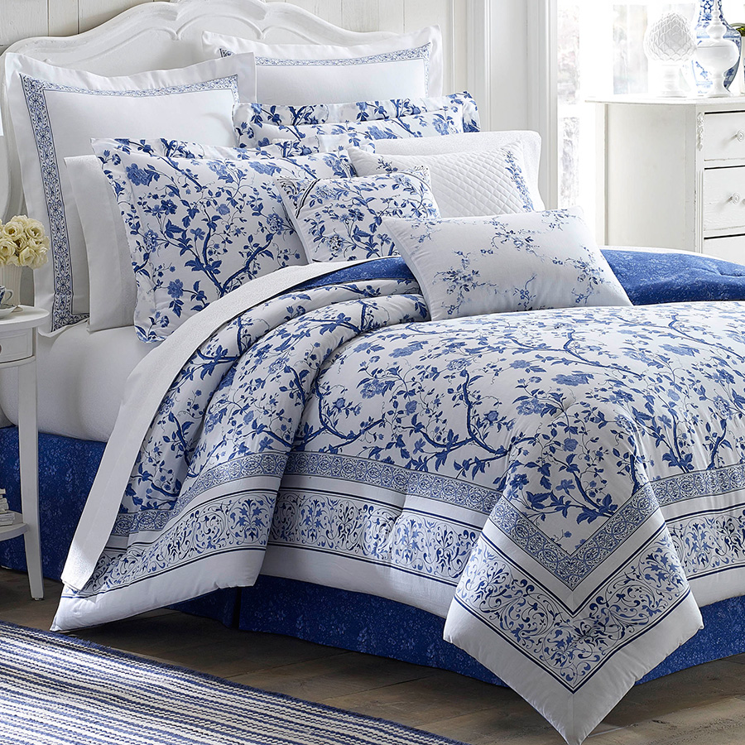

Dyma gwely odd Laura Ashley wedi creu.
This Photo by Unknown author is licensed under CC BY-NC-ND.
This Photo by Unknown author is licensed under CC BY.

Slide 5
Mae Laura Ashley yn boblogaidd iawn ond 1 dydd roedd hi'n dod lawr y grisiau, wedyn roedd hi wedi cwmpo lawr a marw!
This Photo by Unknown author is licensed under CC BY.
This Photo by Unknown author is licensed under CC BY-SA.
This Photo by Unknown author is licensed under CC BY-SA.
This Photo by Unknown author is licensed under CC BY.

