Slide 1
Y galon
Gan Harvey a Joseff a Noah

Slide 2
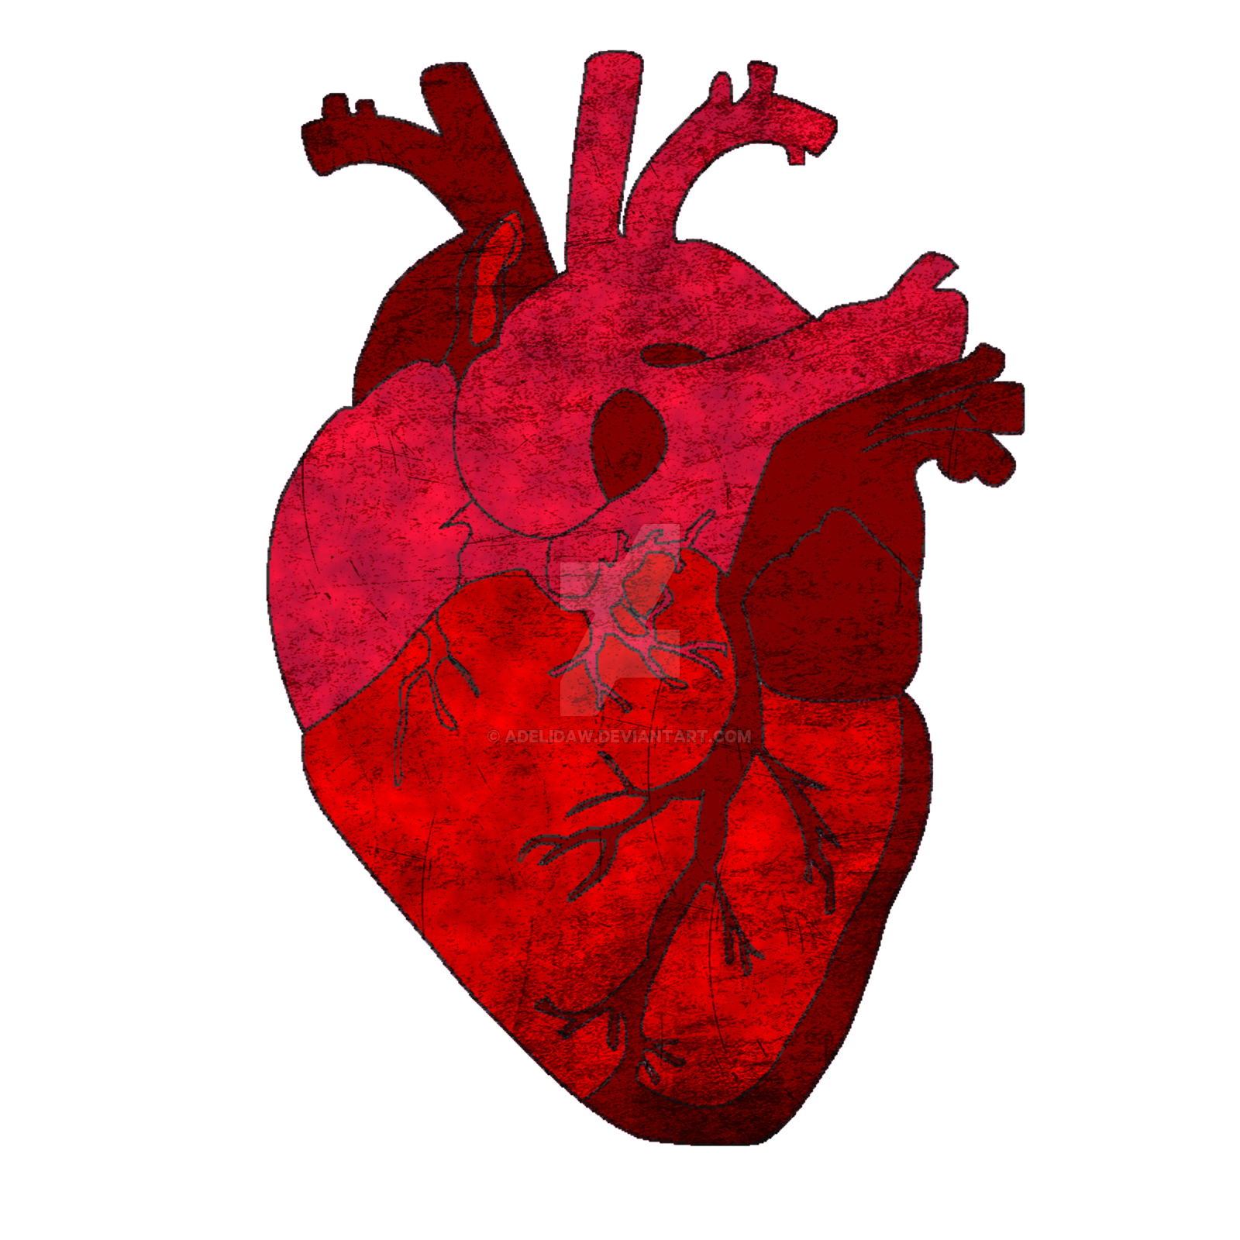
Dyma'r galon
Mae'r galon yn pwysig iawn achos mae'r galon yn pwmpio oxegan o amgylch y corff.
This Photo by Unknown author is licensed under CC BY-NC-ND.

Slide 3
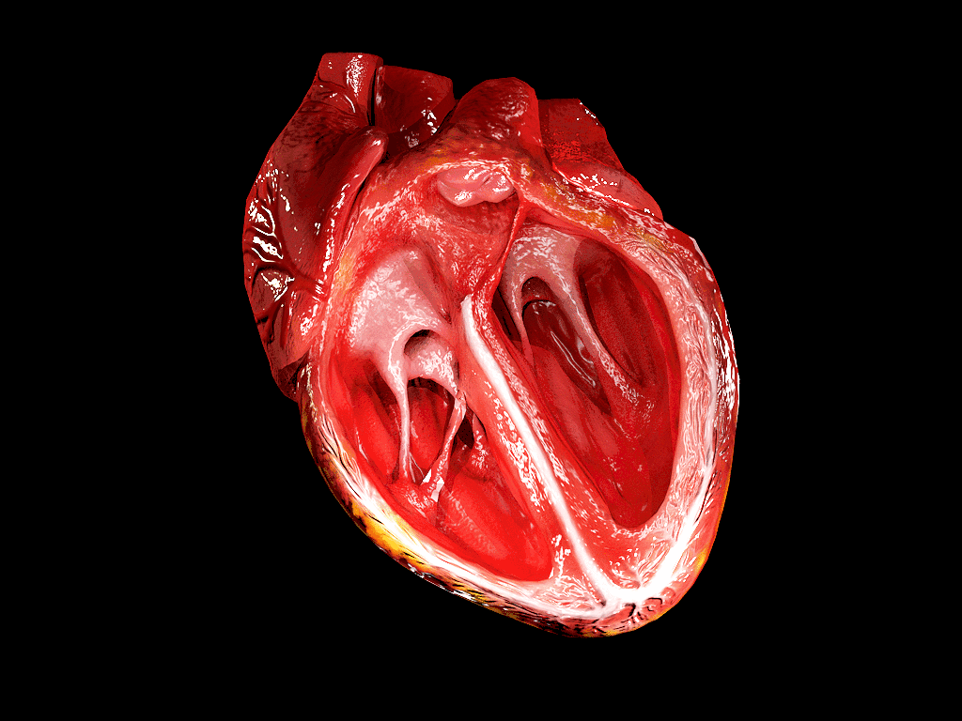
Y galon
Hon ydy'r galon mewn tu fewn
This Photo by Unknown author is licensed under CC BY-SA-NC.

Slide 4
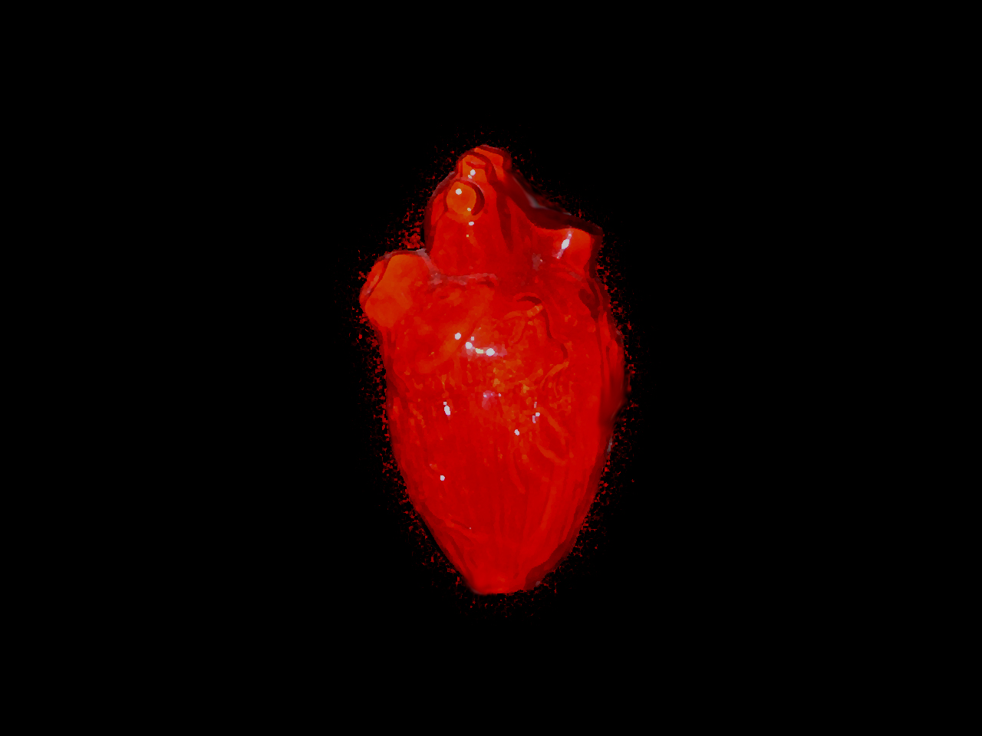
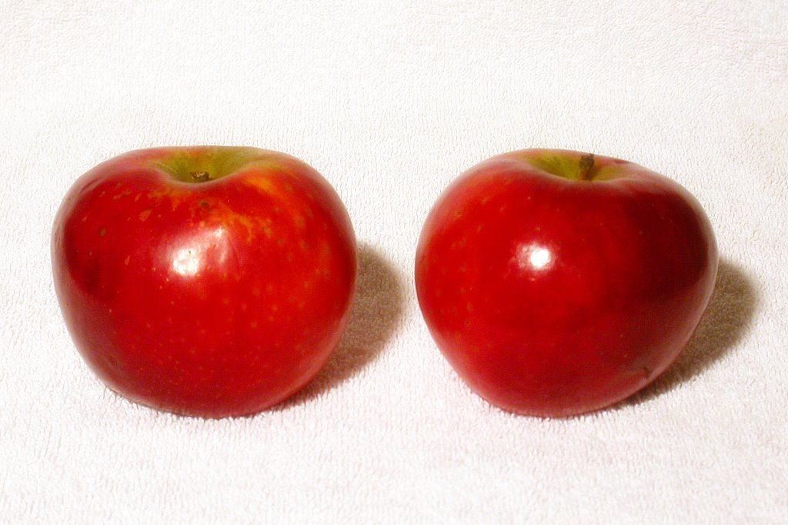
Mae y galon yn pwyso tua dau afal
This Photo by Unknown author is licensed under CC BY-SA.
This Photo by Unknown author is licensed under CC BY-NC-ND.

Slide 5

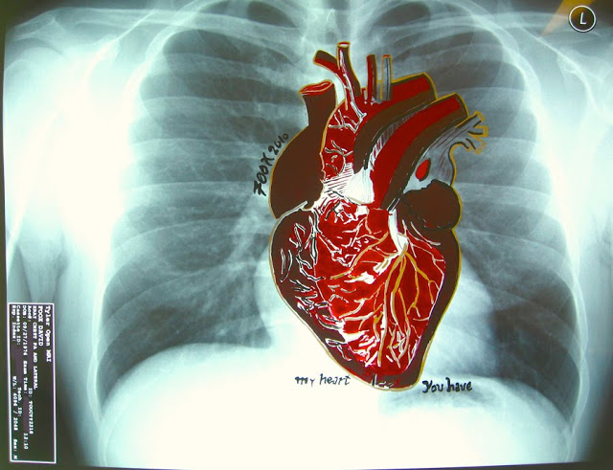
Sut mae'r galon yn edrych?
Nid yw'r galon yn edrych fel hyn.
Maer galon yn edrych fel hwn.
This Photo by Unknown author is licensed under CC BY-NC-ND.

Slide 6

Y diwedd
Gobeithio chi wedi dysgu rwypeth yn ein cyflwyniad.
This Photo by Unknown author is licensed under CC BY-NC.
This Photo by Unknown author is licensed under CC BY-NC.

