Slide 1
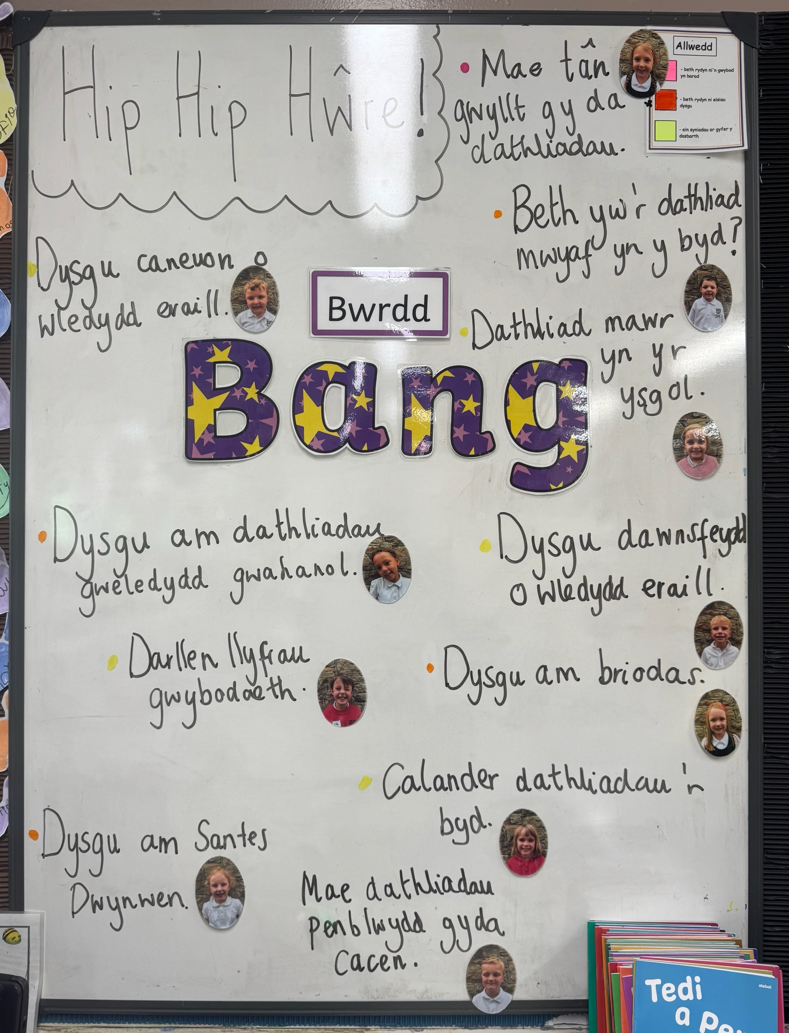
Spring Term 2026
Dosbarth yr Wylan
In this unit of learning, our aim is to inspire pupils to be curious, to ask questions, and to explore the culture of Wales alongside the cultures of other countries around the world. We seek to foster an appreciation of identity and heritage, creating a strong sense of belonging and pride. Learners will also be encouraged to recognise both similarities and differences between ourselves and the wider world. They will have opportunities to use expressive arts to communicate their personal, social, and cultural identity. Through the creative process, pupils will collaborate to produce work of cultural value, developing creative skills and new ways of thinking. Above all, we strive to nurture well-being and foster a deep sense of pride, empowering every learner with confidence, creativity, and a strong sense of identity.
It’s planning time!
Learn songs from different countries.
Rory
We celebrate birthdays and have cake! Myles
Have a big celebration in school.
Saffir
Learn about Santes Dwynwen.
Eliza
Make a calender with celebrations of the world. Ebba
What is the biggest celebration in the world?
Cillian

Slide 2
This term’s unit of learning: Hip, Hip Hooray! Fun and festivals Around the World!
Here are our ideas for this term:
Don’t forget to visit the ‘Pupils section – class pages’ on our school website for more information! www.yggbrynymor.co.uk
Follow us on ‘twitter’ also! @YGGBrynymor1
Humanities
Learn about a range of festivals and celebrations in Wales and around the world.
Enjoy the idea of belonging to our local community and to Wales.
Enjoy finding out about how people in different places in the world live.
Identify similarities and differences between Wales and other countries.
Learn about Eid and Easter festivals.
Health and Wellbeing
Practice and develop our physical skills and continue to improve our fitness.
Develop our fine-motor skills.
Discuss how we can keep our bodies healthy.
Continue to learn how to stay safe online and learn how to send a simple online message.
Discuss the impact of celebrations on our feelings and emotional wellbeing.
Understand that people value different things and develop a sense of identity.
Expressive Arts
Study dances performed at festivals or carnivals. Learn dance patterns. Enjoy performing.
Learn new songs, listen to carnival music and play simple patterns on percussion instruments.
Science and Technology
Design and create an item of food for a special celebration.
Develop our coding skills by giving instructions to a programmable toy or using a computer-based coding program.
Visit the ‘Homework’ section on the class website to see this term’s homework menu.
Gwaith Cartref/Homework
Languages, Literacy and Communication
Create a role-play corner ‘Lluniau Llon' and enjoy dressing up, handling money and being professional photographers!
Read and listen to a variety of non-fiction stories and books.
Developing our reading skills further.
Enjoy writing for a variety of purposes, including writing an invitation and acrostic poem.
Continue to practice our spelling skills and learn to form letters correctly.
Mathematics and Numeracy
Practice counting, reading, writing and arranging numbers.
Practice and improve the skills of addition and subtraction.
Use money and practice giving change.
Develop our clock reading skills.
Play many mental arithmetic games and enjoy problem solving.
Visits/Experiences
Take part in a dance or drumming workshop.
The Closing Project
Plan and organise a celebration of our own!

