Slide 1
Y celtiaid
Gan Thom

Slide 2
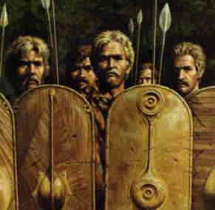
Roedd y celtiaid yn rhyfelwyr ffyrnig a chryf.
This Photo by Unknown author is licensed under CC BY-ND.

Slide 3
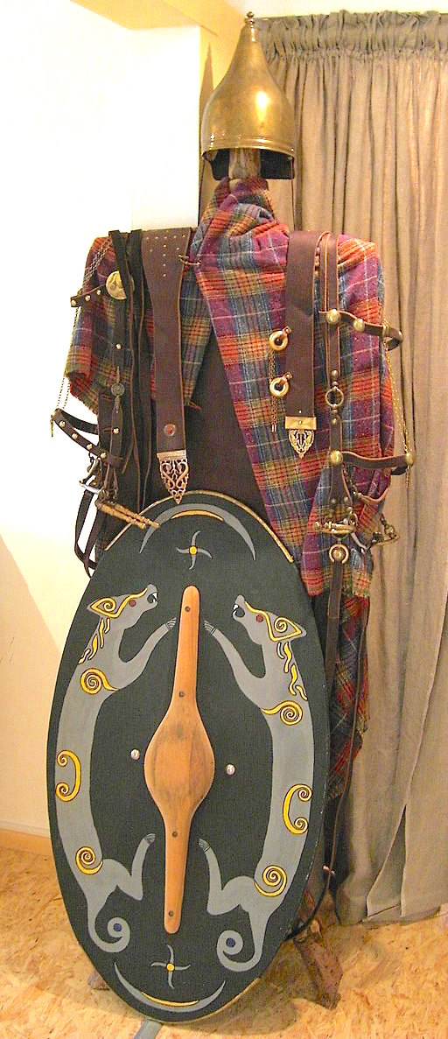
Roedd y celtiaid yn gwisgo ffrog ac esgidiau a chlogyn a bracae.
c
This Photo by Unknown author is licensed under CC BY-SA-NC.

Slide 4
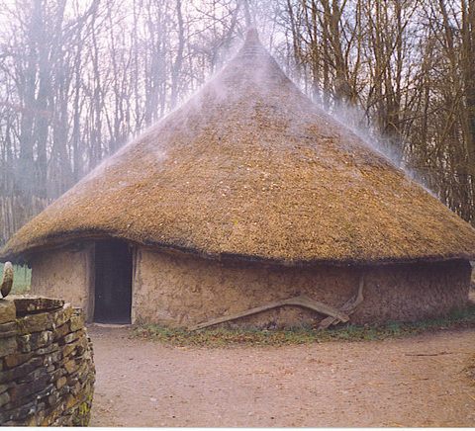
Roedd y celtiaid yn byw mewn tai crwn.
This Photo by Unknown author is licensed under CC BY-SA.

Slide 5
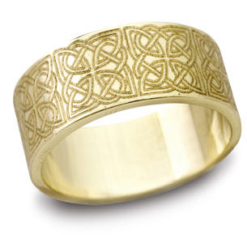
Roedd y celtiaid wedi ffeindio haearn ac roedden nhwn hoffi gwisgo Gemwaith.
This Photo by Unknown author is licensed under CC BY-SA.

