Slide 1
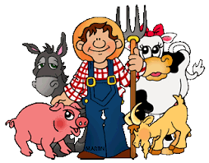

Dewch am dro i fferm Tad-cu
I-AI-I-AI-O
Ac ar y fferm mae…

Slide 2
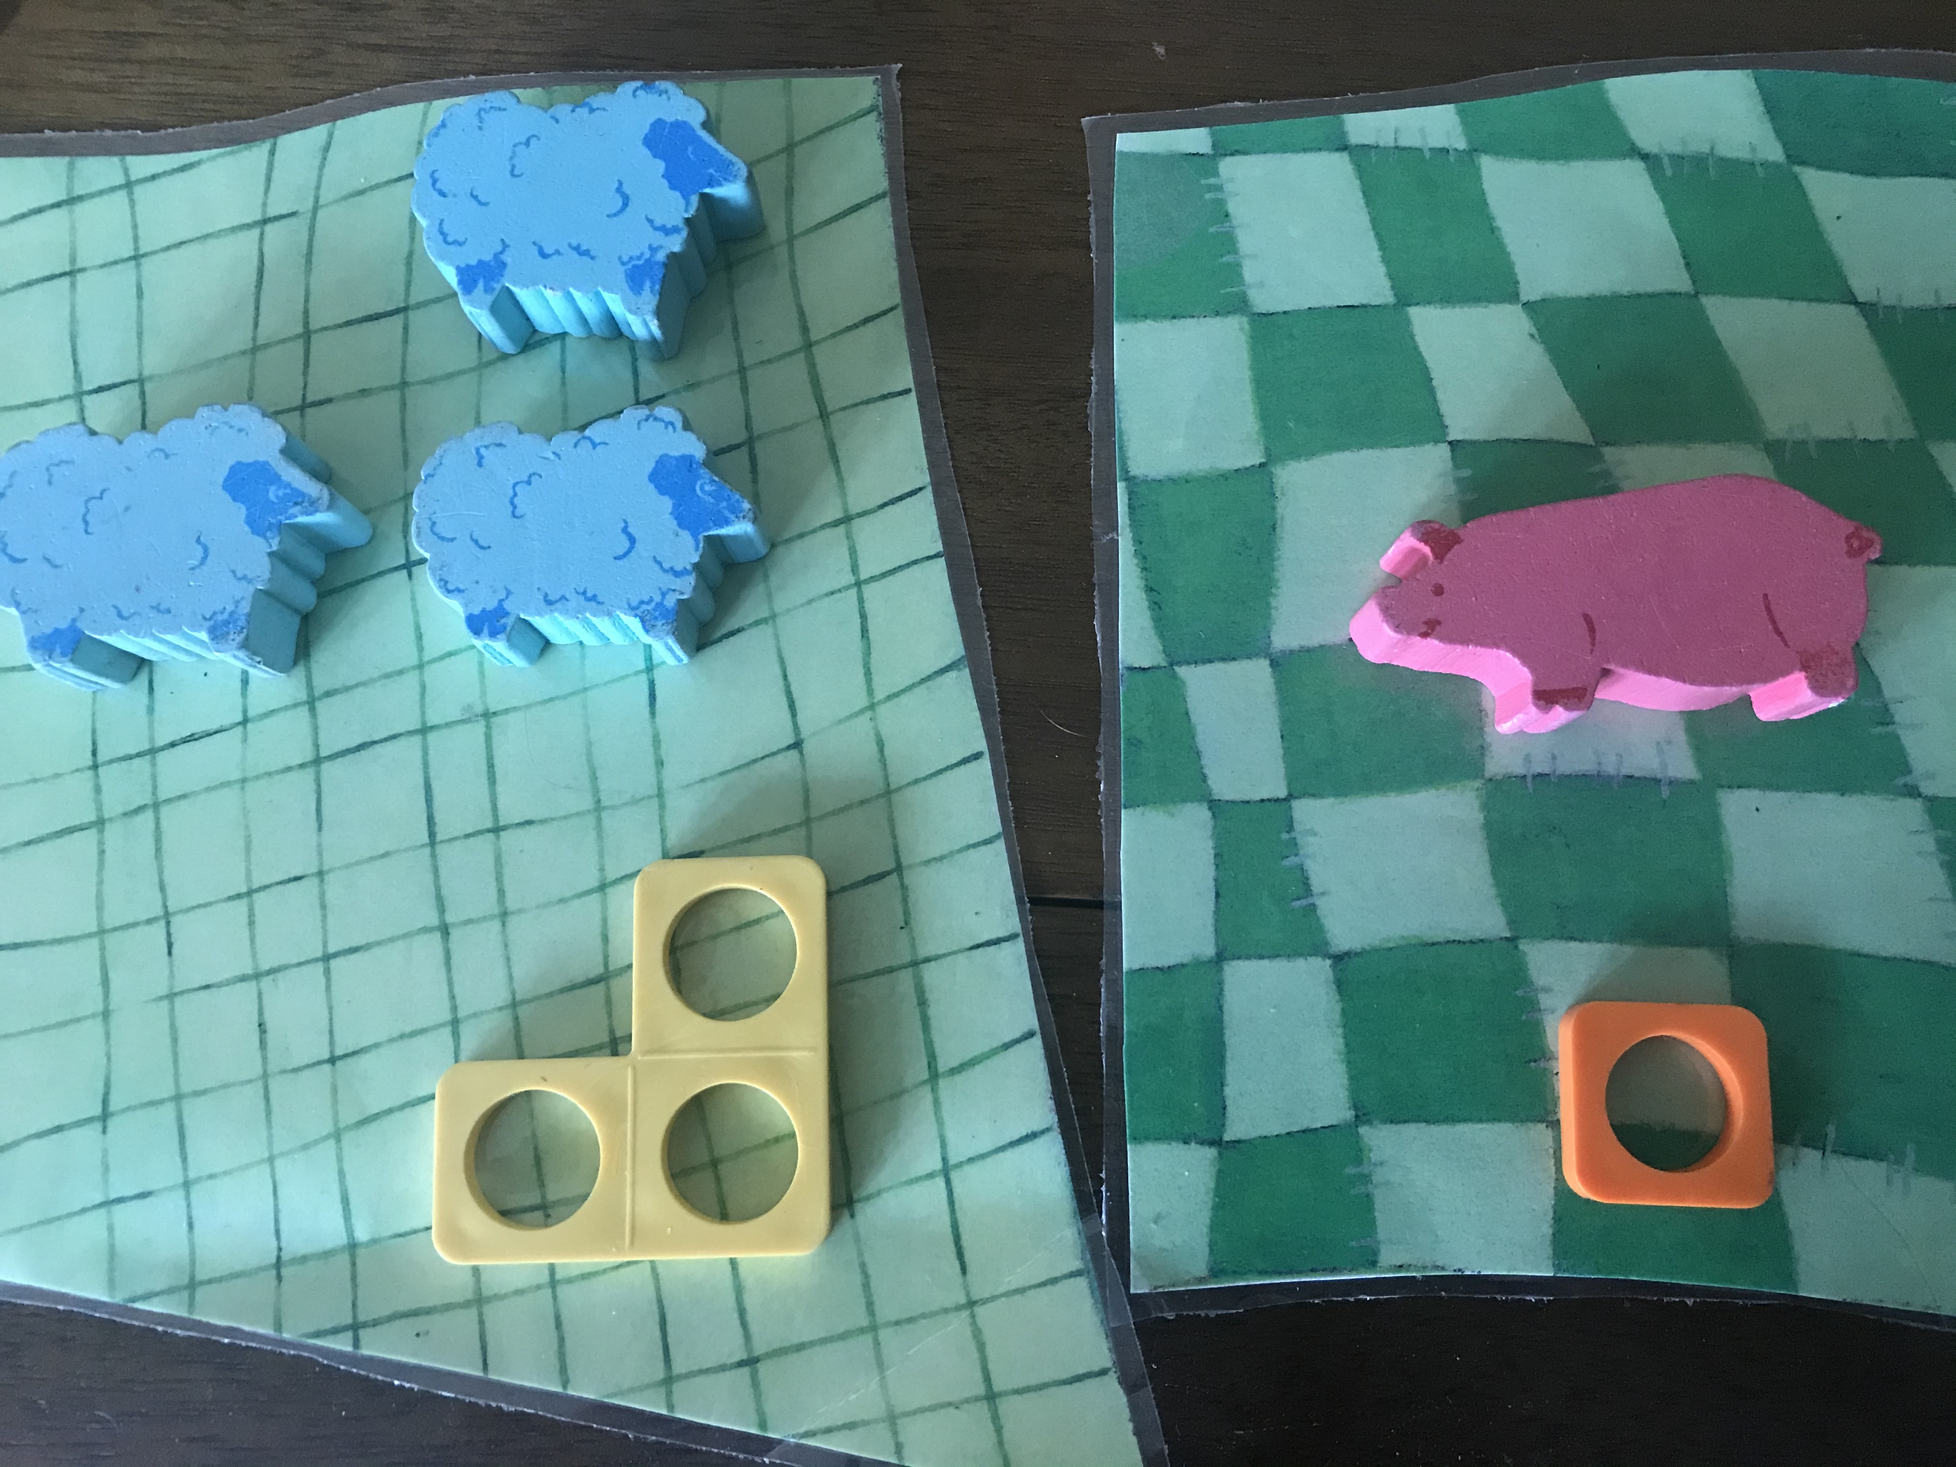
Ar y fferm mae…
3 dafad ac 1 mochyn
On the farm there are 3 sheep and 1 pig.
Sawl anifail sydd i gyd?
How many animals altogther?
+ =

Slide 3
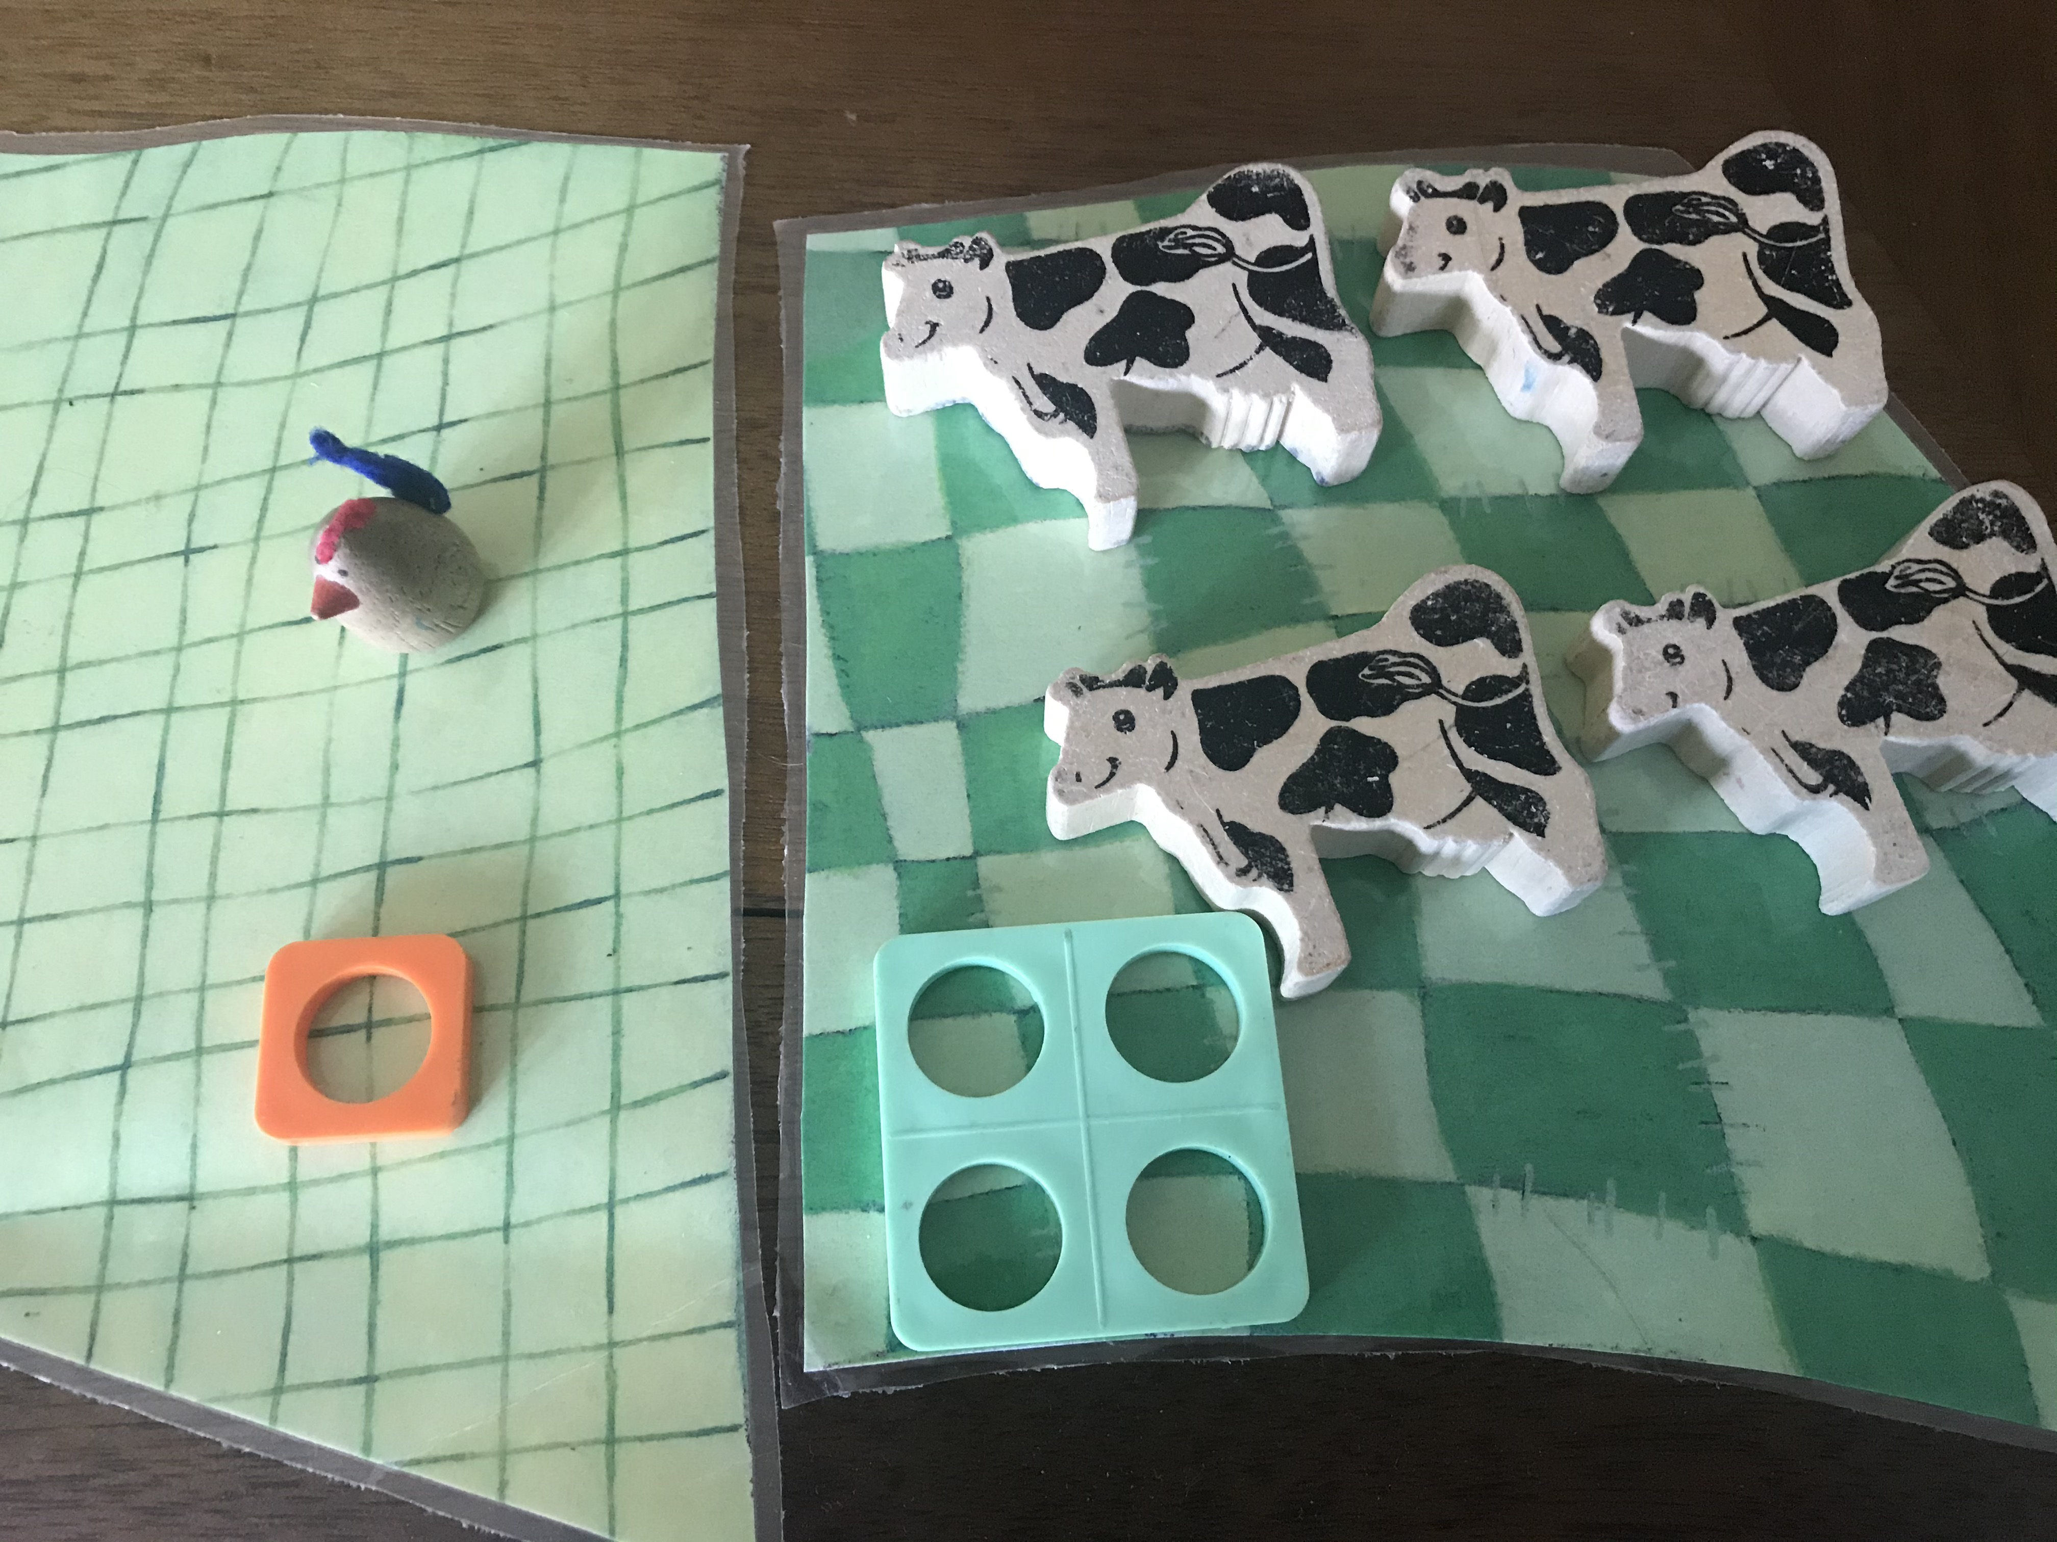
Ar y fferm mae…
1 iâr a 4 buwch
On the farm there is 1 chicken and 4 cows.
Sawl anifail sydd i gyd?
How many animals altogther?
+ =

Slide 4
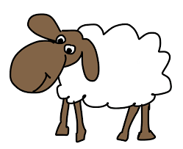
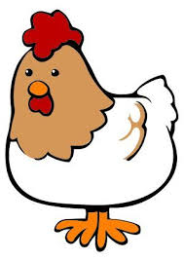

Sawl brawddeg rhif fedrwch chi ysgrifennu?
How many number sentences can you write?
Ar y fferm mae…
defaid ac ieir.
On the farm there are sheep and chickens.
Mae 5 anifail yn gyfan gwbl.
There are 5 animals altogether.
Fframyn 5/5 frame

Slide 5
Sut

