Slide 1


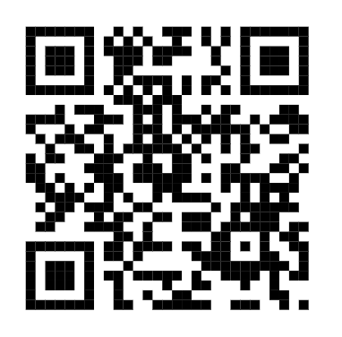
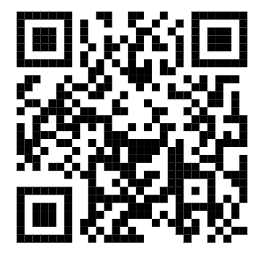
Mae dechrau yn nosbarth Derbyn yn cam mawr i bob plentyn.
Dyma rai pwyntiau i’w hystyried wrth i’ch plentyn gychwyn:
Rhowch amser i’ch plentyn ymgartrefu yn y dosbarth newydd. Mae’n gam mawr symud i’r Dosbarth Derbyn e.e. treulio diwrnod cyfan yn yr ysgol, bwyta cinio yn yr ysgol.
Peidiwch â disgwyl i’ch plentyn ddod yn blentyn Derbyn dro nos. Mae hi’n broses gynyddol.
Cofiwch i gysylltu os oes gennych unrhyw fath o bryder.
Anogwch eich plentyn i fod yn annibynnol e.e. gwisgo/dad-wisgo heb gymorth, rhoi eitemau yn y bag
Rhowch wybod i ni ynglyn â threfniadau diwedd dydd h.y. pwy sy’n casglu eich plentyn o’r ysgol.
Cofiwch roi enw ar bob dilledyn; hyd yn oed esgidiau’ch plentyn!
Cofiwch ddod â’r ‘Passport Derbyn’ i’r ysgol ar ddiwrnod cyntaf y tymor.
Am fwy o wybodaeth am baratoi eich plentyn
ar gyfer ysgol, ewch i wefan yr ysgol:
Gallwch hefyd gwylio’r fideo yma:
Pob hwyl am yr haf,
Staff y Derbyn

Slide 2

Dosbarth Derbyn-
Beth sydd angen?
 | Bydd angen
 | Siwmper / cardigan ysgol
 | Crys polo gwyn
 | Trowsus / sgert/ ffrog ddu
 | Esgidiau du
 | Treinyrs (diwrnod ymarfer corff)
 | Leggins / joggers (diwrnod ymarfer corff)
 | Dillad sbar yn y bag rhag ofn damwain / gwlychu
 | Bag ysgol
 | Bocs bwyd (os nad ydydn yn cael cinio ysgol)
 | Potel o ddŵr
 | Ffrwyth i amser snac (wedi labeli gyda enw eich plentyn)
 | Passport Derbyn
Cofiwch
Labelwch pobeth gyda enw eich plentyn

Slide 3

Your child will be in the Reception Class in September.
Here are some points to consider as your child starts in Reception:
Give your child time to settle in the new class. It’s a big step moving to the Reception Class e.g. spending a whole day in school, eating lunch at school. Don’t expect your child to become a Reception pupil immediately, it is a gradual process.
If you have any worries please don’t hesitate to contact us to discuss them.
Help your child to become independent e.g., encourage your child to put his/her belongings in their bag & recognise their own bottle and snack pot.
Please let us know of end of day arrangements e.g., who will be collecting your child from school.
Remember to put your child’s name on every piece of clothing; even his/her shoes!
Remember to bring the ‘Derbyn Passport’ to school at the beginning of term.
For further information about preparing
your child for school, go to:
This video may also be useful:
Have a lovely summer,
Reception Staff

Slide 4
Reception Class
What’s needed?
 | Bydd angen
 | Red school jumper / cardigan
 | White polo top
 | Black trousers / skirt / dres
 | Black shoes
 | Trainers (gym day)
 | Leggings / joggers (gym day)
 | Spare clothes in the bag incase of an accident / getting wet
 | School bag
 | Lunch box (if not having school dinners)
 | Bottle of water
 | Fruit for snack time (with your childs name clearly labeled)
 | Derbyn Passport
Remember
Please label all items clearly with your child’s name.

